Slide 1
Cancer Genetics
Lucy A. Godley, M.D., Ph.D.
Jeffrey and Marianne Silver Family Professor of Oncology
Director, Silver Family Blood Cancer Institute
Clinical Director of Cancer Genetics
Robert H. Lurie Comprehensive Cancer Center
Division of Hematology/Oncology
Northwestern University

Slide 2
Acknowledgments
Godley Lab
  Stephen Arnovitz
  Kristina Bigelow
  Lorraine Canham
Yoga Haribabu
  Ashwin Koppayi
  Sophia Korotev
  Courtnee Rodgers
  Mancy Shah
  Ryan Stubbins
  Taylor Walker
My patients and their families
Funding: NIH, DoD, The Leukemia and Lymphoma Society, Cancer Research Foundation, The Taub Foundation, V Foundation, Edward P. Evans Foundation, RUNX1 Research Program/Mark Foundation for Cancer Research

Slide 3
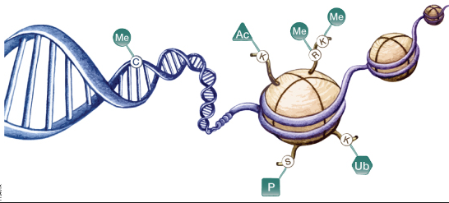
Realizing the goal of
precision medicine in oncology
DEFINE:
Baseline genetics/epigenetics
[germline]
Acquired genetics/epigenetics in the HSC
[clonal hematopoiesis]
Acquired genetics/epigenetics in the tumor
[tumor profiling]
Microbiome/Immunotype
to devise an effective treatment strategy for a particular patient

Slide 4
Cancer =
genetic predisposition with environmental insult
environmental insult
germline predisposition

Slide 5
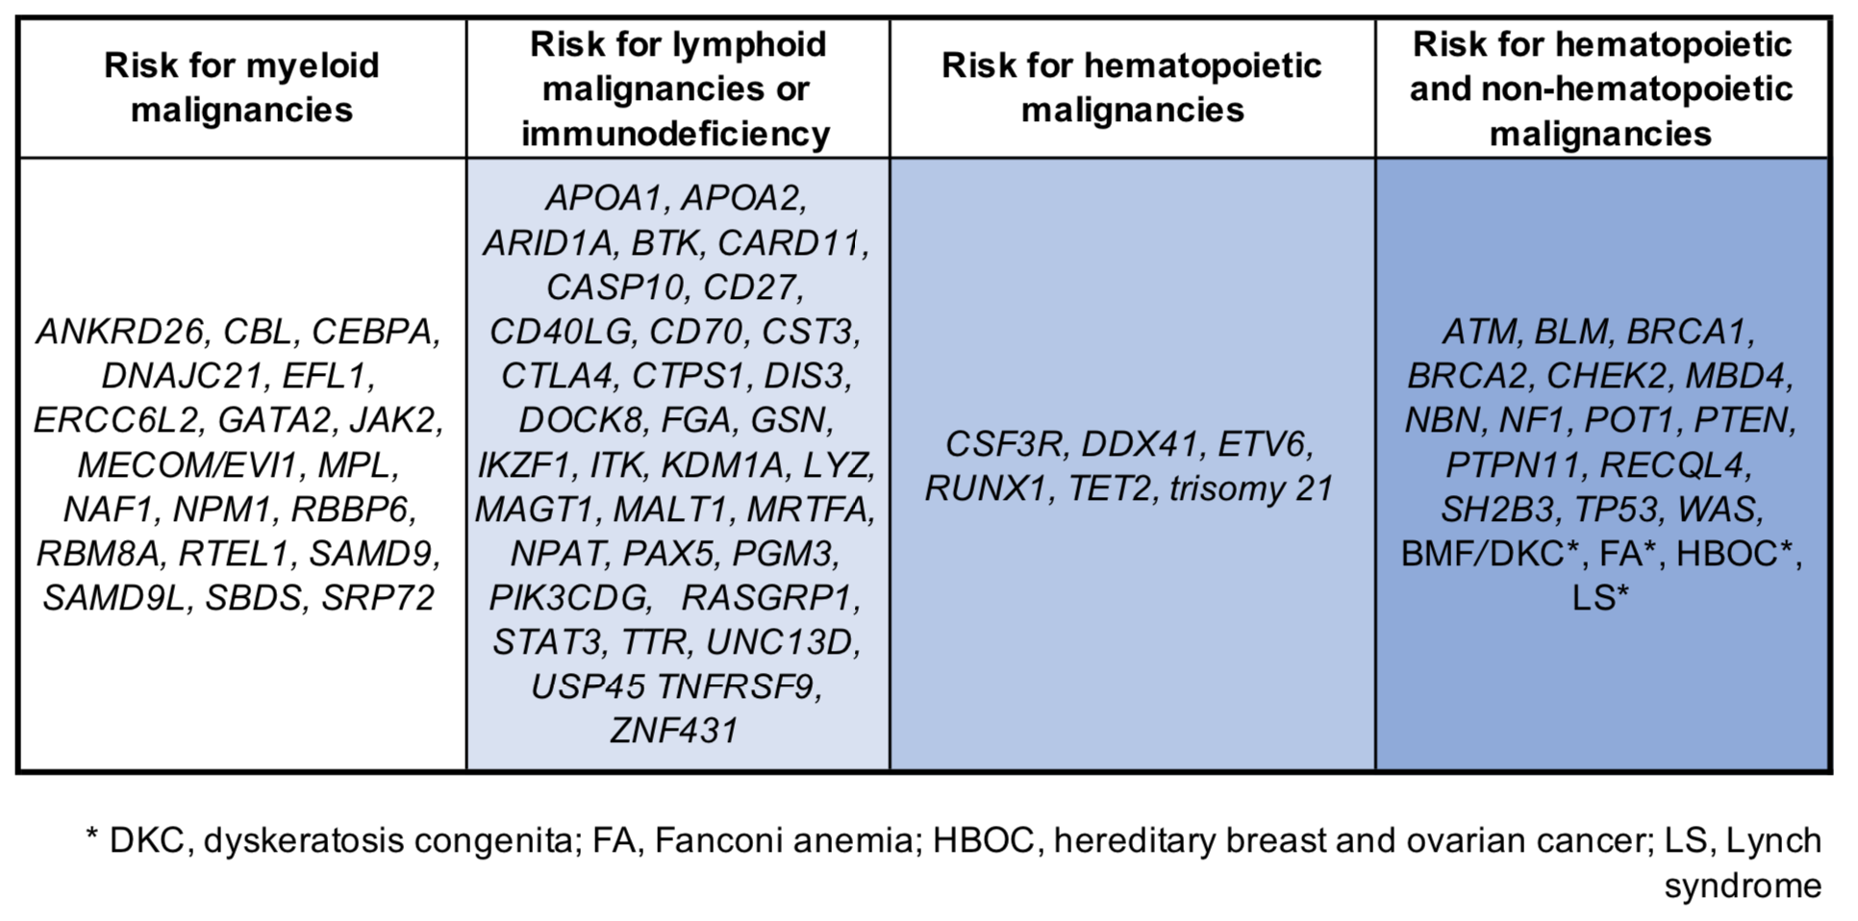
Germline hematopoietic malignancy risk genes

Slide 7
ACD, ADH5/ALDH2, ALAS2, BRCA1/2, BRIP1, CECR1, CSF3R, CTC1, CXCR4, DCLRE1B, DDX41, DKC1, DNAJC21, DPP9, EFTUD1, ELANE, ERCC4, ERCC6L2, FANCA, FANCB, FANCC, FANCD2, FANCE, FANCF, FANCG, FANCI, FANCL, G6PC3, GATA1, GFI1, HAX1, LIG4, MAD2L2, MDM4, MECOM, MPL, NAF1, NHP2, NOP10, NPM1, PALB2, PARN, POT1, RAD51, RAD51C, RBM8A, RFWD3, RPL5, RPL11, RPL15, RPL18, RPL23, RPL26, RPL27, RPL31, RPL35, RPL35A, RPL36, RPS7, RPS10, RPS15A, RPS17, RPS19, RPS24, RPS26, RPS27, RPS28, RPS29, RTEL1, RUNX1, SAMD9, SAMD9L, SBDS, SLX4, SRP54, SRP72, TERC, TERT, TINF2, TP53, UBE2T, USB1, VPS45, WAS, WRAP53, XRCC2

Slide 8
Precision oncology from my perspective today
One of my colleagues was diagnosed with breast cancer…
69yo
ovarian ca
Based on her personal and family history of cancer,
she underwent germline genetic testing
52yo
breast ca
57yo
breast ca
2
61yo
breast ca
The CHEK2 I200T (I157T) allele was identified

Slide 9
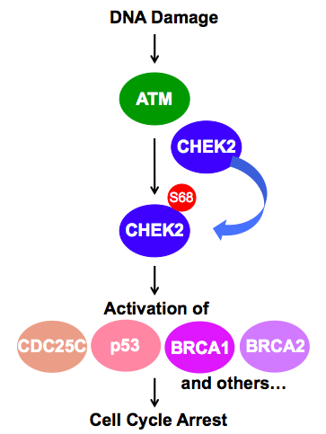
DNA repair pathways are important to prevent cancer
homologous recombination
DNA repair

Slide 10
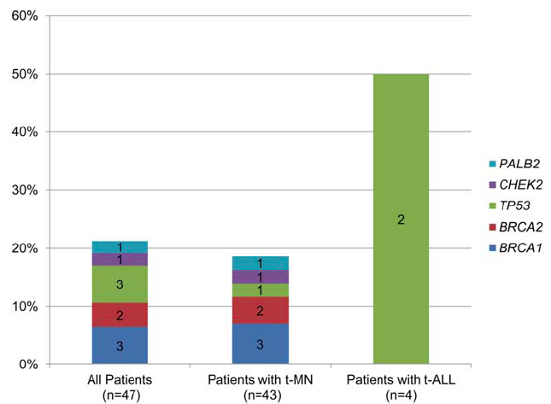
Cancer is a genetic disease–
‘Solid tumor’ gene syndromes do not exist
  Lynch syndrome: MSH2/6, MLH1, PMS2
  Li-Fraumeni syndrome: TP53
  Hereditary Breast/Ovarian CA syndrome: BRCA1/2 are Fanconi anemia genes
Churpek, JE et al. Cancer 122: 304-311, 2016
Notes:
Cowden: breast, thyroid, renal, endometrial, colon
Li Fraumeni: Sarcoma, brain, breast, adrenocortical carcinoma, heme malignancies,

Slide 11
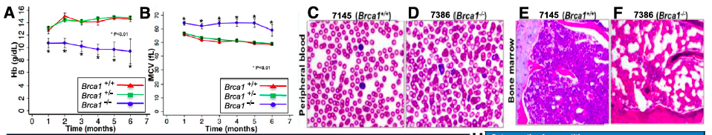
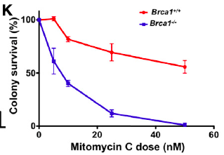
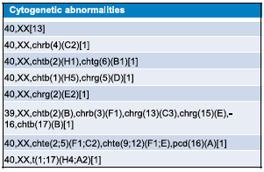
Brca1 is a Fanconi anemia gene
Brca1 +/+
Brca1 +/-
Brca1 -/-
Vasanthakumar, A et al. Blood 127: 310-313 (2016)

Slide 12
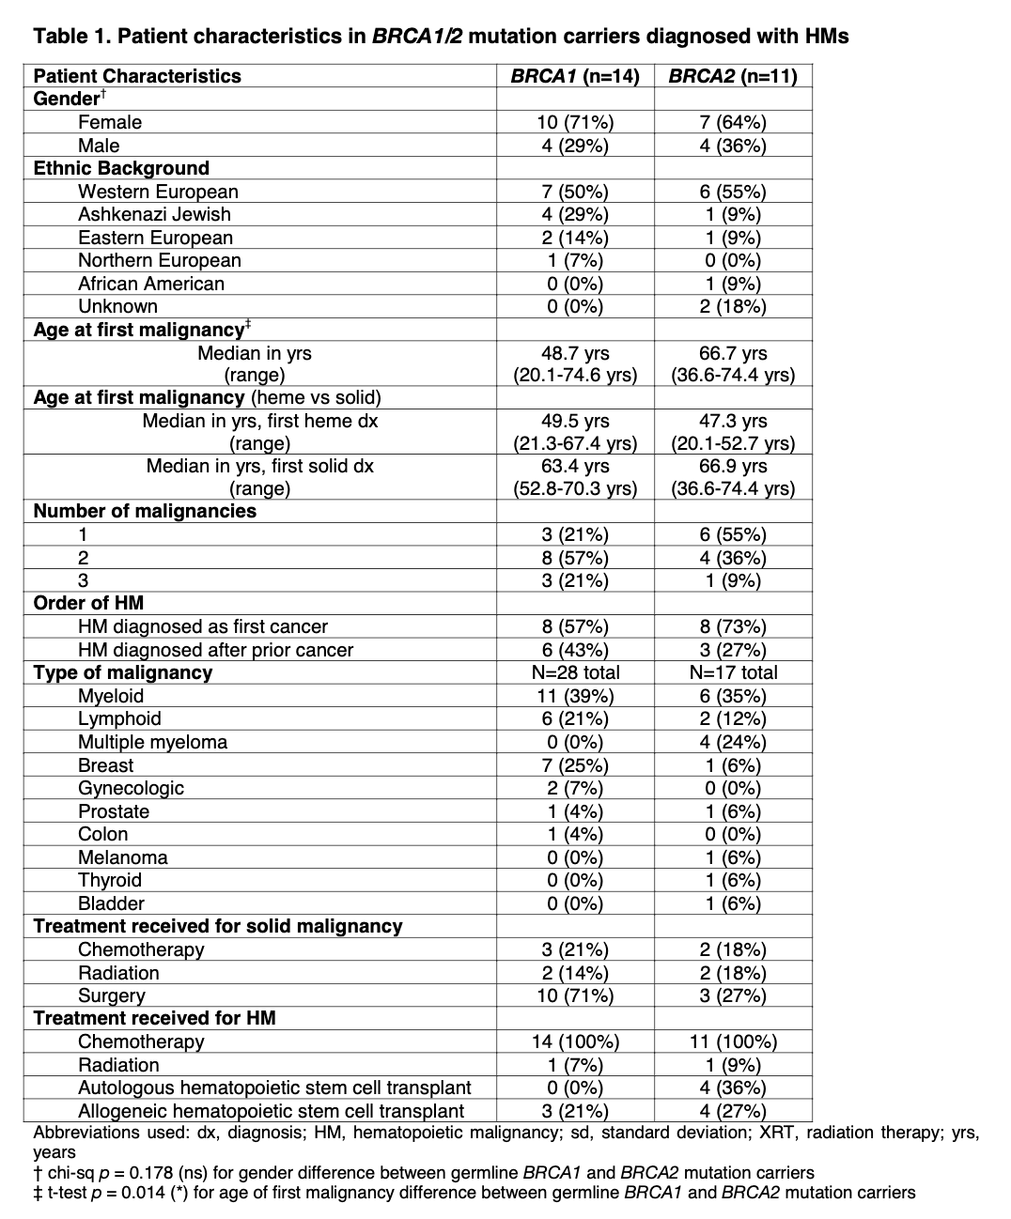
People with deleterious germline BRCA1/2 variants develop bone marrow-derived cancers often before soldi tumors
Stubbins, R. et al. Germline loss of function BRCA1 and BRCA2 mutations and risk of de novo hematopoietic malignancies. Haematologica epub 2023.

Slide 13
People with deleterious germline BRCA1/2 variants develop bone marrow-derived cancers often before soldi tumors
Stubbins, R. et al. Germline loss of function BRCA1 and BRCA2 mutations and risk of de novo hematopoietic malignancies. Haematologica epub 2023.

Slide 14
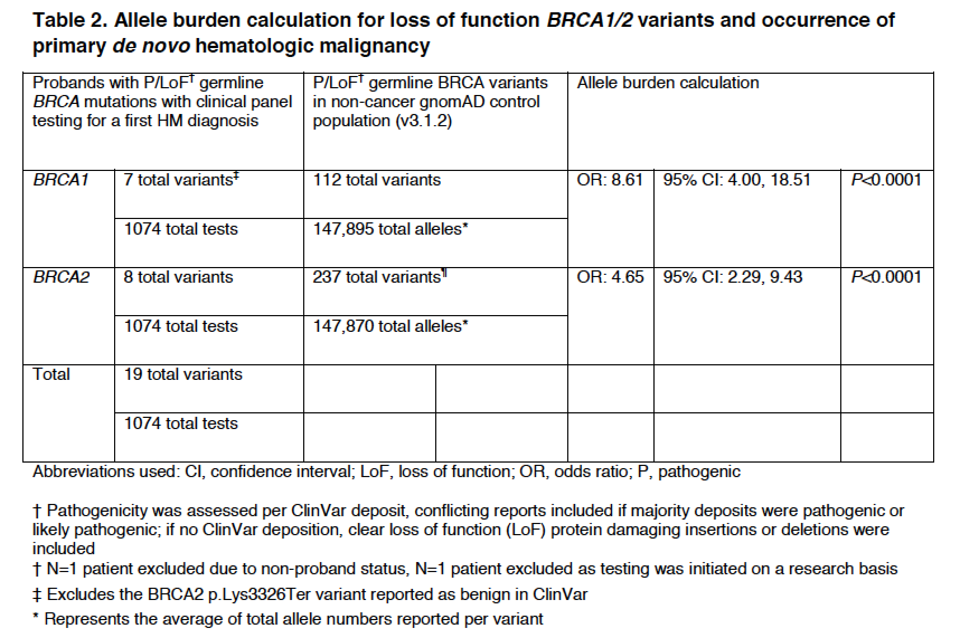
People with deleterious germline BRCA1/2 variants develop bone marrow-derived cancers often before soldi tumors
Stubbins, R. et al. Germline loss of function BRCA1 and BRCA2 mutations and risk of de novo hematopoietic malignancies. Haematologica epub 2023.

Slide 15
Realizing the goal of
precision medicine in oncology
DEFINE:
Baseline genetics/epigenetics
[germline]
Acquired genetics/epigenetics in the HSC
[clonal hematopoiesis]
Acquired genetics/epigenetics in the tumor
[tumor profiling]
Microbiome/Immunotype
to devise an effective treatment strategy for a particular patient

Slide 16
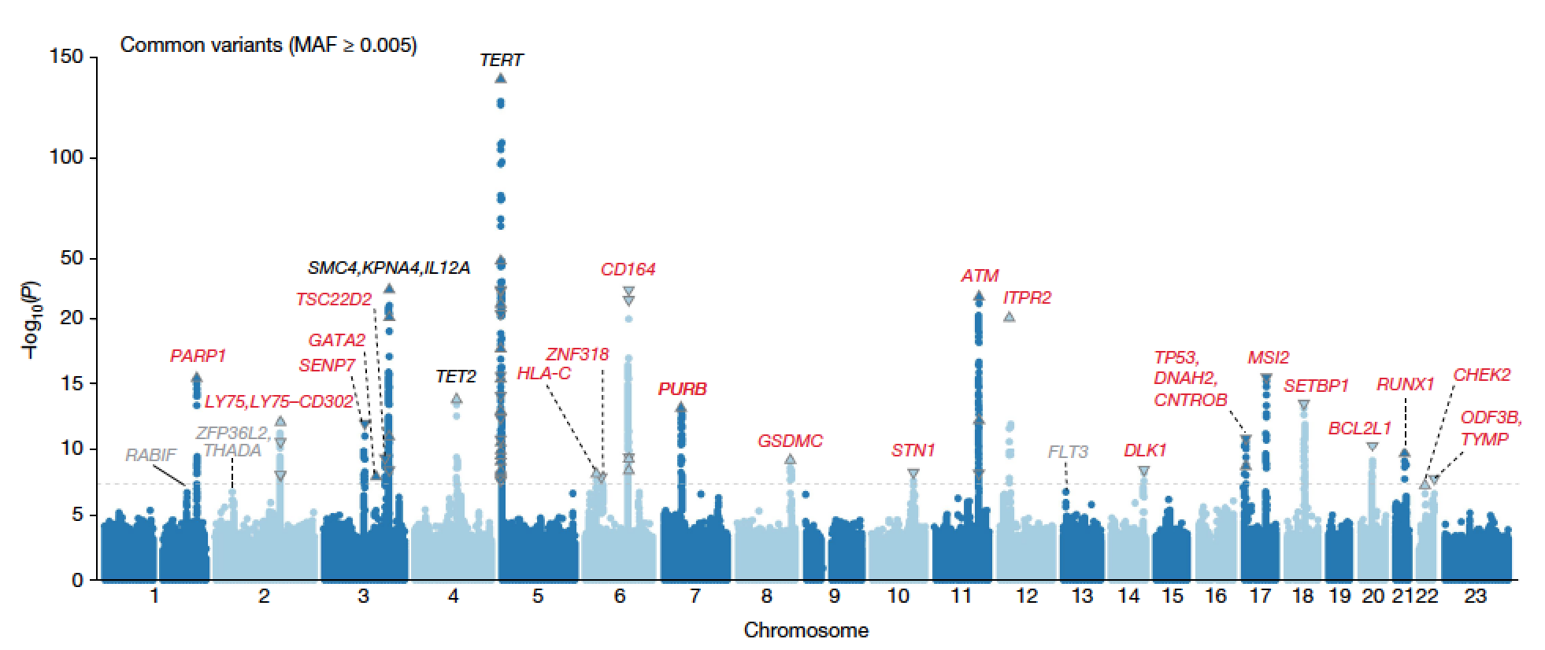
GWAS for genes that confer risk for CH
Many of these genes are germline susceptibility genes for HMs→ Is the mechanism development of CH first, then HM?
Kessler, M.D. et al. (2022) Nature 612: 301-309.

Slide 17
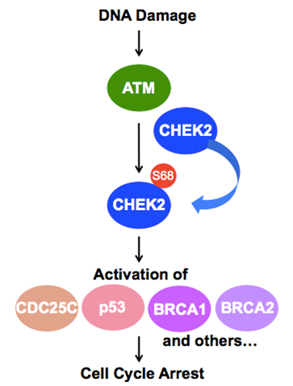
The molecular impact of HR DNA repair pathway deficiencies on DNA integrity within hematopoietic cells

Slide 18
Precision oncology from my perspective today
One of my colleagues was diagnosed with breast cancer…
69yo
ovarian ca
Based on her personal and family history of cancer,
she underwent germline genetic testing
52yo
breast ca
57yo
breast ca
2
61yo
breast ca
The CHEK2 I200T (I157T) allele was identified

Slide 19
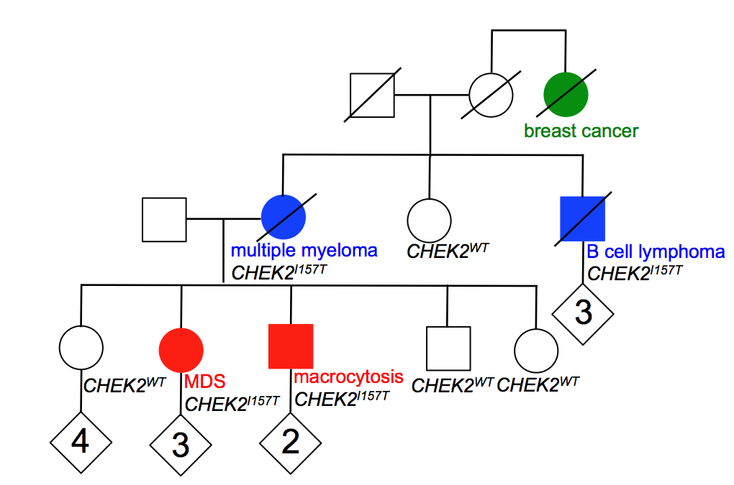
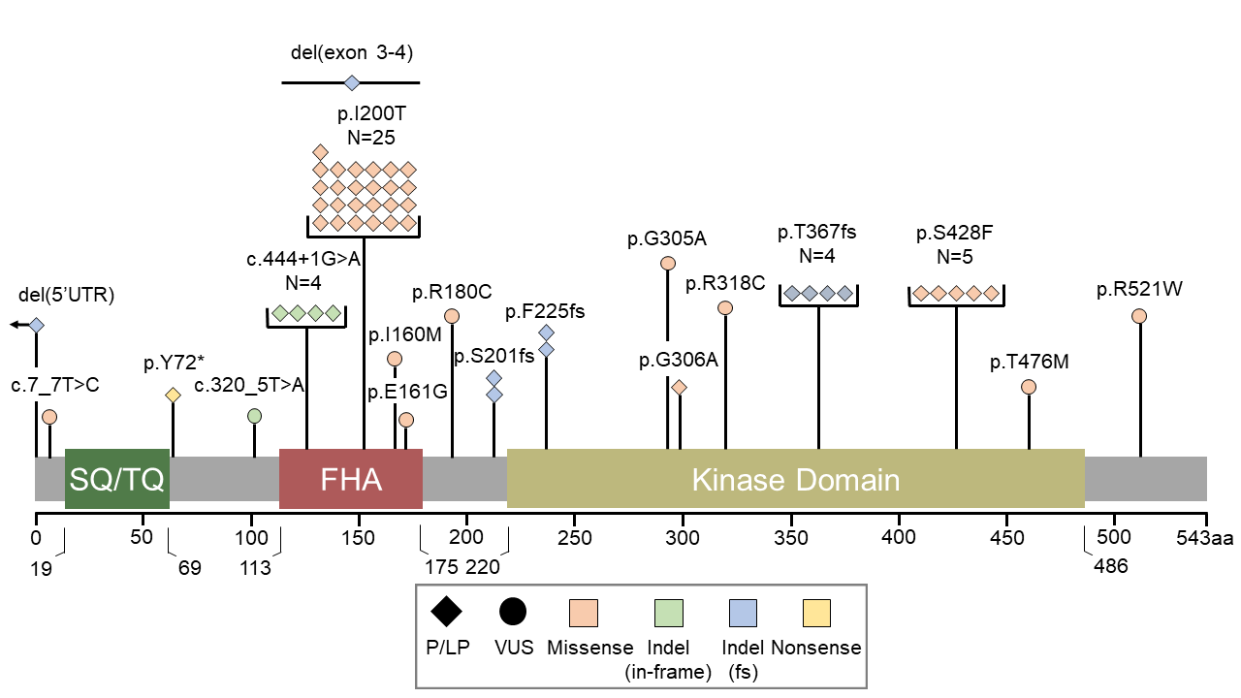
Germline CHEK2 mutations and hematopoietic malignancies
representative pedigree
Godley Lab Cohort
CHEK2^{I200T}
CHEK2^{I200T}
CHEK2^{I200T}
CHEK2^{I200T}
breast ca
thyroid ca
Adapted from Anase Ansom

Slide 20
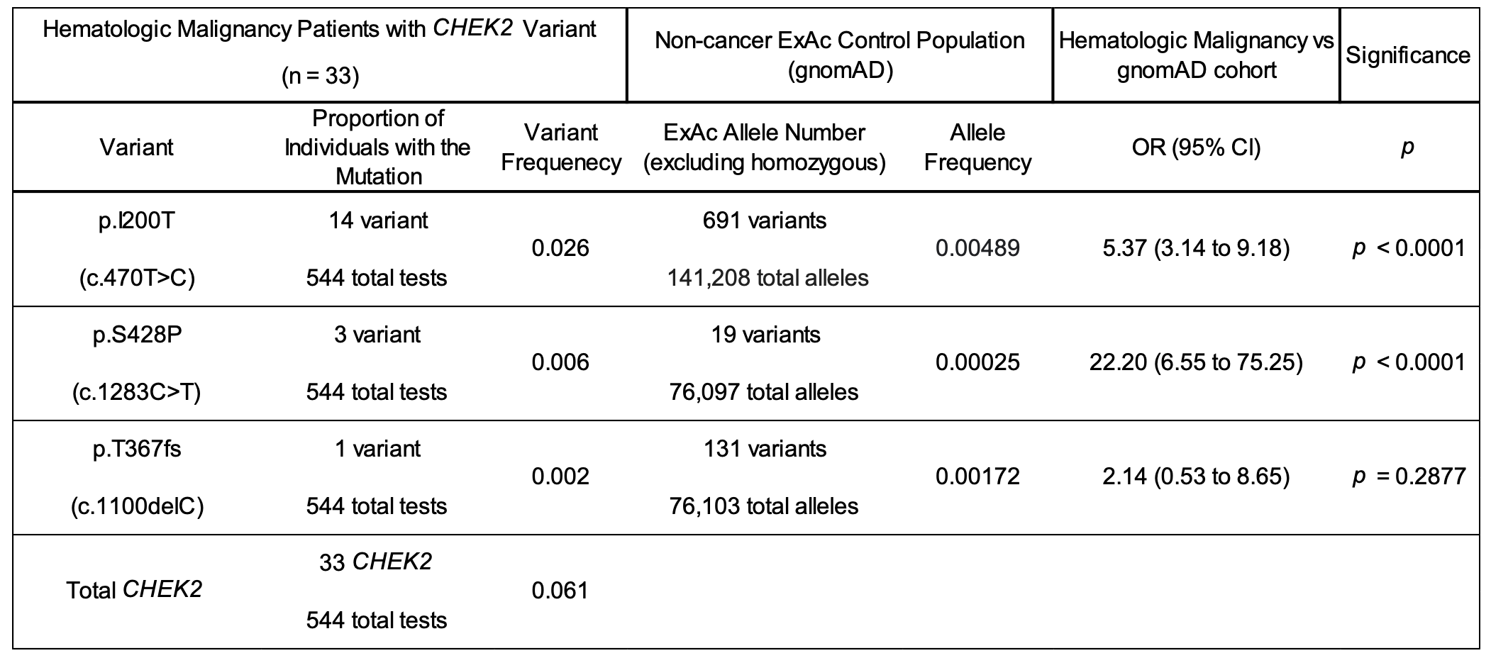
Germline CHEK2 mutations and hematopoietic malignancies

Slide 21
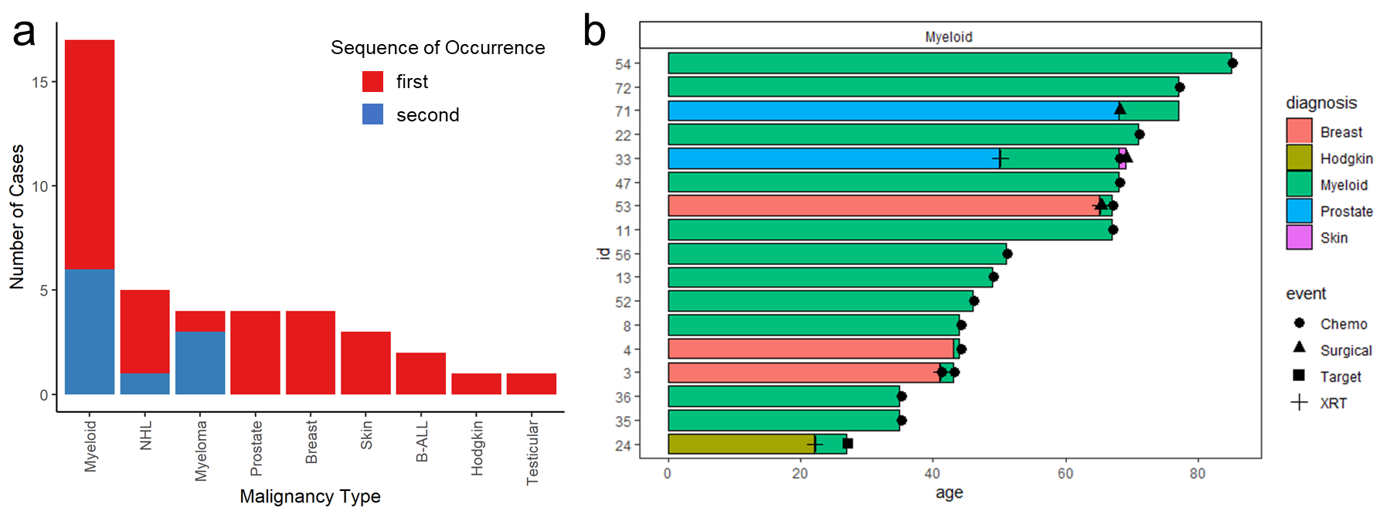
Germline CHEK2 mutations and hematopoietic malignancies
Adapted from Anase Ansom

Slide 22
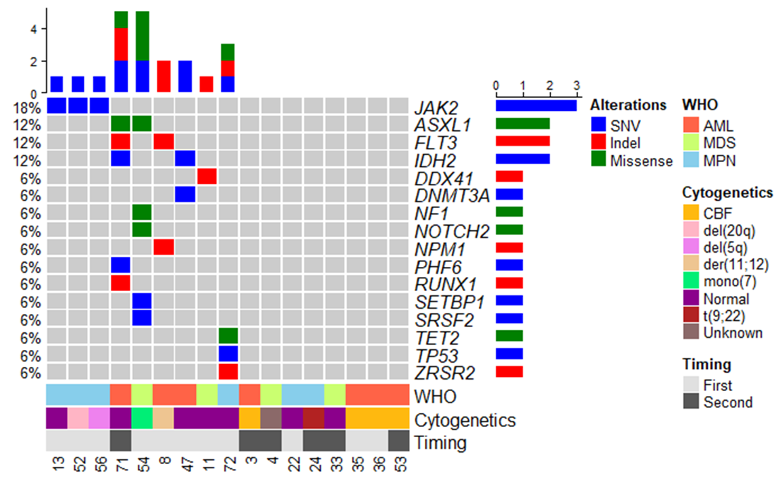
Germline CHEK2 mutations and hematopoietic malignancies
mutational spectrum in myeloid malignancies
Adapted from Anase Ansom

Slide 23


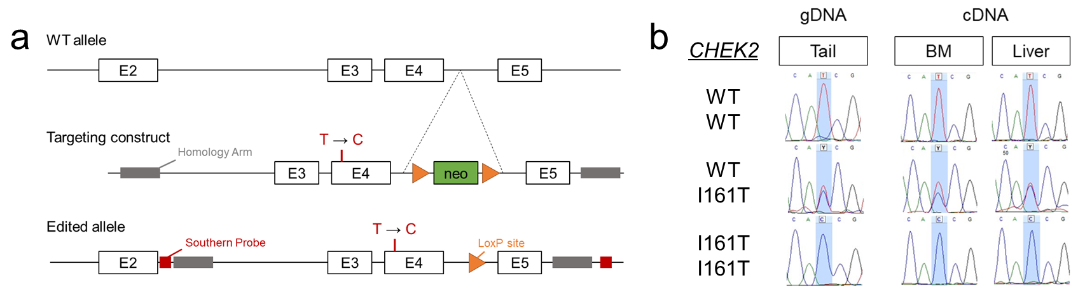
Germline CHEK2 mutations and hematopoietic malignancies

Slide 24
Do the knock-in Chek2^{I161T}-mutant mice
develop clonal hematopoiesis?

Slide 25
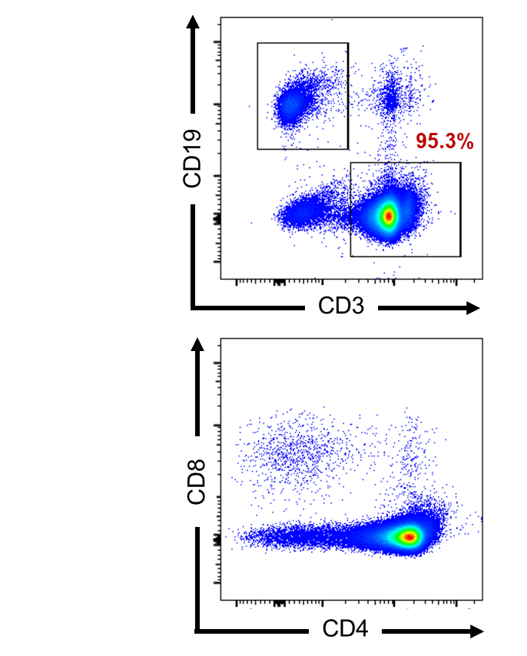
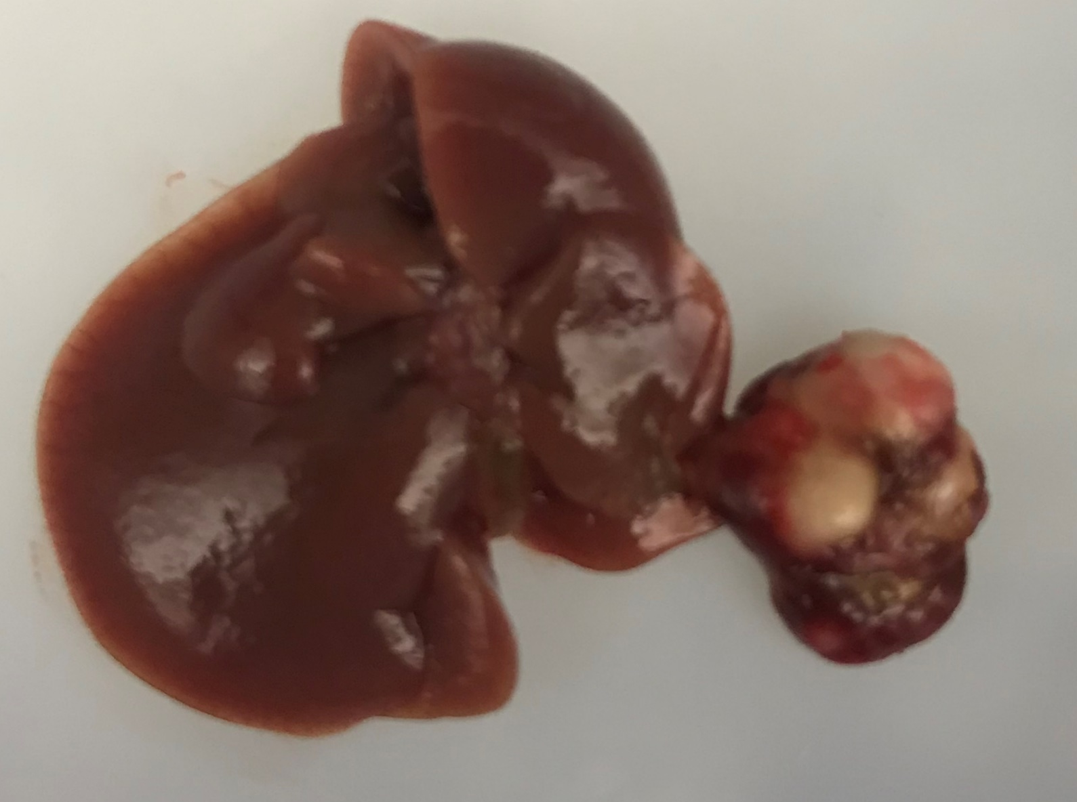
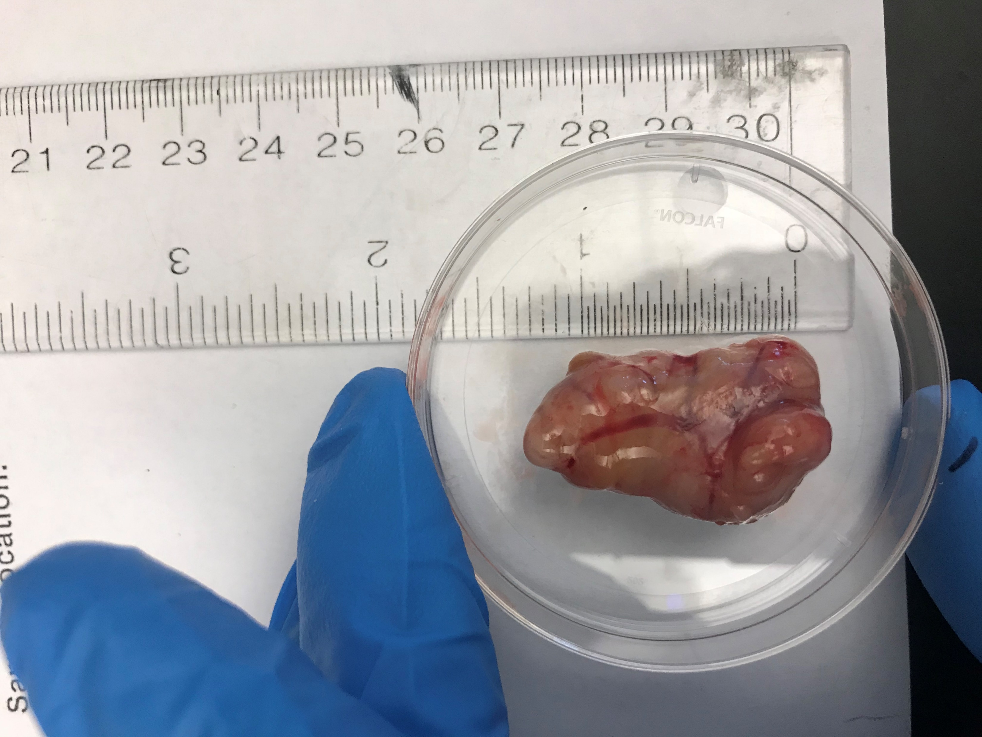
Germline CHEK2 mutations and hematopoietic malignancies
T-helper cell Leukemia (18 mo)
Lymphoma (24 mo)
Abdominal mass
Liver

Slide 26
The molecular impact of HR DNA repair pathway deficiencies on DNA integrity within hematopoietic cells

Slide 27
Precision oncology from my perspective today
So what did we do for my colleague?
69yo
ovarian ca
52yo
breast ca
57yo
breast ca
2
61yo
breast ca
Assessed for clonal hematopoiesis
It was not there→
Surgical treatment for her breast cancer [she opted for bilateral mastectomy]
Cytotoxic chemotherapy

Slide 28

Disease mechanisms–
Is clonal hematopoiesis a universal predictor of HHMs?
years
5
CH
HHM
10
15

Slide 29
Disease mechanisms–
DDX41 and its unique biology

Slide 30
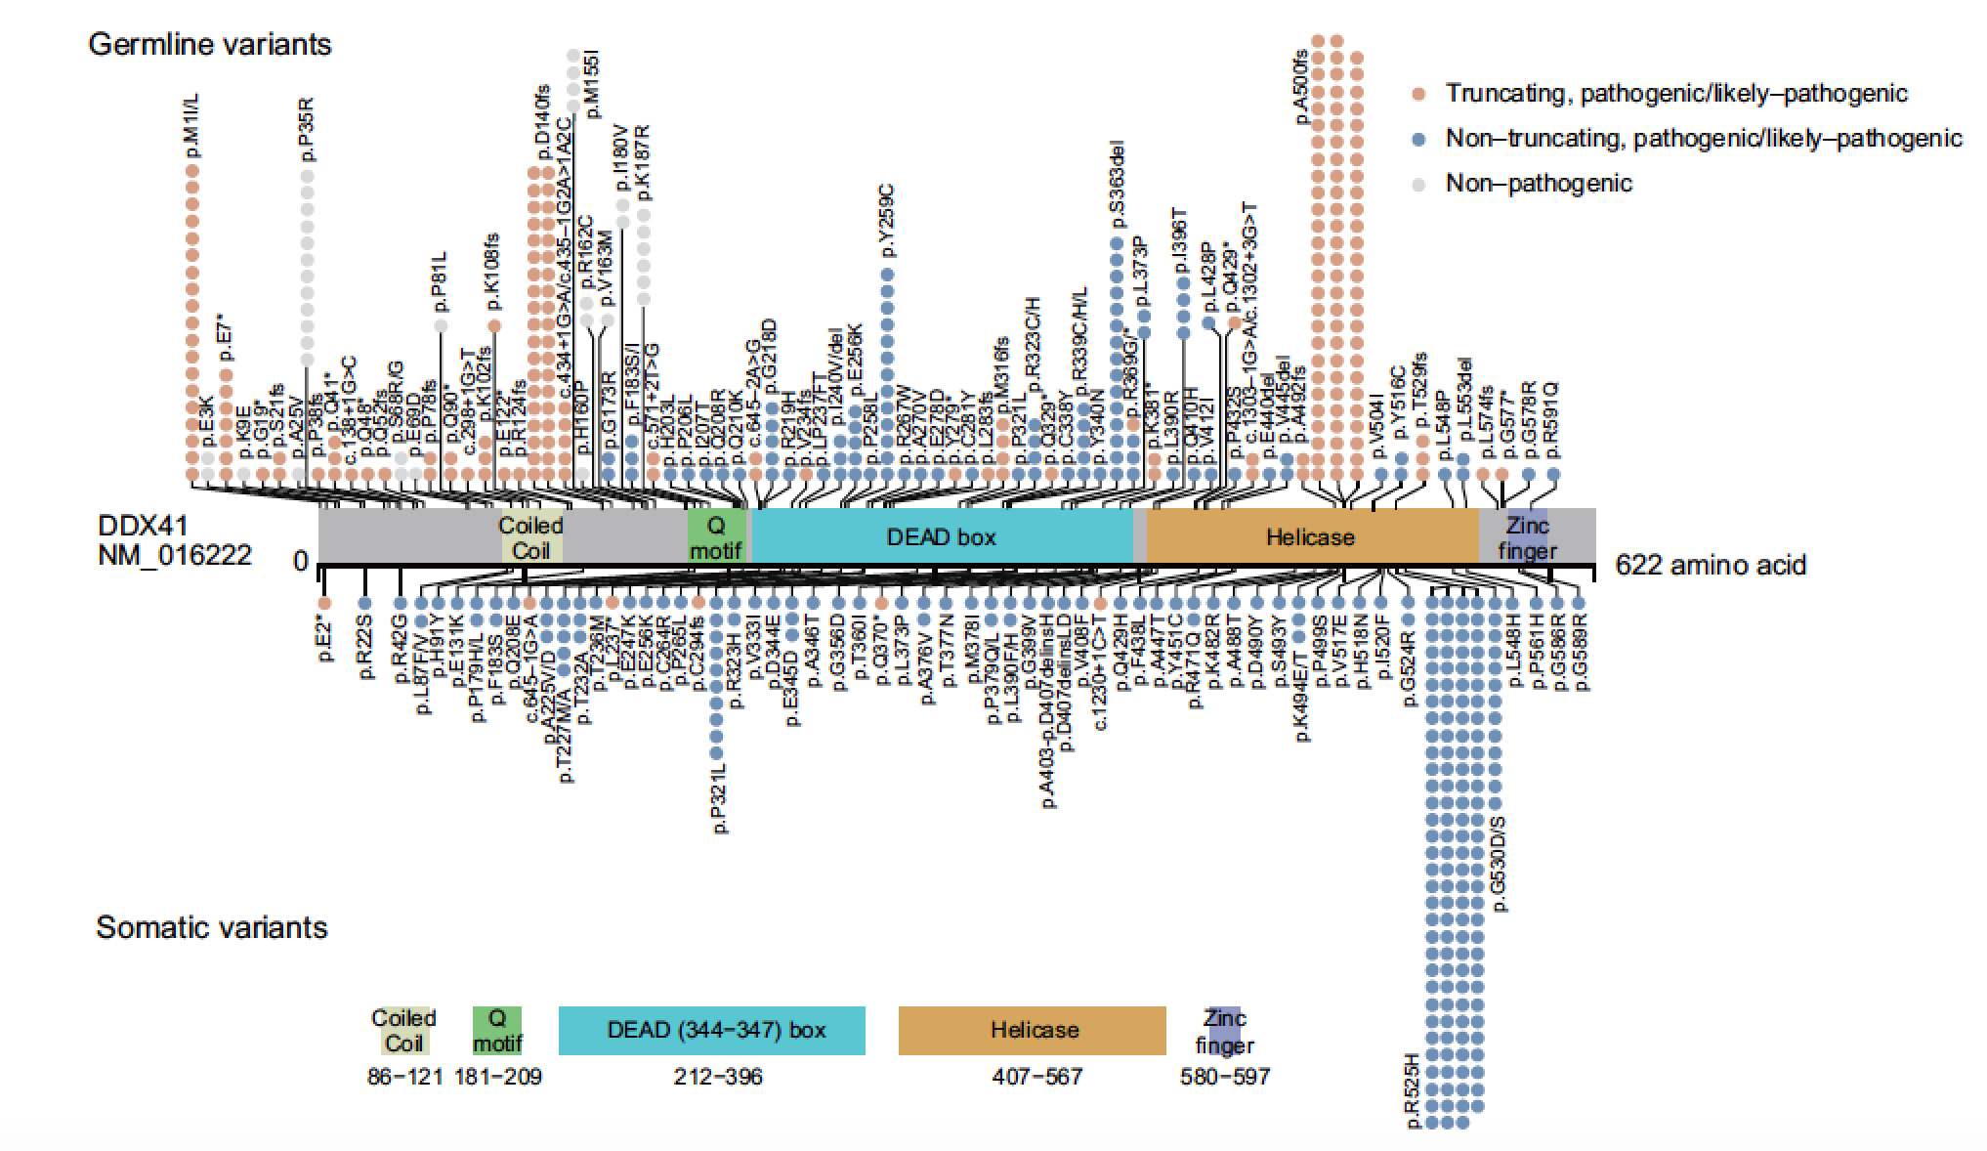
DDX41 on 5q35.3 encodes a DEAD/H-Box helicase
Makishima, H. et al. Blood epub (2022) PMID: 36322930

Slide 31
Germline DDX41^{mut} predispose to late-onset malignancies
<50 years
≥50 years

Slide 32
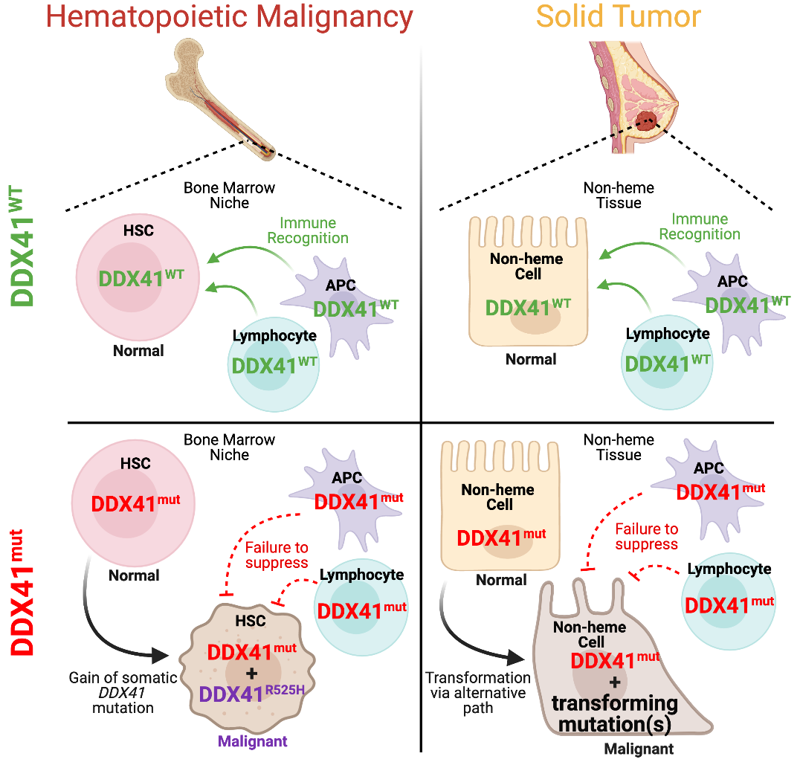
Mechanistic model for DDX41^{mut}-mediated tumorigenesis
inflammation?

Slide 33
Mechanistic model for DDX41^{mut}-mediated tumorigenesis
inflammation?

Slide 34
Inherited predisposition to cancer:
What have we learned?
Germline predisposition to all cancers is COMMON, and there is significant overlap between ‘solid’ and ‘liquid’ cancer syndromes.
Testing for cancer risk is complicated and in the future is likely to be performed through molecular profiling of tumors.
Future:
Standardization of germline testing for all cancer patients and their blood stem cell donors.
Development of treatment plans based on susceptibilities conferred by germline variants.

