Slide 1


Clinical Trials in Ovarian Cancer
Daniela Matei, MD

Slide 2
The News
Dec 19, 2014: The U.S. FDA granted accelerated approval to olaparib for women with recurrent OC with defective BRCA genes (>3 lines).
Dec 2014: US FDA approved bevacizumab for recurrent platinum resistant OC in combination with chemotherapy
Dec 19 2016: US FDA approved rucaparib for women with recurrent ovarian cancer associated with defective BRCA genes (>2 lines).
December 2016: FDA approved bevacizumab for recurrent platinum sensitive OC in combination with Ctx
March 2017: US FDA approves niraparib for recurrent OC after response to platinum
August 2017: US FDA approved olaparib for recurrent OC after response to platinum
October 2018: US FDA approved olaparib for upfront treatment of OC associated with BRCA1 or 2 mutations
2020: Approval of bevacizumab+Olaparib for upfront treatment of ovarian cancer in HRD+ ovarian cancer
2020: Approval of niraparib for upfront treatment of ovarian cancer
November 2022: US FDA approval for Elahere for platinum resistant ovarian cancer

Slide 3
The news
Moment of celebration!—these approvals follow a long drought period(>20 years)
-1995: liposomal doxorubycin
-1996: topotecan
-2006: gemcitabine
The new drug approvals follow decades of basic science and clinical research.
Long way forward!
  -Bring these discoveries to upfront treatment of ovarian cancer!
  -Find a cure.
  -Find new pathways to target refractory, resistant tumors.

Slide 4
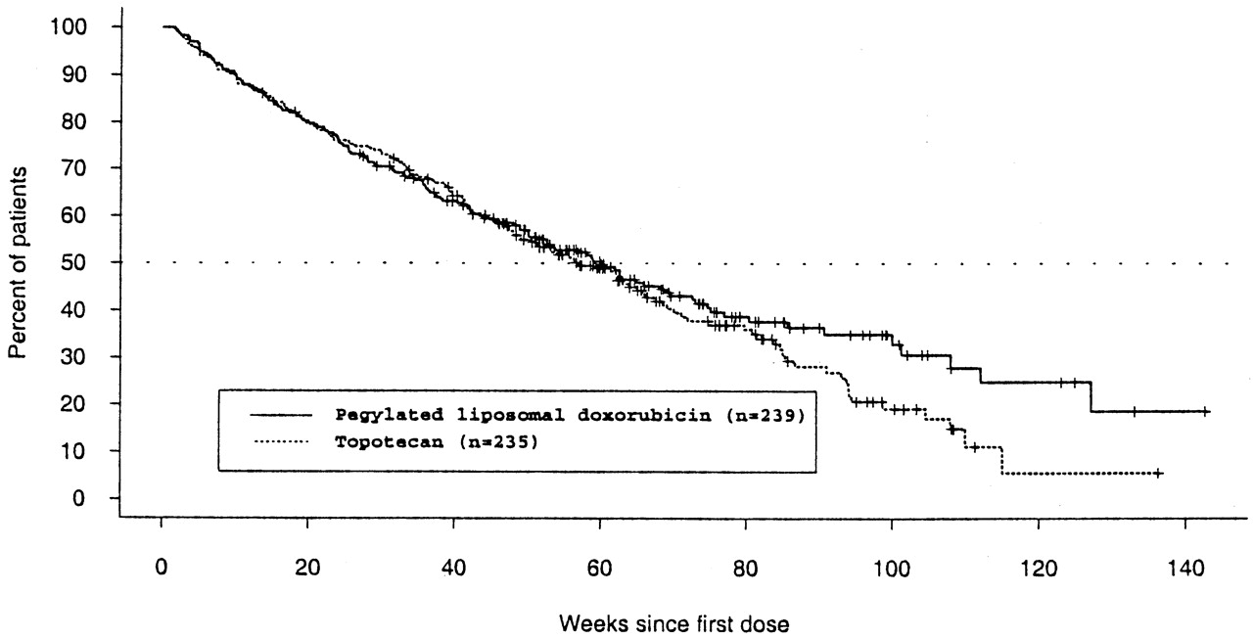
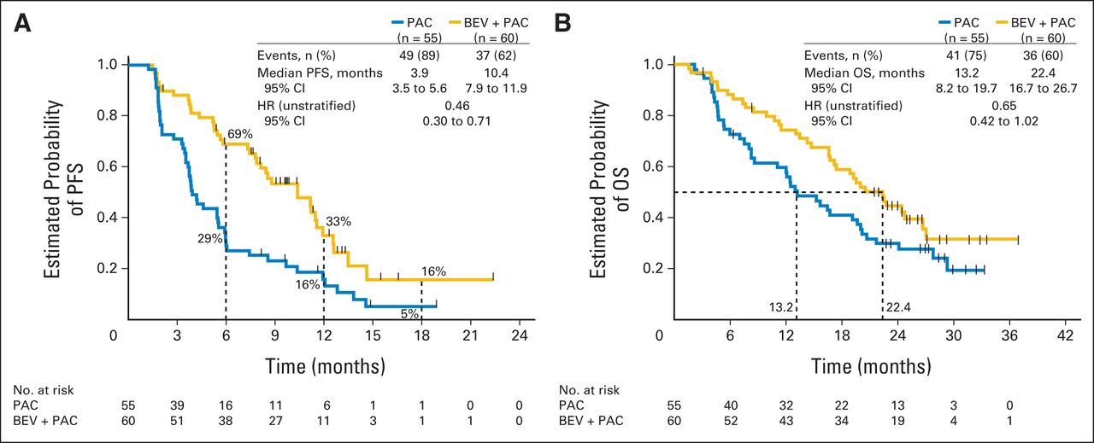
A change in the course of the disease—longer survival!
CTX
CTX1 vs. CTX2
CTX + Targeted agent
CTX

Slide 5
What are clinical trials?
Clinical trials are research studies that explore whether a medical strategy, treatment, or device is safe and effective for humans.
These studies also may show which medical approaches work best for certain illnesses or groups of people.
Clinical trials produce the best data available for health care decision-making.
The purpose of clinical trials is research, so the studies follow strict scientific standards. These standards protect patients and help produce reliable study results.
National Institute of Health

Slide 6
What are clinical trials?
Type of clinical trials
Interventional clinical trials:
-A new intervention is tested (new drug, new device, new test, new procedure).
-There are risks and inconvenience associated with new interventions (side effects, doctor visits)
-There are potential benefits (longer survival)
-Informed Consent Form: risks/benefits

Slide 7
What are clinical trials?
Interventional clinical trials types: Phase I
Drug or device tested in humans for the first time
Main goal: determine tolerable dose
Toxicity and efficacy are NOT known
Correct dose is not known: dose escalation
High risk, benefit is unknown (response rates <10%)
Intense monitoring: visits, blood draws
All participants receive the drug: incremental doses
Open eligibility, any cancer, any number of prior therapies

Slide 8
What are clinical trials?
Interventional clinical trials types: Phase II
Dose and toxicity are known
Main goal: testing efficacy in specific disease
Risk is smaller, benefit higher
All participants receive the intervention
May require additional testing (biopsies, scans)
Restrictive eligibility: strict criteria for enrollment

Slide 9
What are clinical trials?
Interventional clinical trials types: Phase III:
Dose, toxicity are known
Efficacy in specific disease is known (phase II)
Definitive proof before approval by the FDA
Very restrictive eligibility criteria
Randomized design:
½ participants receive intervention;
½ participants receive control (approved treatment or intervention). If no approved treatment exists, then placebo is the control.

Slide 10
What are clinical trials?
Interventional clinical trials types: Phase IV
Dose, toxicity are known
Efficacy in specific disease is known (phase III)
Approval by the FDA has been granted, subject to acquisition of additional information
Post approval observation and data collection
Very low risk, low benefit

Slide 11
What are clinical trials?
Observational clinical trials:
Data collection from medical records
Use of tissue already collected and archived, or tissue that would be otherwise discarded
Questionnaires, surveys
Low risk, no benefit to the study participant
Can help test a preliminary idea
Can lead to new scientific hypothesis

Slide 12
Vocabulary of cancer clinical trials
Response rate: how many participants respond to the intervention out of all the participants
Progression free survival: the period from starting the intervention until the cancer progresses (remission)
Overall survival: duration of survival
Toxicity: number of reported side effects
Quality of life: questionnaires assess function—social, psychological, sexual, reproductive, etc.

Slide 13
Are clinical trials for you?
Benefits:
--Access to new drugs, otherwise not available
--Potential benefit: “unknown”
--Increased monitoring, more frequent visits
--Advance knowledge, help future patients have access to novel therapies
Risks/Cons:
--Potential toxicities which are not anticipated
--Potential lack of benefit: “unknown”
--Time commitment, additional testing which is not required outside of a clinical trial

Slide 14
Are clinical trials for you?
Resources:
--Clinicaltrials.gov (NIH sponsored website)
--American Cancer Society
--Your oncologist
Northwestern University Gynecology Oncology Clinical Trials:
Jonnathan Parker, Divyia Kumar:
312 472 5726

Slide 15
Is Personalized Treatment Achievable in Gynecologic Cancer?
Molecular
subtypes
Specific
agent
Histological
Subtypes
Ovarian Cancer

Slide 16
Personalized Therapy in Ovarian Cancer

Slide 17
Personalized Therapy in Ovarian Cancer
High grade serous cancer: BRCA and HRD
High grade serous ovarian cancer: Folate receptor
High grade serous ovarian cancer: Cyclin E
Low grade cancer: Ras/Raf/MAPK
Clear cell cancer and other types (MSI High or High tumor burden) immunotherapy

Slide 18
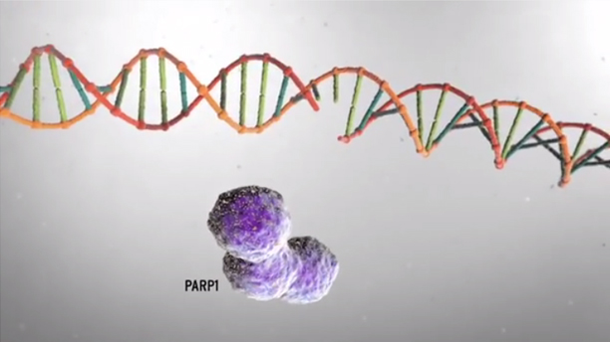
DNA Repair—What is PARP?

Slide 19
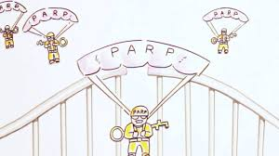
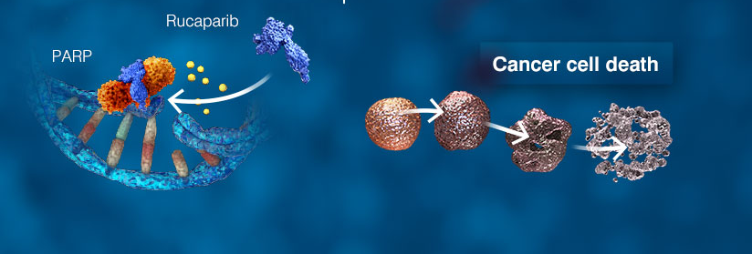
PARP enzyme repairs single strand DNA breaks
PARP inhibitor

Slide 20
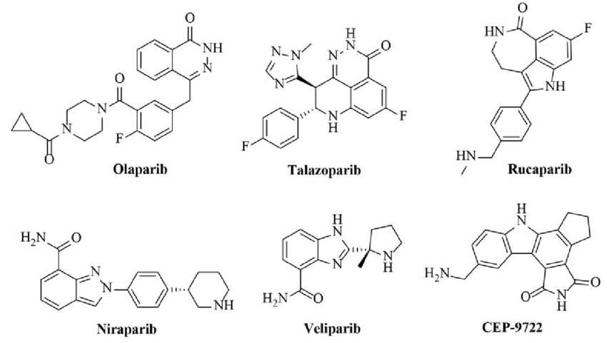
PARP Inhibitors Bind to PARP Enzyme

Slide 21
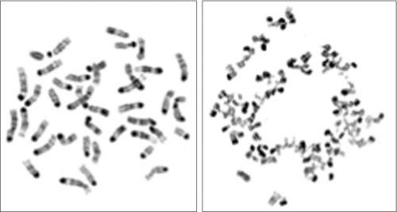
PARP inhibition in BRCA deficient cells
BRCA intact
BRCA mutated
BRCA2-mutant cells treated with a PARP inhibitor undergo massive chromosomal crisis due to the defect in DNA repair mechanisms.
Banerjee, Nature Reviews Clinical Oncology, 2010

Slide 22
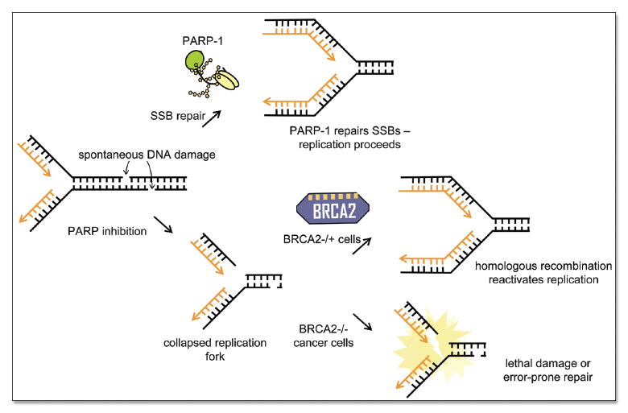
How do PARP Inhibitors Work? Synthetic Lethality

Slide 23
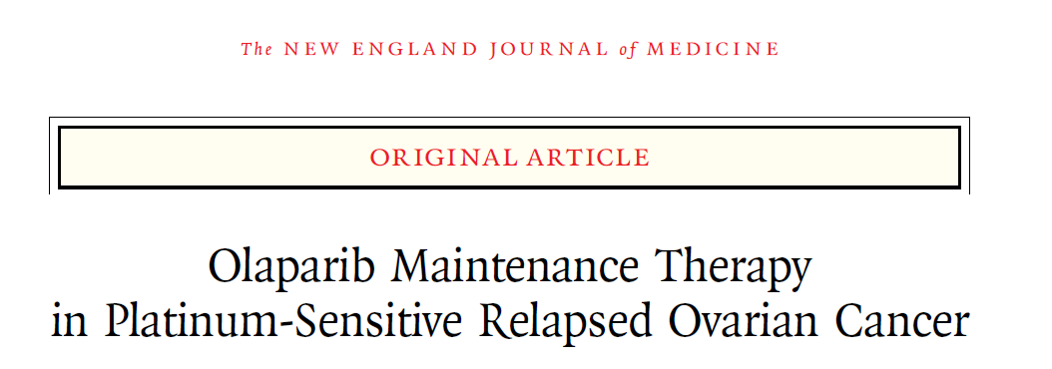
1.0
Olaparib
400 mg po bid
0.9
Hazard ratio 0.35
(P<0.00001)
0.8
0.7
Treatment until disease progression
Probability of
progression-free survival
Platinum
based therapy
0.6
0.5
0.4
Placebo
po bid
0.3
0.2
Placebo
0.1
Olaparib
0
0
3
6
9
12
15
18
Time from randomization (months)
Olaparib was the first approved PARP inhibitor
Side effects include: fatigue, anemia, nausea
Recent conversion from capsules to tablets: easier to tolerate
Ledermann J et al. N Engl J Med 2012;366:1382–1392
Notes:
Jonathan Ledermann presented results of maintenance olaparib therapy in women who had had at least a PR following platinum based chemotherapy for plat sensistive disease

Slide 24
Survival by BRCA mutated status
1.0
0.9
0.8
0.7
0.6
Proportion of patients progression-free
0.5
0.4
0.3
Olaparib BRCAm
0.2
Placebo BRCAm
0.1
0
0
3
6
9
12
15
Time from randomization (months)
Highest benefit in patients with BRCA mutated tumors

Slide 25
PARP Inhibitors in BRCA Mutated Tumors
FIRST LINE SOLO1
Olaparib
300 mg po bid
Treatment
for 2 years
Platinum
based therapy
Surgery
Placebo
po bid

Slide 26
PARP Inhibitors in BRCA Mutated Tumors
FIRST LINE SOLO1
Is a cure possible?

Slide 27
Who will respond to PARPi?
Tumors with BRCA 1,2 mutations
Other mutations in genes that regulate DNA damage response
Tumors with epigenetic changes in genes that control DNA repair (BRCA1, MLH1 methylation)
HR Deficient tumors
Platinum sensitive tumors

Slide 28
Who does not respond to PARP inhibitors?
New mutations (BRCA, RAD51) that make tumors resistant
Upregulation of growth pathways that stimulate cancer cell growth (e.g. Wnt)
Loss of DNA repair mechanisms (Sheldin, PTIP).
Drug efflux
Area of outmost interest for research

Slide 29
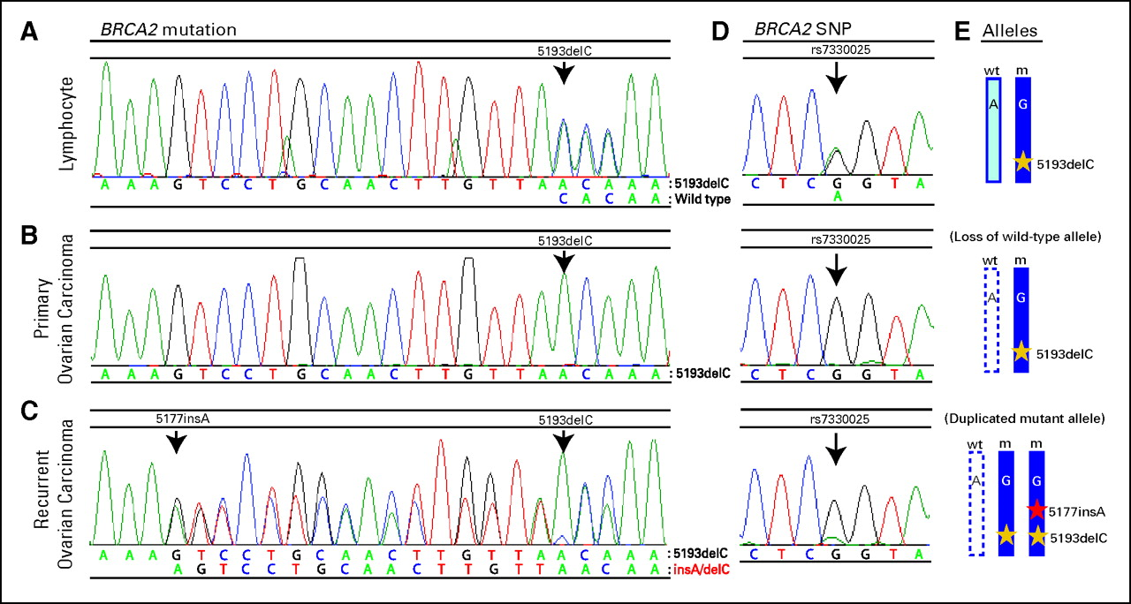
Who does not respond to PARP inhibitors?
Samples from individual with germline BRCA2 5193delC mutation demonstrating a secondary somatic mutation restoring BRCA2 in ovarian carcinoma.
Norquist B et al. JCO 2011;29:3008-3015

Slide 30
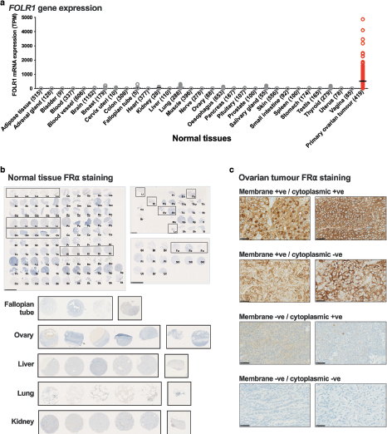
Folate receptor
Bax, British J of Cancer, 2022

Slide 31
Folate receptor alpha
Bax, British J of Cancer, 2022

Slide 32
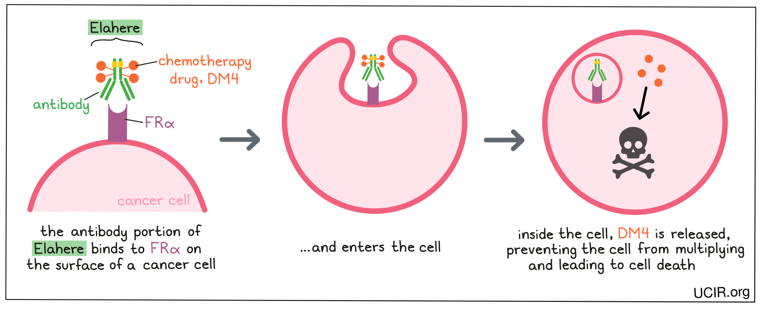
Mirvetuximab soravtansine
—Mechanism of action

Slide 33
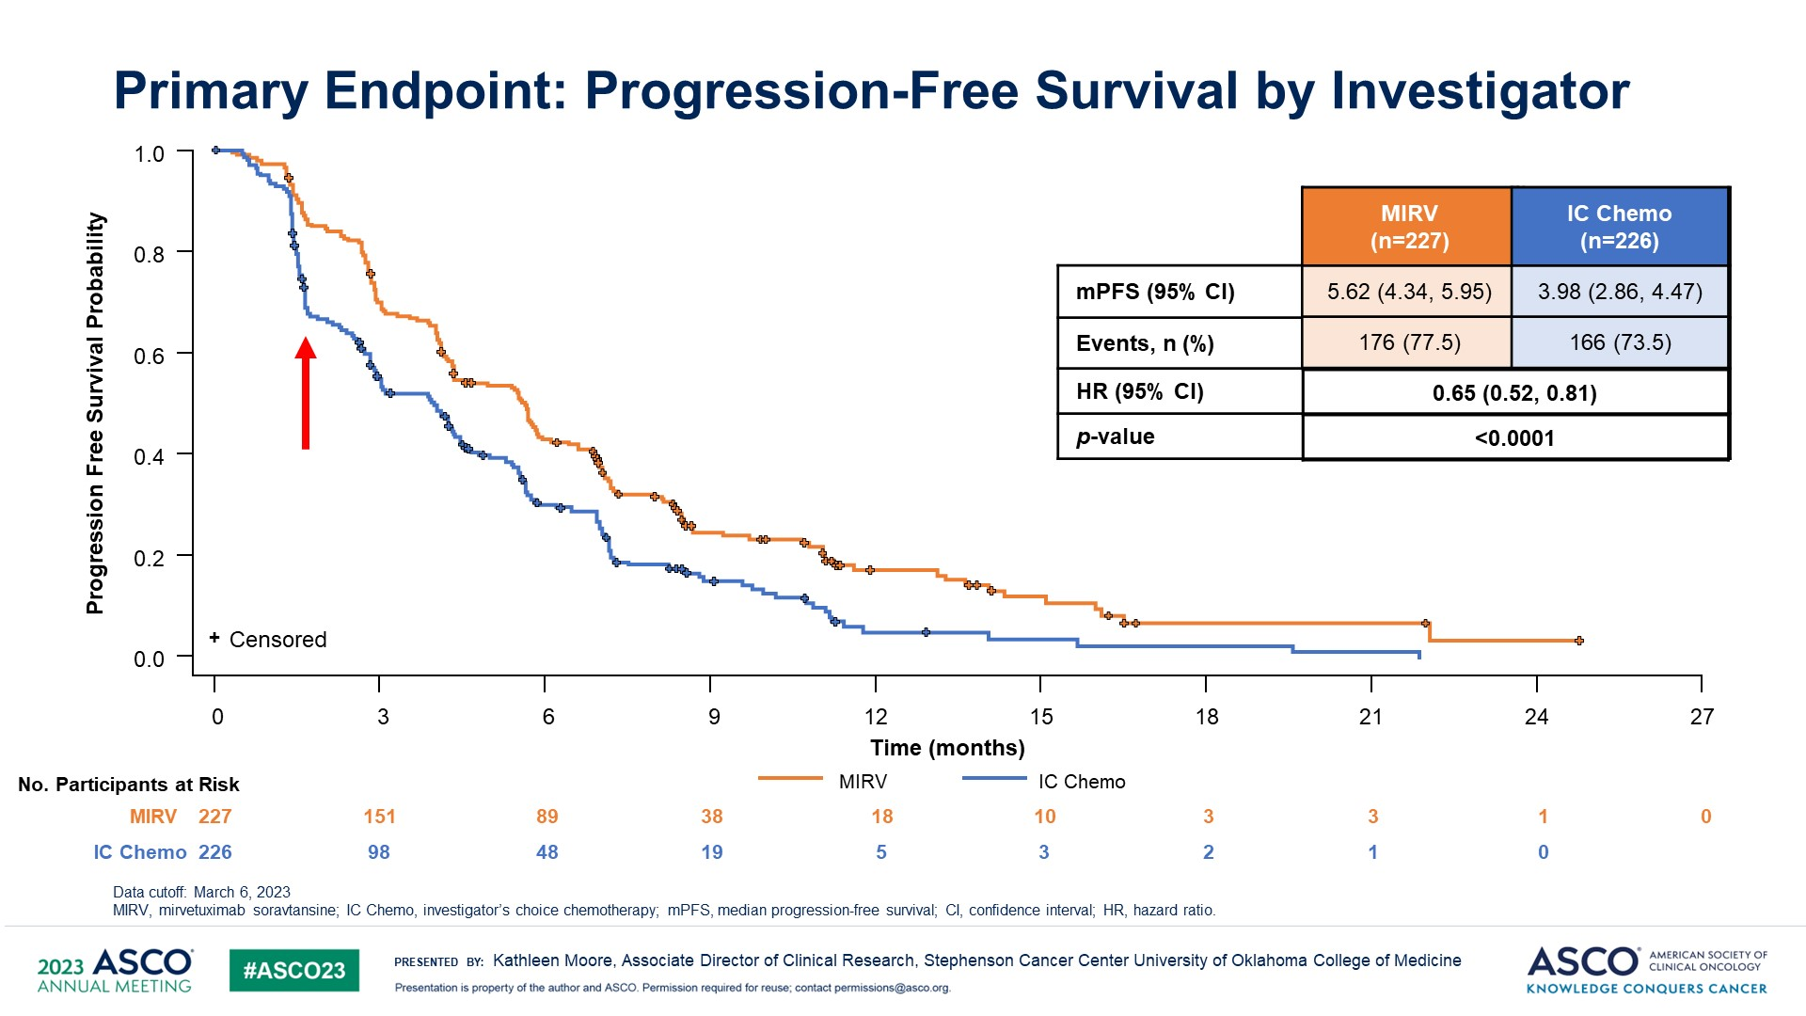
Mirvetuximab soravtansine
Clinical Activity

Slide 34
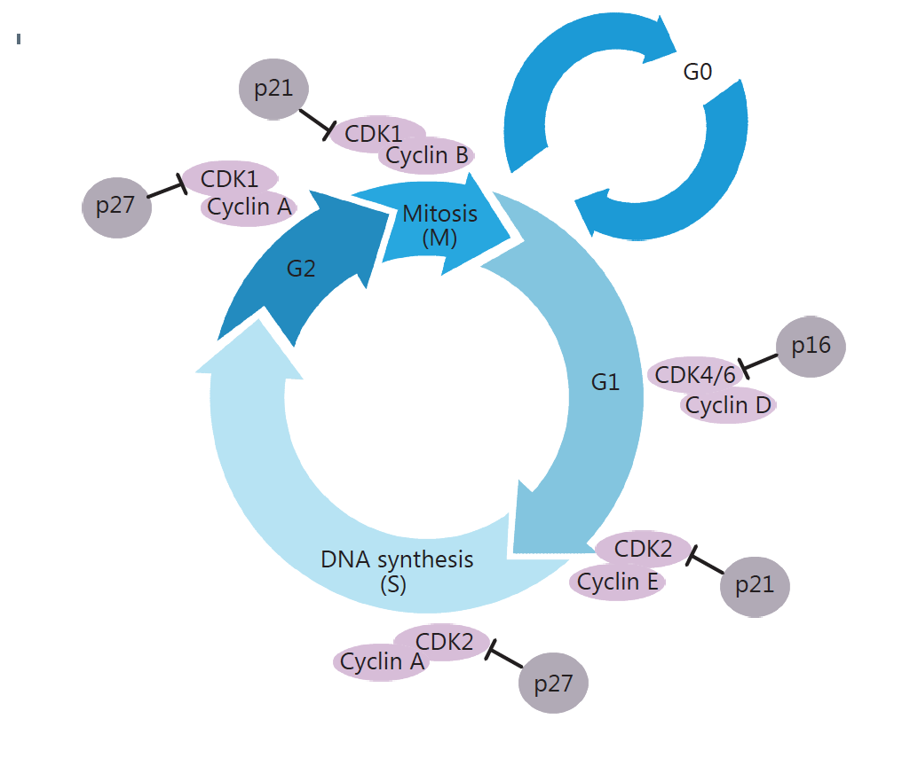
Cyclin E Overexpression
Cyclin E overexpression
-in 10% of ovarian cancers
-aggressive cancers
-resistant to chemotherapy
Testing of new agents that block CDK2

Slide 35
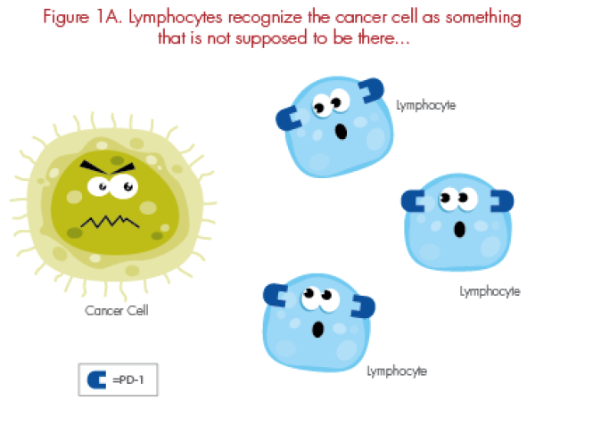
Immunotherapy:
How does the immune system work?

Slide 36
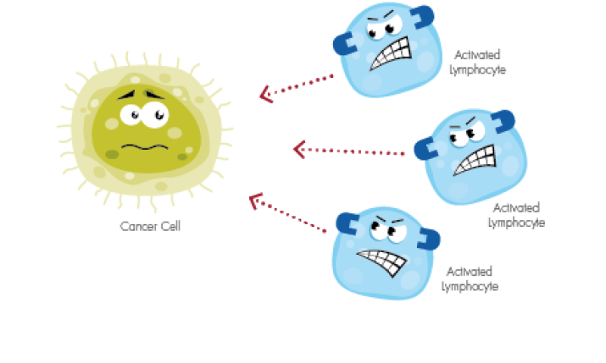
How does the immune system work?

Slide 37
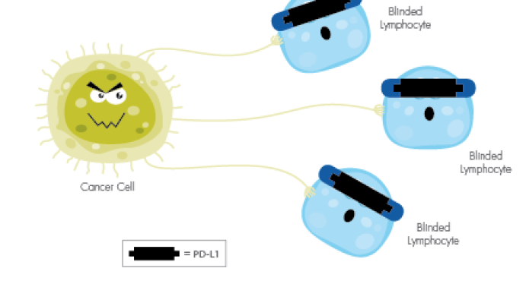
Mechanism by which tumor cells evade the immune system

Slide 38
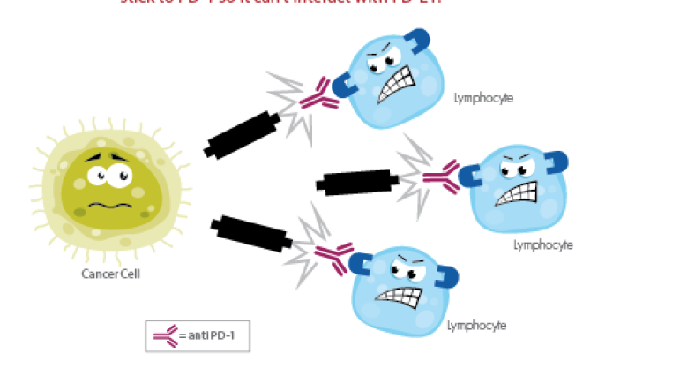
How to unblock anti-tumor immunity: Anti-PD1
Examples: Pembrolizumab approved for lung cancer, melanoma, renal cancer,
Nivolumab

Slide 39
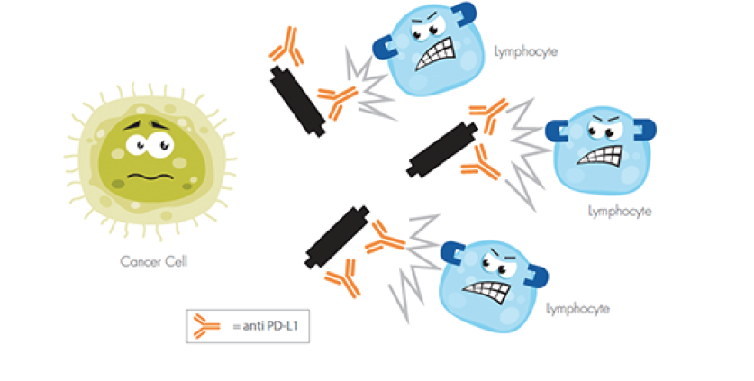
How to unblock anti-cancer immunity anti-PDL1
Examples: pembrolizumab or dastalimab —approved for endometrial cancer

Slide 40
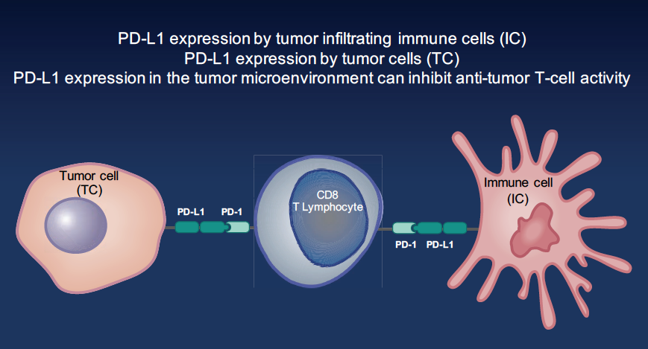
Anti-PD1 inhibitor
Anti-PD1 inhibitor

Slide 41
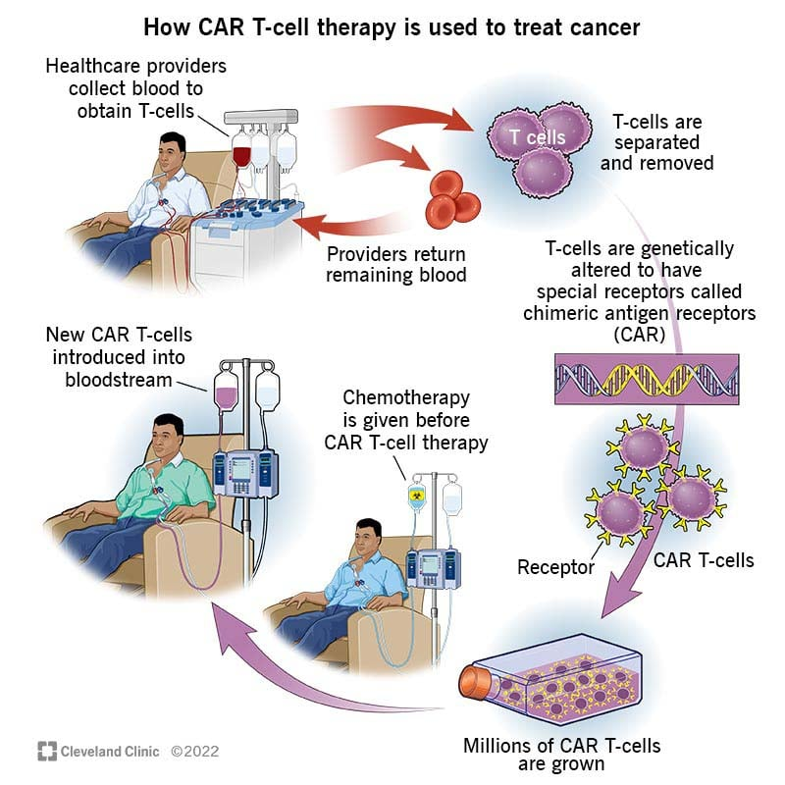
OTHER FORMS OF IMMUNOTHERAPY

Slide 42
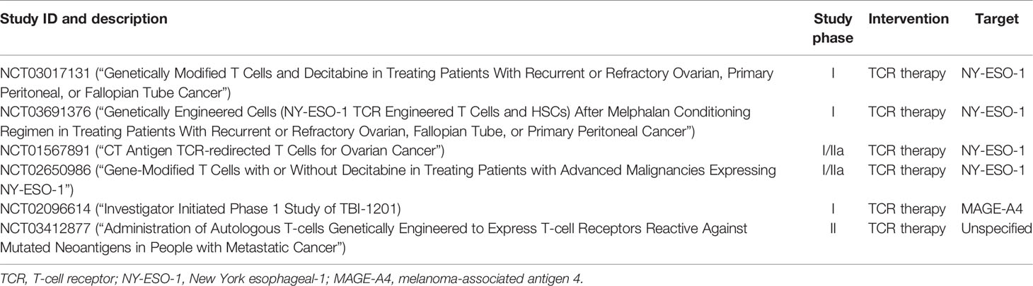
CAR T Cell Trials in Ovarian Cancer

Slide 43
Immunotherapy-take home message
New class of drugs very active in cancer
Toxicity profiles includes immune effects (rash, arthritis, diarrhea)
Efficacy in ovarian cancer is modest, but immune therapies are active in endometrial cancer and cervical cancer
High MSI or High tumor mutation burden are predictors of response to immunotherapy (rare in ovarian cancer)
Patients who respond have long remissions
Research ongoing to identify combinations that may boost the effects of immunotherapy in ovarian cancer and to define ways to find patients likely to benefit from immunotherapy.

Slide 44
Low grade serous ovarian cancer
Rare subtype of ovarian cancer.
Slow tumor growth
Poor response to chemotherapy
Present estrogen receptor, response to anti-estrogens.
Present mutations in the growth pathway RAS-RAF-MAPK
Trametinib
Recurrent
Low grade
ovarian cancer
Standard of care treatment
(chemotherapy or hormonal therapy)

Slide 45
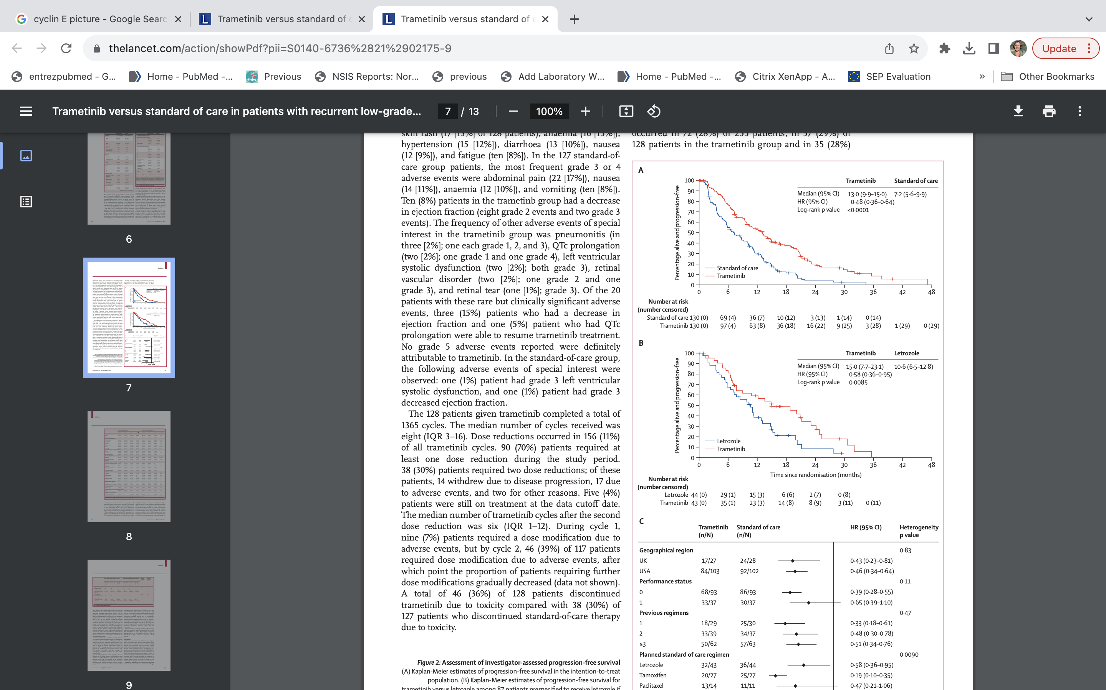
Low grade serous ovarian cancer
Gershenson, Lancet, 2022

Slide 46
Is Personalized Treatment Achievable in Gynecologic Cancer?
Molecular
subtypes
Specific
agent
Histological
Subtypes
Ovarian Cancer

Slide 47

The future is possible
“In time the murky skies would clear up and the green growth would wind its way up
through the rubble. Now there was new hope for the Wumps.”
Bill Peet:
“The Wump World”

Slide 48
THANK YOU

