Slide 1
Updates In Treatment for Metastatic and Recurrent Endometrial Cancer
Raanan Alter MD

Slide 2
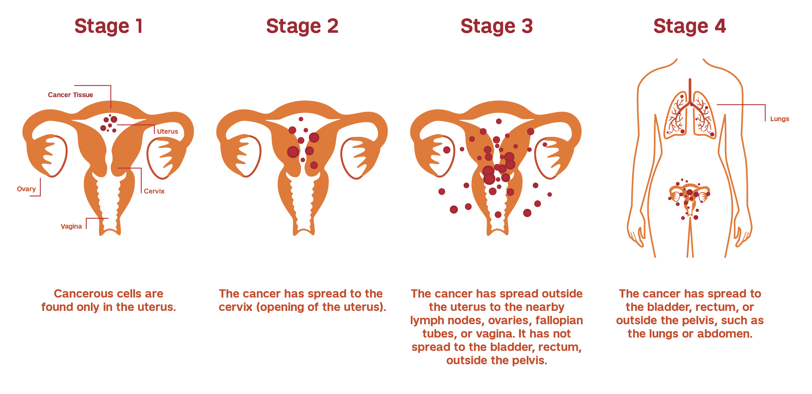
Endometrial Cancer Statistics
Most common gynecologic cancer
3rd Most Common Cancer to Affect Women
Estimated 66,000 cases in 2023 in the USA
3% of all cancer diagnoses
60-70%
20%
10%
10-20% Recurrence
Systemic Treatment

Slide 3
Treatment for Metastatic/Recurrent Endometrial Cancer
Subsequent Lines
Chemotherapy
Endocrine Therapy
+/- Radiation
+/- Surgery
First Line:
Chemotherapy
+/- Radiation
+/- Surgery

Slide 4
Immune Therapies

Slide 5
Immunotherapy
Checkpoint Inhibitors
Adoptive Cell Therapy
Cytokine Therapy
Vaccine Therapy
Oncolytic Virus Therapy

Slide 6
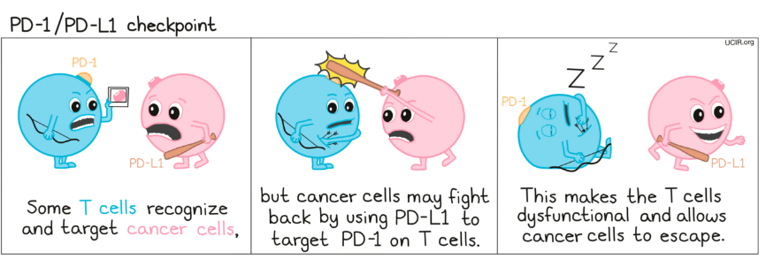
Immune Checkpoint Blockade (ICB)
Pembrolizumab, Nivolumab, Durvalumab, Dostarlimab, Atezolizumab, Avelumab
https://www.ucir.org/therapies/checkpoint-blockade

Slide 7
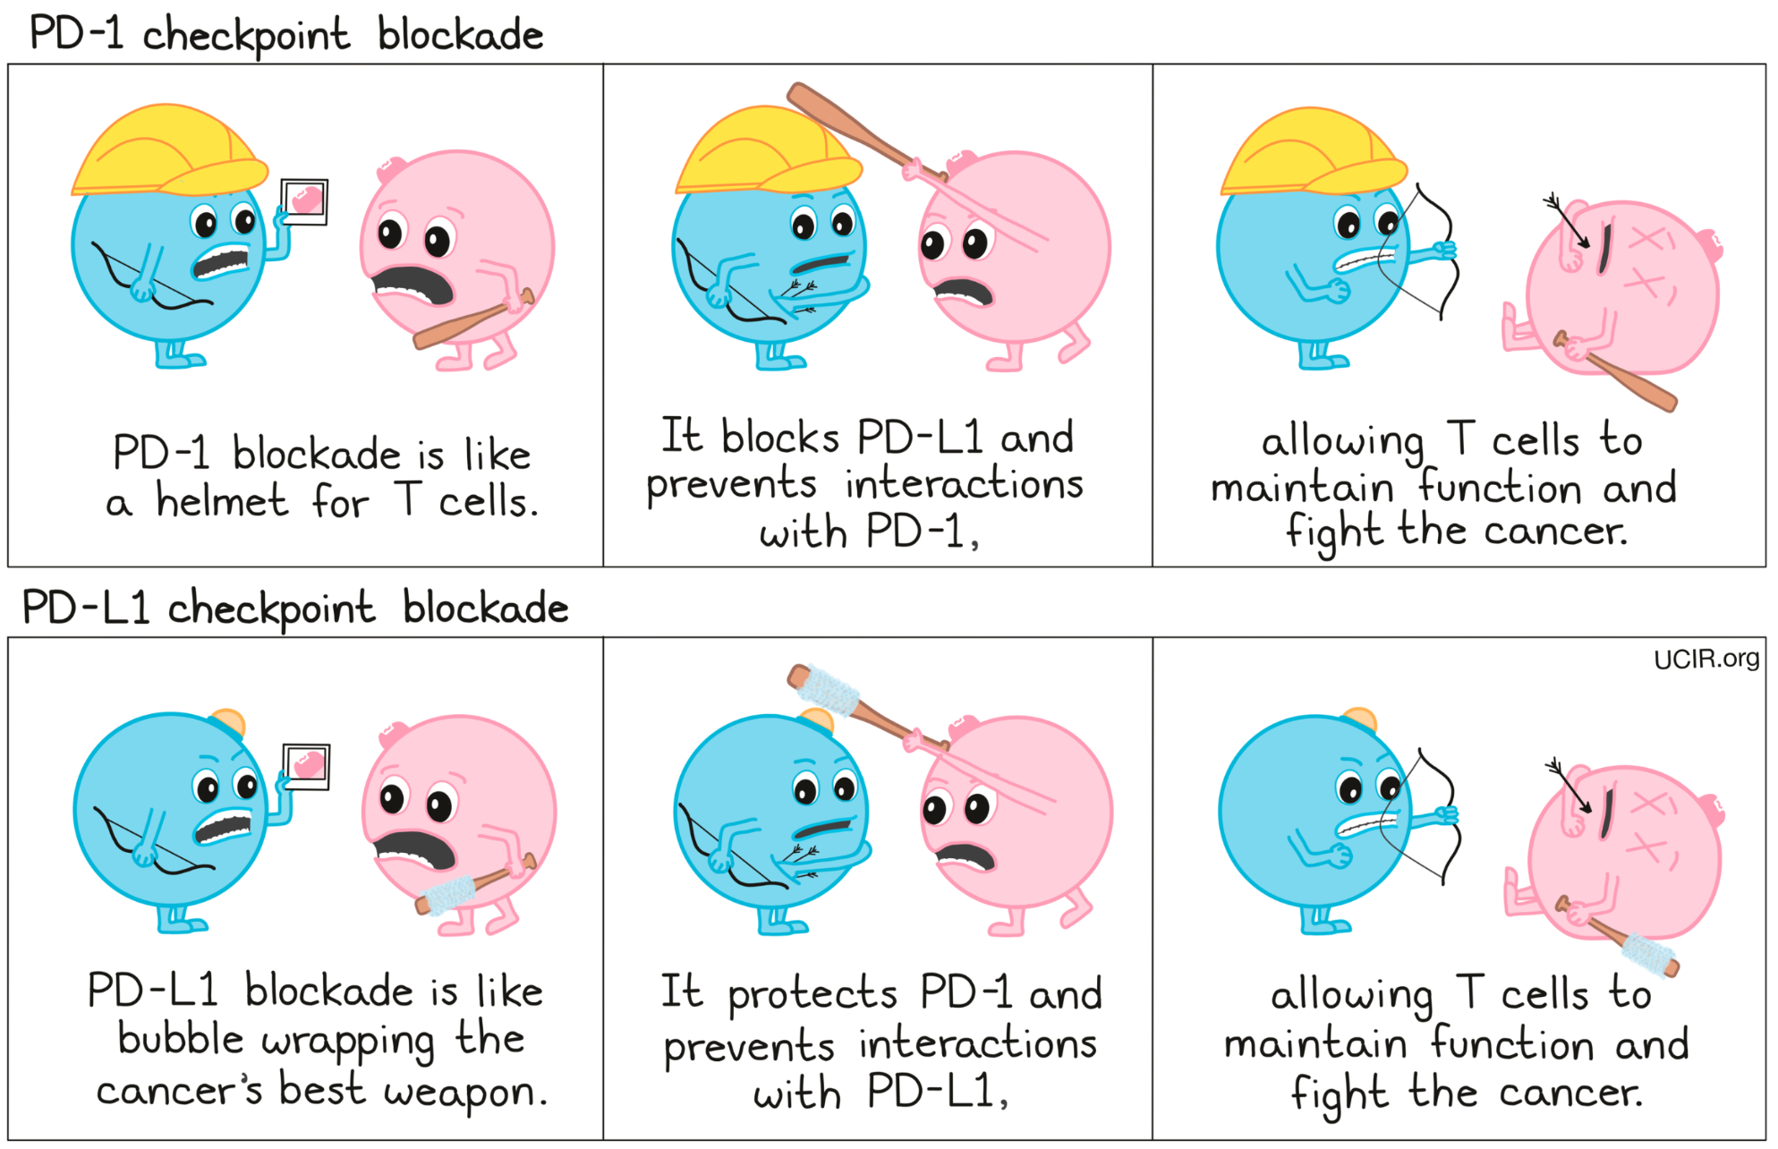
Immune Checkpoint Blockade (ICB)
Pembrolizumab, Nivolumab, Durvalumab, Dostarlimab, Atezolizumab, Avelumab
https://www.ucir.org/therapies/checkpoint-blockade

Slide 8
Biomarkers to Predict Immune Therapy Efficacy
Tumor Mutational Burden (TMB)
Mismatch Repair Deficiency (MMR) / Microsatellite Instability (MSI)
PDL1 Expression

Slide 9
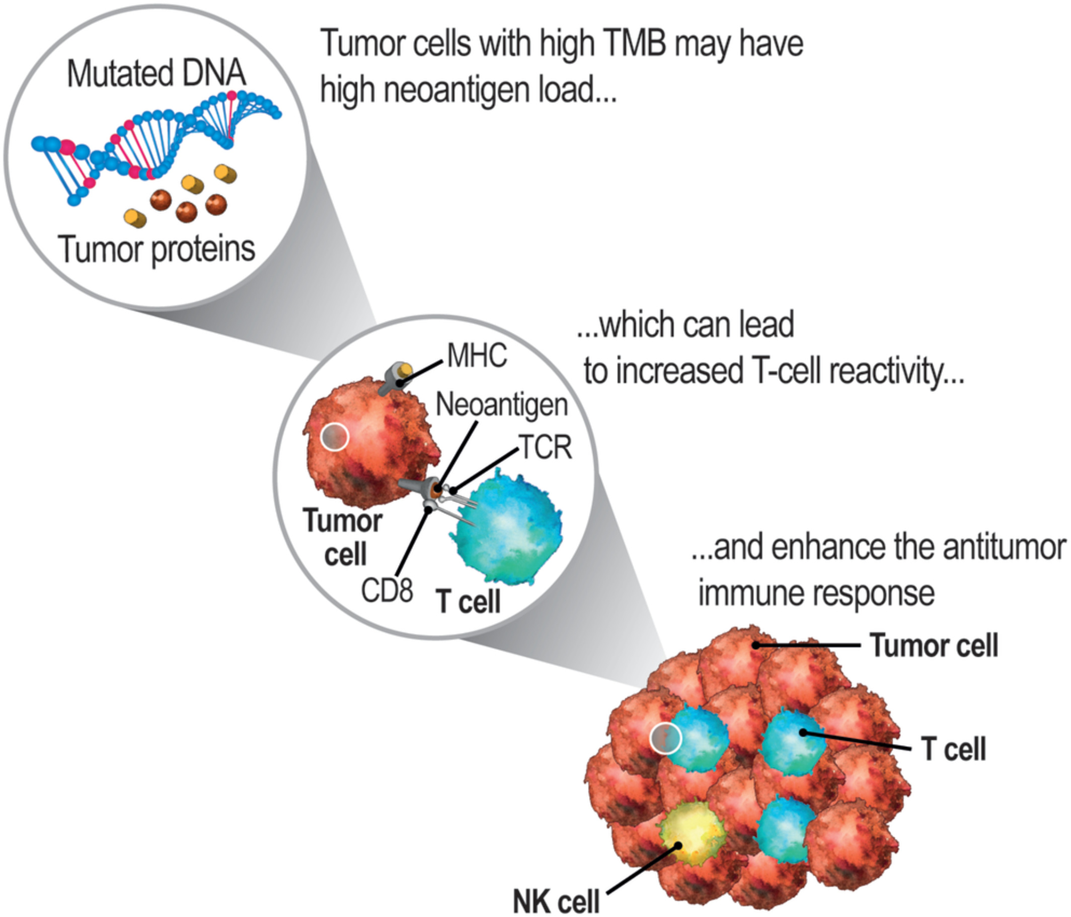
Biomarkers to Predict Immune Therapy Efficacy
Tumor Mutational Burden (TMB)
Mismatch Repair Deficiency (MMR) / Microsatellite Instability (MSI)
PDL1 Expression
High TMB = More Likely to Respond to Immune Therapy
Stenzinger et al, Genes Chromosomes and Cancer 2019

Slide 10
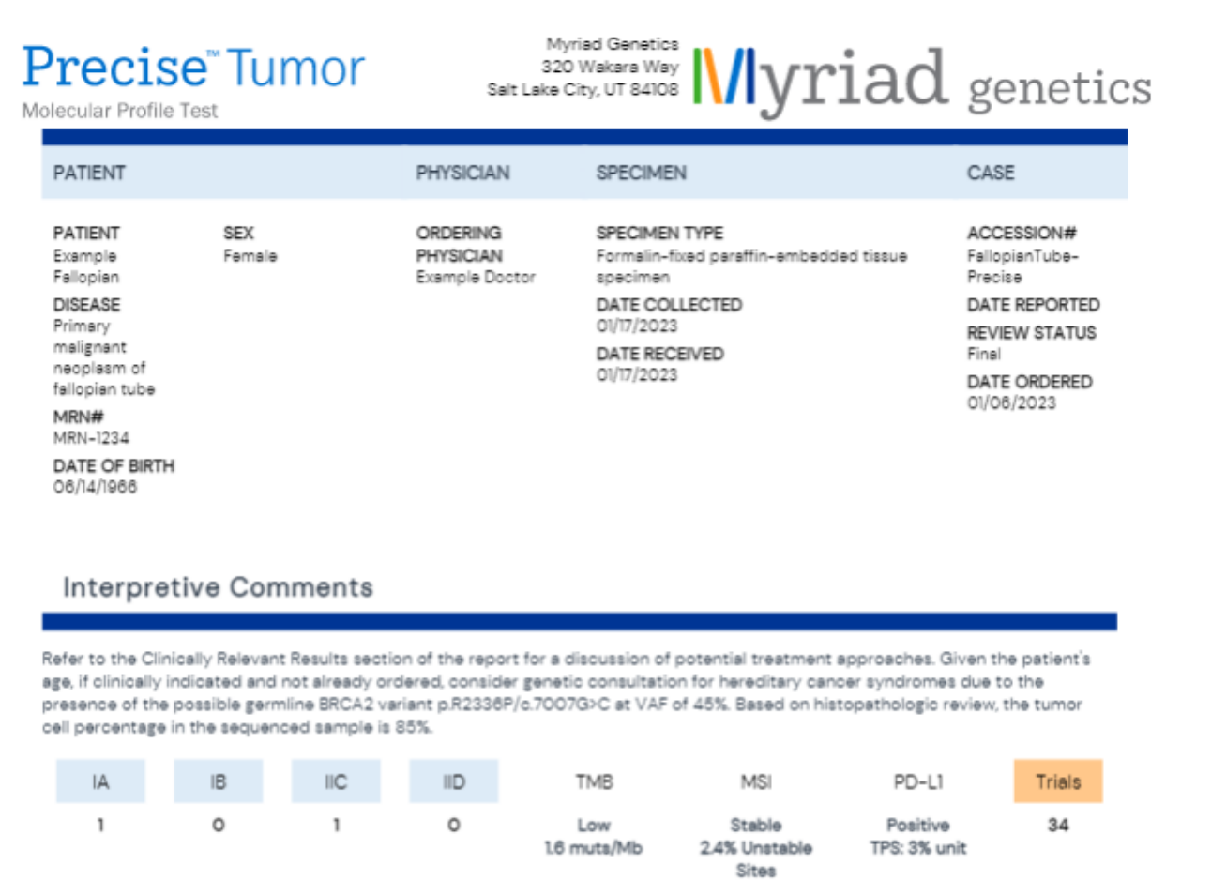
Biomarkers to Predict Immune Therapy Efficacy
Tumor Mutational Burden (TMB)
Mismatch Repair Deficiency (MMR) / Microsatellite Instability (MSI)
PDL1 Expression
High TMB = More Likely to Respond to Immune Therapy

Slide 11
Biomarkers to Predict Immune Therapy Efficacy
Tumor Mutational Burden (TMB)
Mismatch Repair Deficiency (MMR) / Microsatellite Instability (MSI)
PDL1 Expression

Slide 12
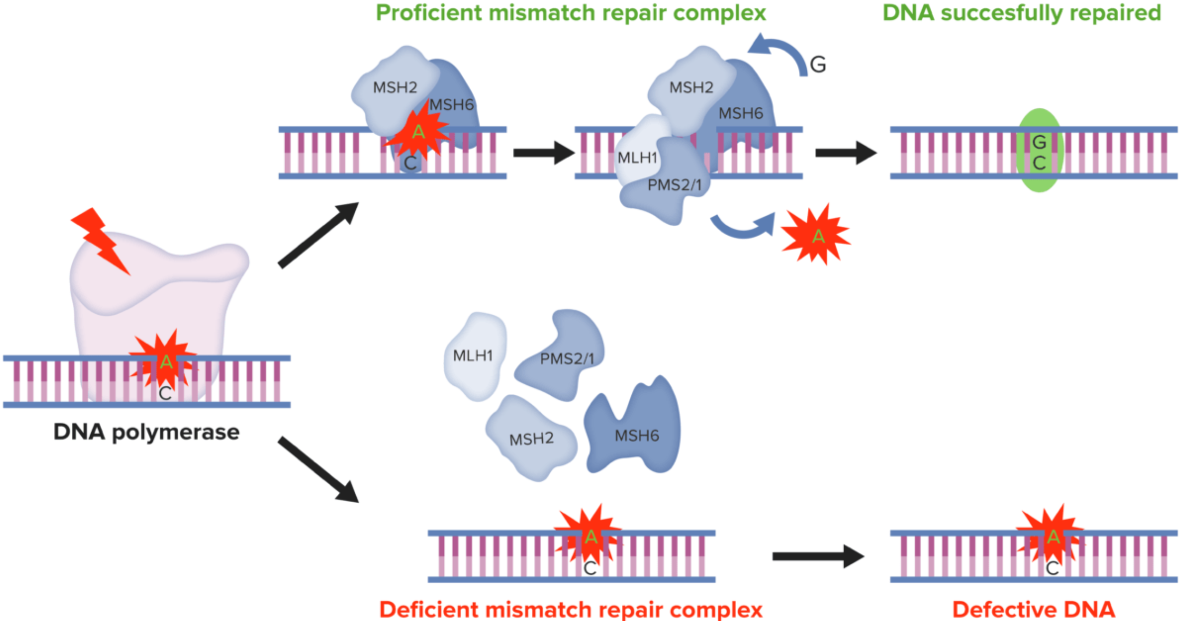
Biomarkers to Predict Immune Therapy Efficacy
Tumor Mutational Burden (TMB)
Mismatch Repair Deficiency (MMR) / Microsatellite Instability (MSI)
PDL1 Expression
MMR Deficiency
Microsatellite Instability (MSI-H)
↑ Neoantigens
https://www.lecturio.com/pt/concepts/sindrome-de-lynch/
Notes:
Mismatch Repair Genes work like genetic “spell checkers.” When problems occur in these spell-checking MMR genes, it means that areas of DNA start to become unstable and the body is unable to correct the errors that occur during DNA replication and consequently accumulate errors. The accumulation of errors causes the creation of novel microsatellite fragments that can be measured. The presence of MSI represents evidence that the MMR function is not working normally and predisposition to developing cancer exists.

Slide 13
Biomarkers to Predict Immune Therapy Efficacy
Tumor Mutational Burden (TMB)
Mismatch Repair Deficiency (MMR) / Microsatellite Instability (MSI)
PDL1 Expression
MMR Deficiency
Microsatellite Instability (MSI-H)
↑ Neoantigens
Notes:
Mismatch Repair Genes work like genetic “spell checkers.” When problems occur in these spell-checking MMR genes, it means that areas of DNA start to become unstable and the body is unable to correct the errors that occur during DNA replication and consequently accumulate errors. The accumulation of errors causes the creation of novel microsatellite fragments that can be measured. The presence of MSI represents evidence that the MMR function is not working normally and predisposition to developing cancer exists.

Slide 14
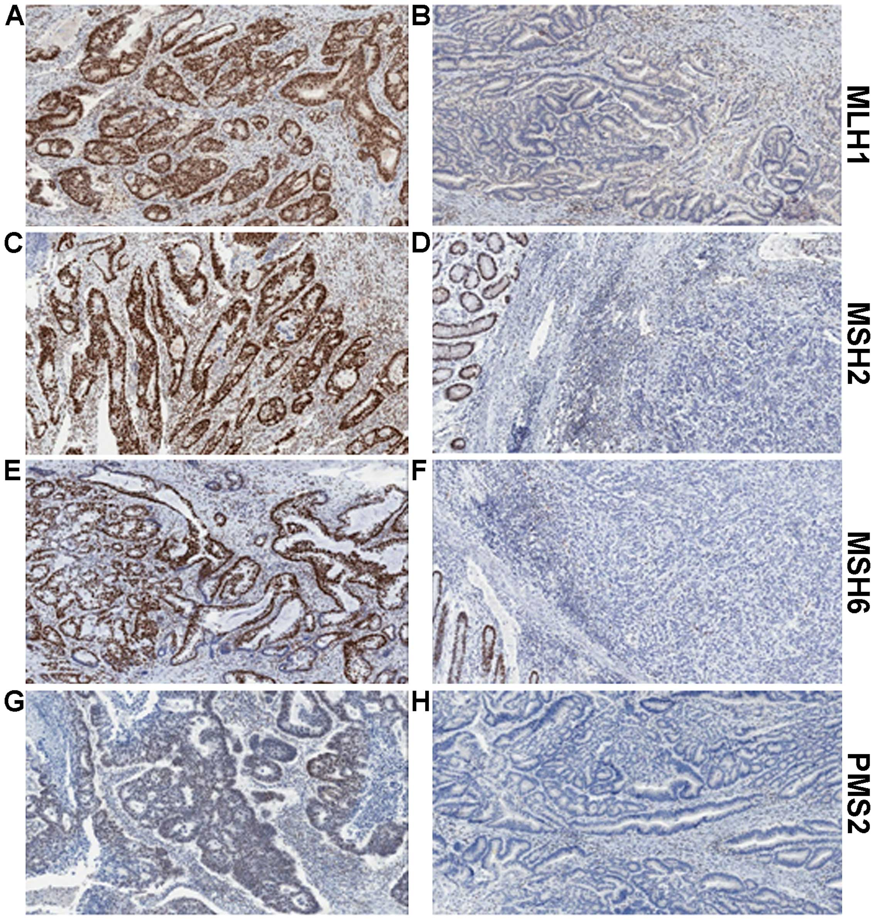
Biomarkers to Predict Immune Therapy Efficacy
Tumor Mutational Burden (TMB)
Mismatch Repair Deficiency (MMR) / Microsatellite Instability (MSI)
PDL1 Expression
Notes:
Mismatch Repair Genes work like genetic “spell checkers.” When problems occur in these spell-checking MMR genes, it means that areas of DNA start to become unstable and the body is unable to correct the errors that occur during DNA replication and consequently accumulate errors. The accumulation of errors causes the creation of novel microsatellite fragments that can be measured. The presence of MSI represents evidence that the MMR function is not working normally and predisposition to developing cancer exists.

Slide 15
Biomarkers to Predict Immune Therapy Efficacy
Tumor Mutational Burden (TMB)
Mismatch Repair Deficiency (MMR) / Microsatellite Instability (MSI)
PDL1 Expression

Slide 16
Tumor Mutational Burden (TMB)
Mismatch Repair Deficiency (MMR) / Microsatellite Instability (MSI)
PDL1 Expression
https://www.ucir.org/therapies/checkpoint-blockade
Notes:
Mismatch Repair Genes work like genetic “spell checkers.” When problems occur in these spell-checking MMR genes, it means that areas of DNA start to become unstable and the body is unable to correct the errors that occur during DNA replication and consequently accumulate errors. The accumulation of errors causes the creation of novel microsatellite fragments that can be measured. The presence of MSI represents evidence that the MMR function is not working normally and predisposition to developing cancer exists.

Slide 17
Tumor Mutational Burden (TMB)
Mismatch Repair Deficiency (MMR) / Microsatellite Instability (MSI)
PDL1 Expression
Notes:
Mismatch Repair Genes work like genetic “spell checkers.” When problems occur in these spell-checking MMR genes, it means that areas of DNA start to become unstable and the body is unable to correct the errors that occur during DNA replication and consequently accumulate errors. The accumulation of errors causes the creation of novel microsatellite fragments that can be measured. The presence of MSI represents evidence that the MMR function is not working normally and predisposition to developing cancer exists.

Slide 18
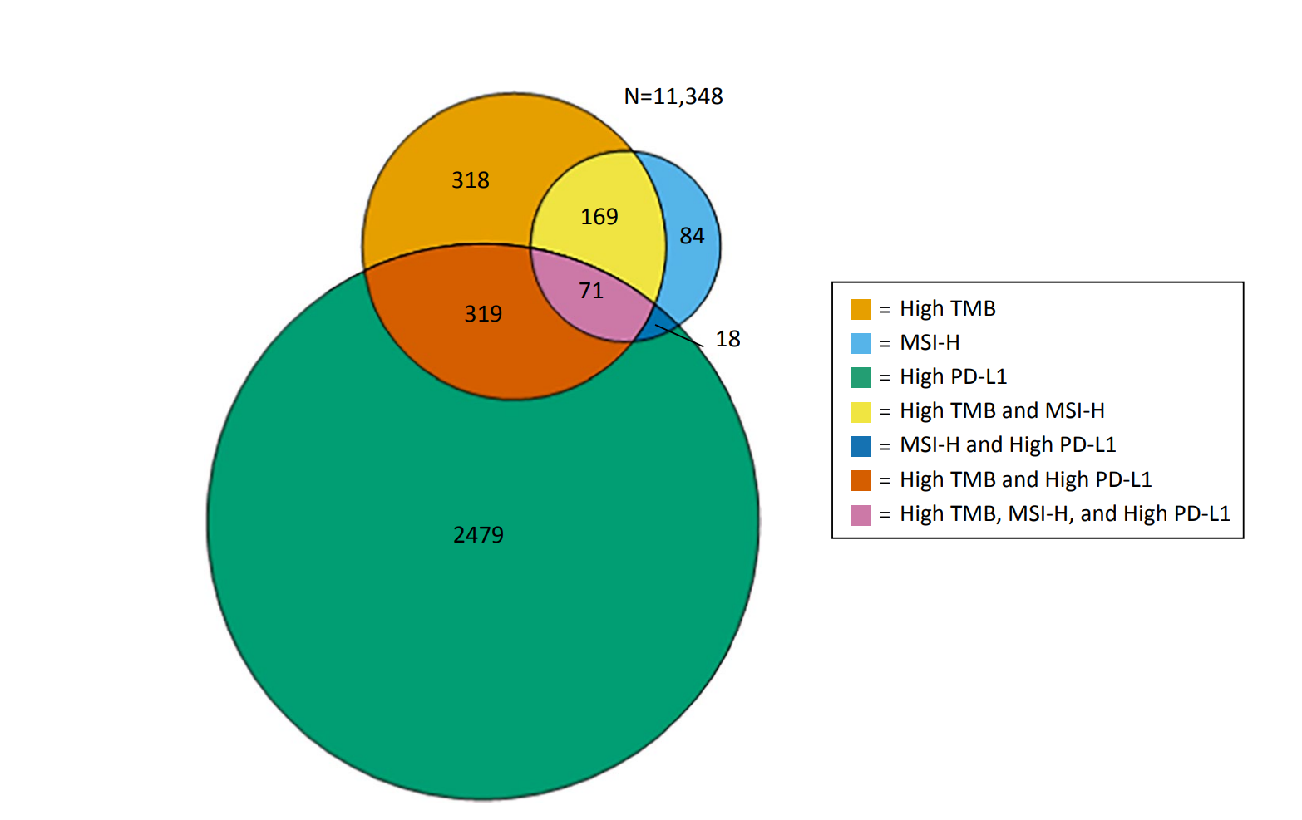
Relationship of PDL1, TMB, and MSI
El-Dieiry et al, CA Cancer J Clin, 2019

Slide 19
Immune Therapy to Treat Endometrial Cancer

Slide 20
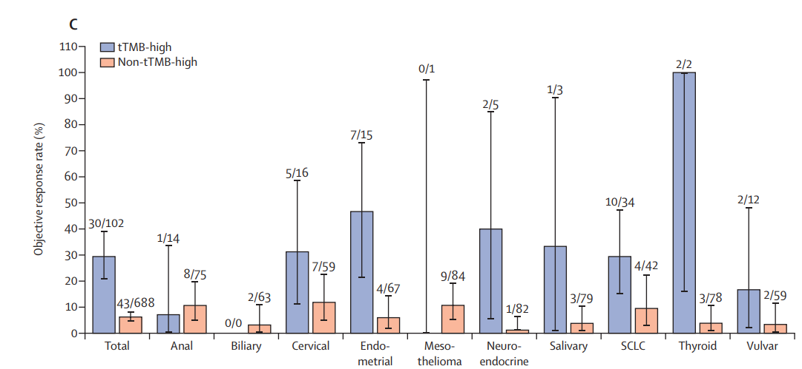
Pembrolizumab in Recurrent *Previously Treated* Endometrial Cancer
KEYNOTE-158
Tumor Mutational Burden (TMB)
Mismatch Repair Deficiency (MMR) / Microsatellite Instability (MSI)
PDL1 Expression
15 patients
47% response rate in high TMB (>10mut/mb)
Marabelle et al, Lancet Oncol 2020

Slide 21
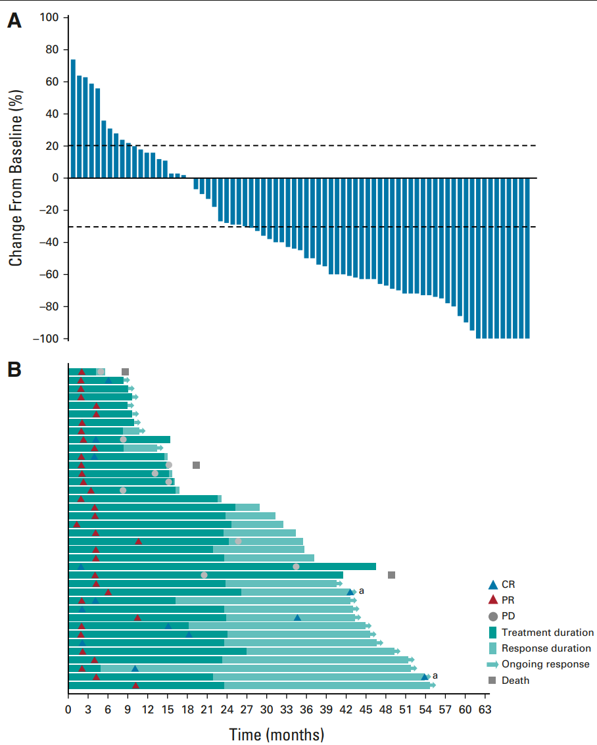
Pembrolizumab in Recurrent *Previously Treated* Endometrial Cancer
KEYNOTE-158
Tumor Mutational Burden (TMB)
Mismatch Repair Deficiency (MMR) / Microsatellite Instability (MSI)
PDL1 Expression
79 Patients
48% Response Rate
66% Clinical Benefit Rate
Median Duration of Response Not reached at 42 months.
2/3 of patients have a response duration of > 3 years
O’Malley et al, JCO 2022
Notes:
pembrolizumab monotherapy demonstrated robust and clinically meaningful antitumor activity, with 48% of patients experiencing an objective response. Responses were durable: the median duration of response was not reached after a median follow-up of 42.6 months and approximately two thirds of patients were estimated to have a response duration of $ 3 years. As of data cutoff, responses were ongoing in 21 of 38 patients who had a confirmed response, including eight of 11 patients with a confirmed CR. In addition, PFS and OS outcomes were promising, with estimated 3-year rates of 37% and 60%, respectively. Median PFS was 13.1 months, and median OS was not reached

Slide 22
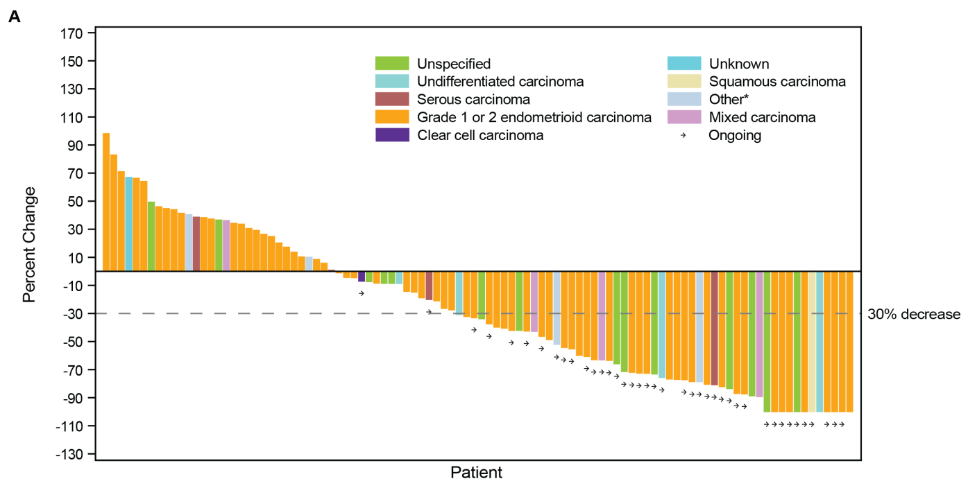
Dostarlimab in Recurrent *Previously Treated* Endometrial Cancer
GARNET
Tumor Mutational Burden (TMB)
Mismatch Repair Deficiency (MMR) / Microsatellite Instability (MSI)
PDL1 Expression
Oaknin et al, Journal of Immunotherapy of Cancer 2022
Notes:
Similar results seen in the GARNET study

Slide 23
Pembrolizumab in Recurrent *Previously Treated* Endometrial Cancer
Tumor Mutational Burden (TMB)
Mismatch Repair Deficiency (MMR) / Microsatellite Instability (MSI)
PDL1 Expression
Not been shown to predict response to immunotherapy

Slide 24
What About Patients Who Lack The Biomarkers?
KEYNOTE 775
Makker et al, NEJM 2022

Slide 25
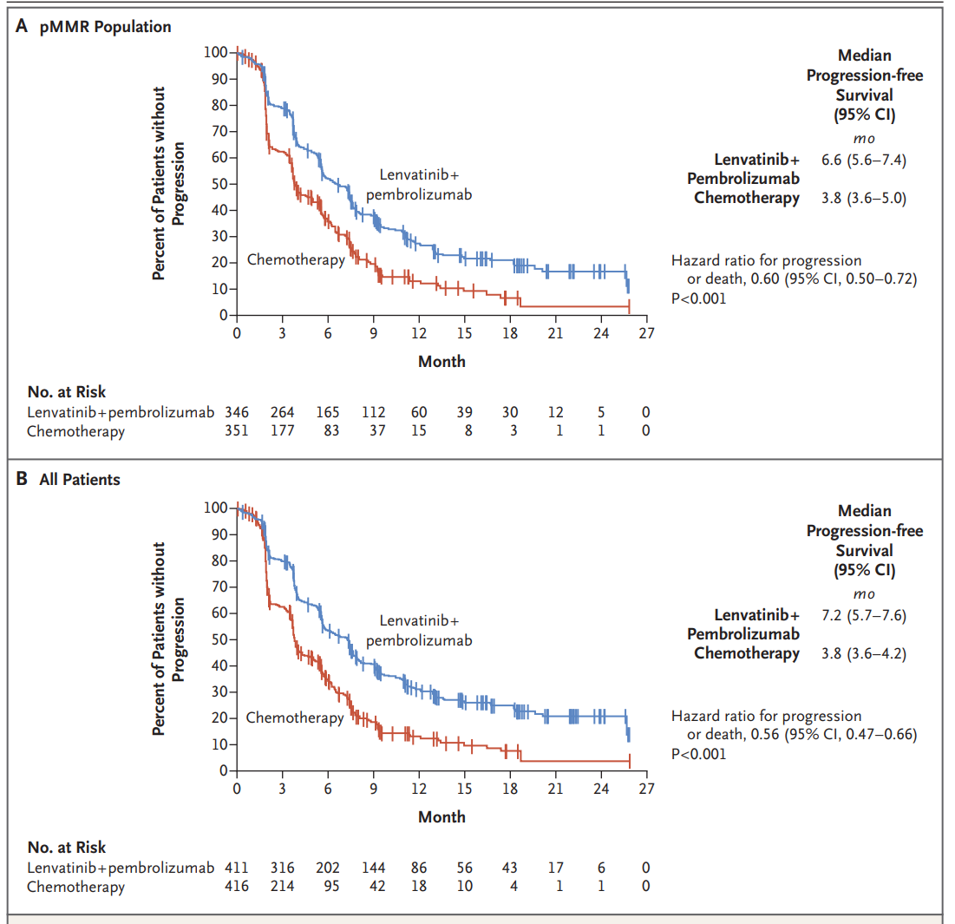
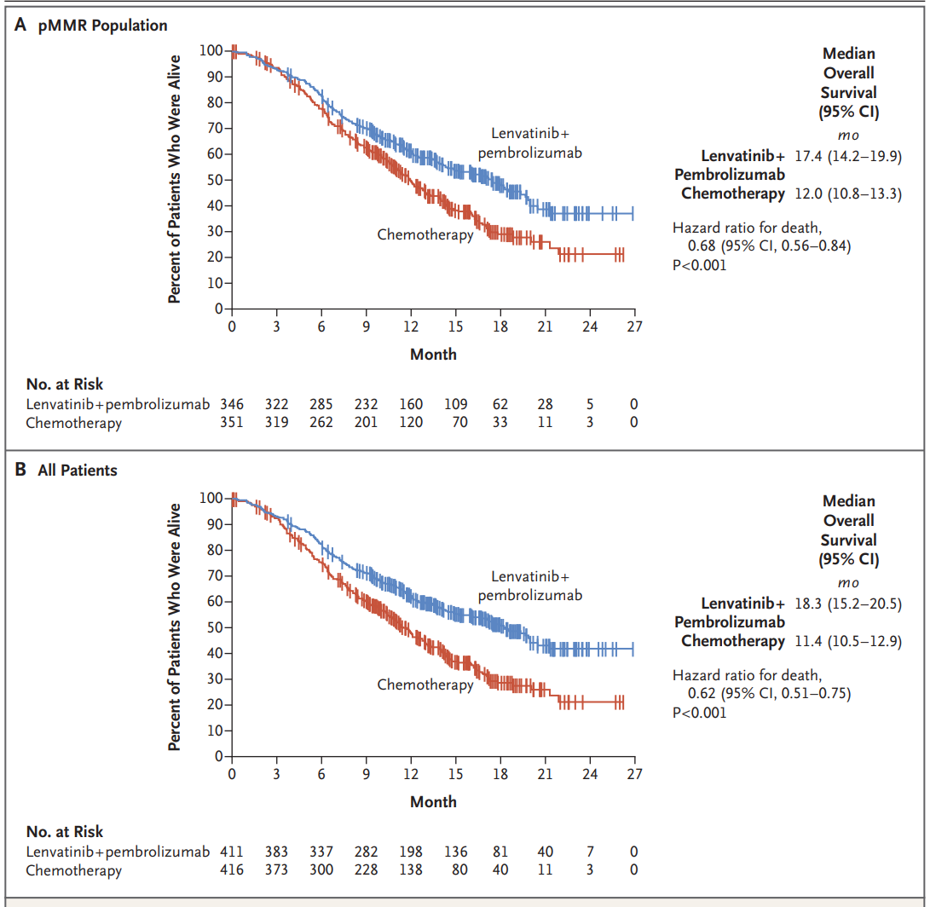
KEYNOTE 775
Notes:
827 patients previously treated with chemotherapy
Randomized to len/pem vs additional chemotherapy
Len/pem found to improve PFS and OS

Slide 26
Treatment for Metastatic/Recurrent Endometrial Cancer
Subsequent Lines
Chemotherapy
Endocrine Therapy
+/- Radiation
+/- Surgery
First Line:
Chemotherapy
+/- Radiation
+/- Surgery

Slide 27
Treatment for Metastatic/Recurrent Endometrial Cancer
Subsequent Lines
Chemotherapy
Immune Therapy
Endocrine Therapy
+/- Radiation
+/- Surgery
First Line:
Chemotherapy
+/- Radiation
+/- Surgery
?

Slide 28
Eskander et al, NEJM 2023

Slide 29
GY-018
Chemotherapy + Placebo x 6 cycles
Placebo for additional 1.5 years
Stage III or IVA (measurable)
Stage IVB
Recurrent
Randomization
Chemotherapy + Pembrolizumab x 6 cycles
Pembrolizumab for additional 1.5 years
Double blinded, placebo controlled
Stratified by MMR status
Inclusion Criteria
All histologies except carcinosarcomas
Recurrent Cancers could only have received prior chemotherapy as a part of initial treatment and had to be more then 12 months prior
Eskander et al, NEJM 2023

Slide 30
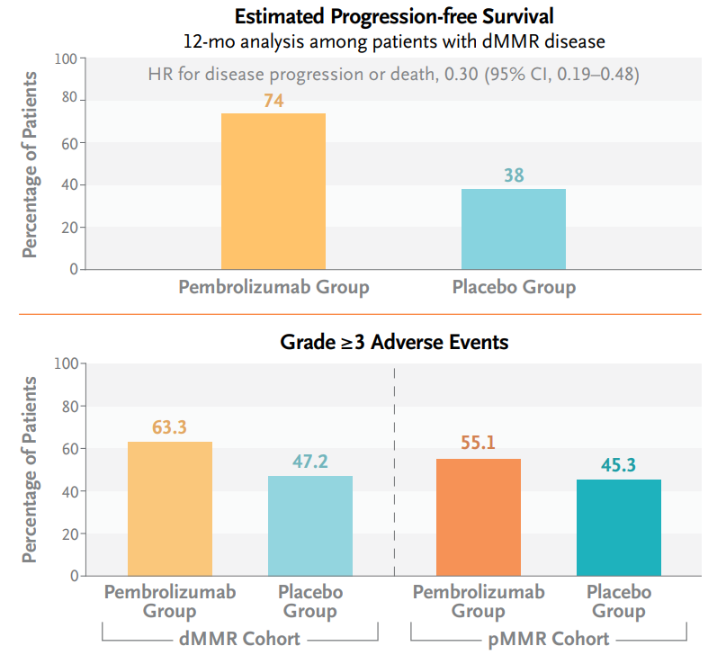
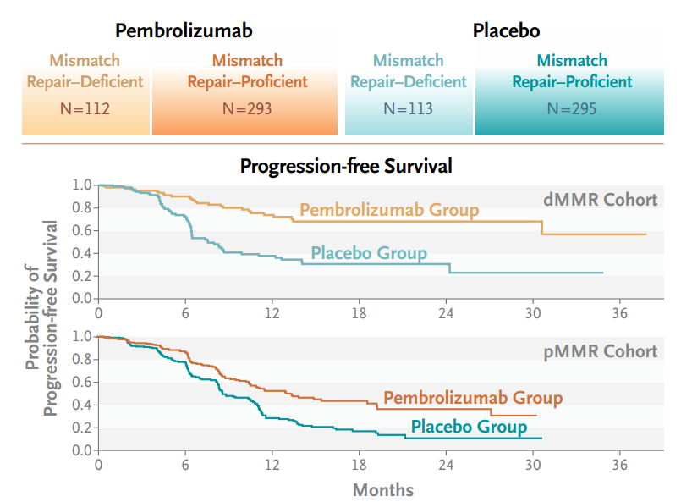
GY-018
MMR Deficient = 70% Lower risk of Disease Progression of Death
MMR Proficient = 46% lower risk of disease progression or Death
Eskander et al, NEJM 2023
Notes:
n this phase 3 trial, we found that the addition of pembrolizumab to standard chemotherapy, followed by pembrolizumab maintenance, resulted in a 70% lower risk of disease progression or death in patients in the dMMR cohort and a 46% lower risk in the pMMR cohort than in the placebo group.

Slide 31
Mirza et al, NEJM 2023

Slide 32
RUBY Trial
Chemotherapy + Placebo x 6 cycles
Placebo for additional 3 years
Stage IIIA-IIIC1 (measurable)
Stage IIIC1 high risk histology (ALL)
Stage IIIC2-IVB (ALL)
Recurrent
Randomization
Chemotherapy + Dostarlimab x 6 cycles
Dostarlimab for additional 3 years
Double blinded, placebo controlled
Stratified by MMR status
Inclusion Criteria
All histologies including carcinosarcomas
Recurrent Cancers could only have received prior chemotherapy as a part of initial treatment and had to be more then 6 months prior
Eskander et al, NEJM 2023
Notes:
Important differences:
Did not require all Stage III cancers to have measurable disease (would allow some high risk histologies and IIIC2 cancers to enroll even without measurable disease)
Allowed for carcinosarcomas
Allowed patients to be enrolled as soon as 6 months from progressing after completing initial treatment
Dostarlimab was given for an additional 3 years after completing treatment

Slide 33
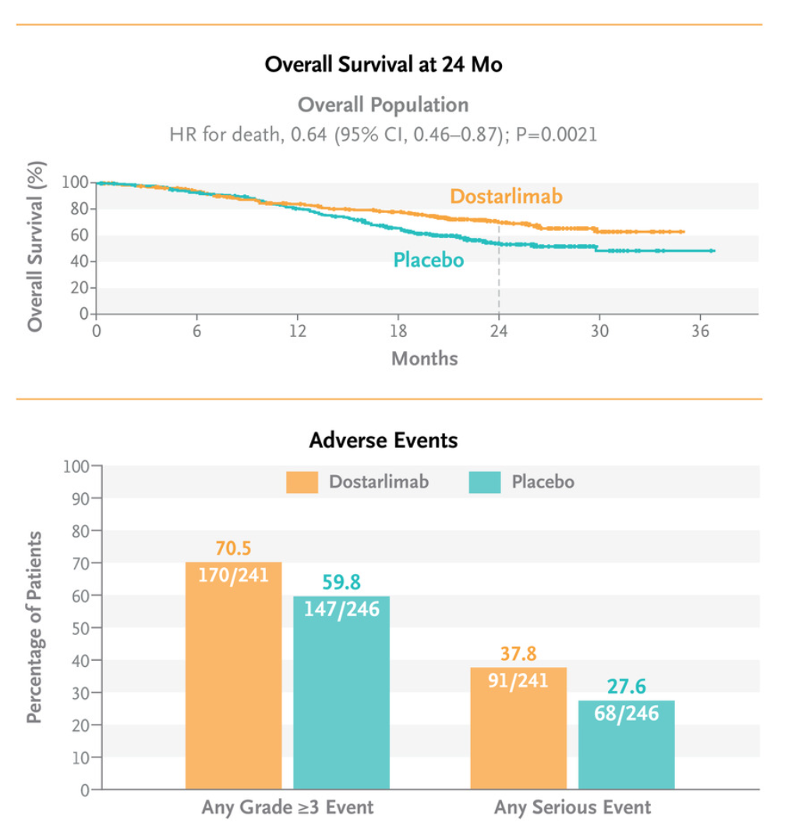
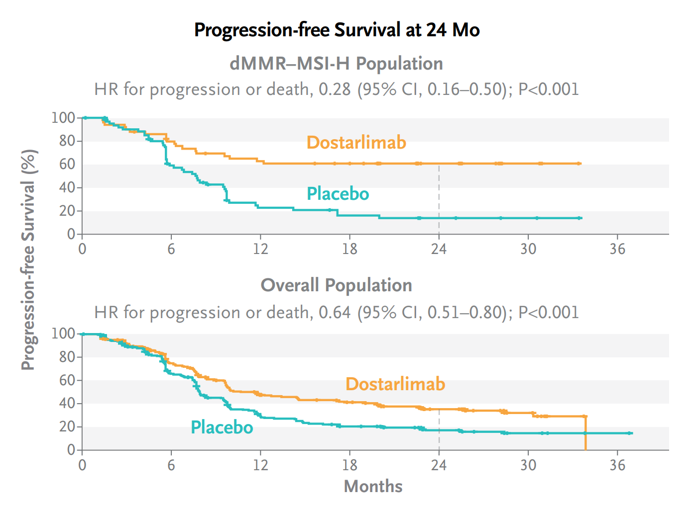
RUBY
MMR Deficient = 72% Lower risk of Disease Progression of Death
Overall Population = 36% Lower risk of Disease Progression or death
Eskander et al, NEJM 2023
Notes:
Despite some differences in study design, similar findings of improved disease control, 72% reduction in recurrence risk, and similar at 24 months a 35% improvement in survival.
Adverse events were similar, the slight increase is due to skin rashes that occurred more frequently in patients receiving dostarlimab

Slide 34
Treatment for Metastatic/Recurrent Endometrial Cancer
Subsequent Lines
Chemotherapy
Immune Therapy
Endocrine Therapy
+/- Radiation
+/- Surgery
First Line:
Chemotherapy
+/- Radiation
+/- Surgery
?

Slide 35
Treatment for Metastatic/Recurrent Endometrial Cancer
Subsequent Lines
Chemotherapy
Immune Therapy
Endocrine Therapy
+/- Radiation
+/- Surgery
First Line:
Chemotherapy + Immunotherapy
+/- Radiation
+/- Surgery

Slide 36
Conclusions
Immune Therapies – specifically immune checkpoint inhibitors have improved outcomes in the treatment of advanced/recurrent endometrial cancer
Addition of Immune Therapy to chemotherapy in the metastatic/recurrent setting adds significant benefit in both MMR-d and MMR-p patients
Most significant benefit seen in the patients with MMR-deficient tumors
Unanswered questions – should immune therapy replace chemotherapy?
Can immune therapy benefit patients in early stage disease? (GY020)

Slide 37
Thank you!

