Slide 1
PARP Inhibitors in Ovarian Cancer
Daniela Matei, MD
Edward Tanner, MD

Slide 2
DNA Repair—What is PARP?

Slide 3
PARP enzyme repairs single strand DNA breaks
PARP inhibitor

Slide 4
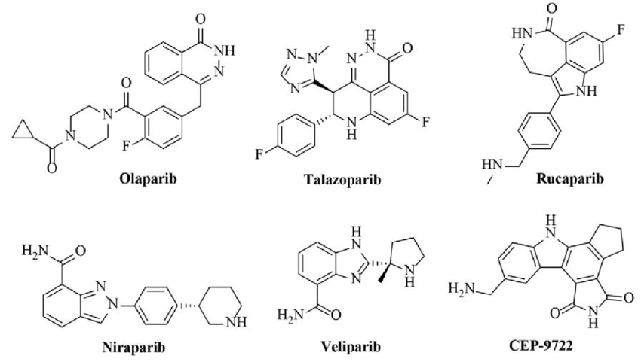
PARP Inhibitors Bind to PARP Enzyme

Slide 5
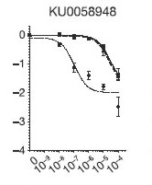
PARP Inhibitors Kill BRCA Mutated Cancer Cells
Normal
BRCA mutation
Farmer, Nature, 2005

Slide 6
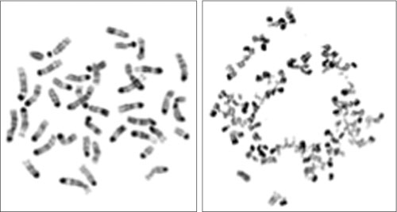
PARP inhibition in BRCA deficient cells
BRCA intact
BRCA mutated
BRCA2-mutant cells treated with a PARP inhibitor undergo massive chromosomal crisis due to the defect in DNA repair mechanisms.
Banerjee, Nature Reviews Clinical Oncology, 2010

Slide 7
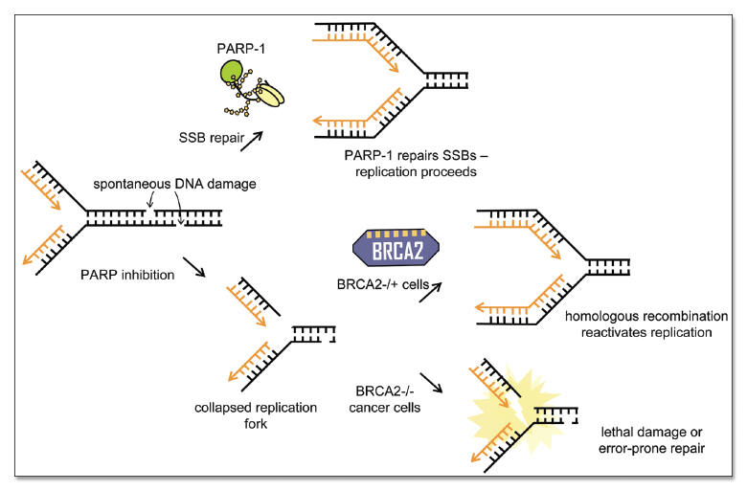
How do PARP Inhibitors Work? Synthetic Lethality

Slide 8
PARP Inhibitors in the News
Dec 19, 2014: The U.S. FDA granted accelerated approval to olaparib for women with recurrent OC with defective BRCA genes (>3 lines).
Dec 19 2016: US FDA approved rucaparib for women with recurrent ovarian cancer associated with defective BRCA genes (>2 lines).
March 2017: US FDA approves niraparib for recurrent OC after response to platinum
August 2017: US FDA approved olaparib for recurrent OC after response to platinum
April 2018: US FDA approved rucaparib for maintenance treatment for women with recurrent ovarian cancer.
December 2018: US FDA approved olaparib for upfront treatment of OC associated with BRCA1 or 2 mutations
May 2020: US FDA approved olaparib with bevacizumab for upfront treatment of HR deficient OC
April 2020: US FDA approved niraparib for upfront treatment of OC achieving response after chemotherapy

Slide 9
PARP Inhibitors in the News
Moment of celebration!—these approvals follow a long drought period(>20 years)
-1995: liposomal doxorubycin
-1996: topotecan
-2006: gemcitabine
The new drug approvals follow decades of basic science and clinical research.
Long way forward!
-Find a cure.
-Find new pathways to target refractory, resistant tumors.

Slide 10
PARP Inhibitors in BRCA Mutated Tumors FIRST LINE SOLO1
Olaparib 300 mg po bid
Treatment
for 2 years
Platinum
based therapy
Surgery
Placebo po bid

Slide 11
PARP Inhibitors in BRCA Mutated Tumors FIRST LINE SOLO1
Is a cure possible?

Slide 12
PARP Inhibitors in BRCA Mutated Tumors SECOND/THIRD LINE
1.0
0.9
Olaparib 400 mg po bid
0.8
0.7
0.6
Proportion of patients progression-free
0.5
Platinum
based therapy
Treatment until disease progression
0.4
0.3
Olaparib BRCAm
0.2
Placebo BRCAm
Placebo po bid
0.1
0
0
3
6
9
12
15
Time from randomization (months)
Highest benefit in patients with BRCA mutated tumors

Slide 13
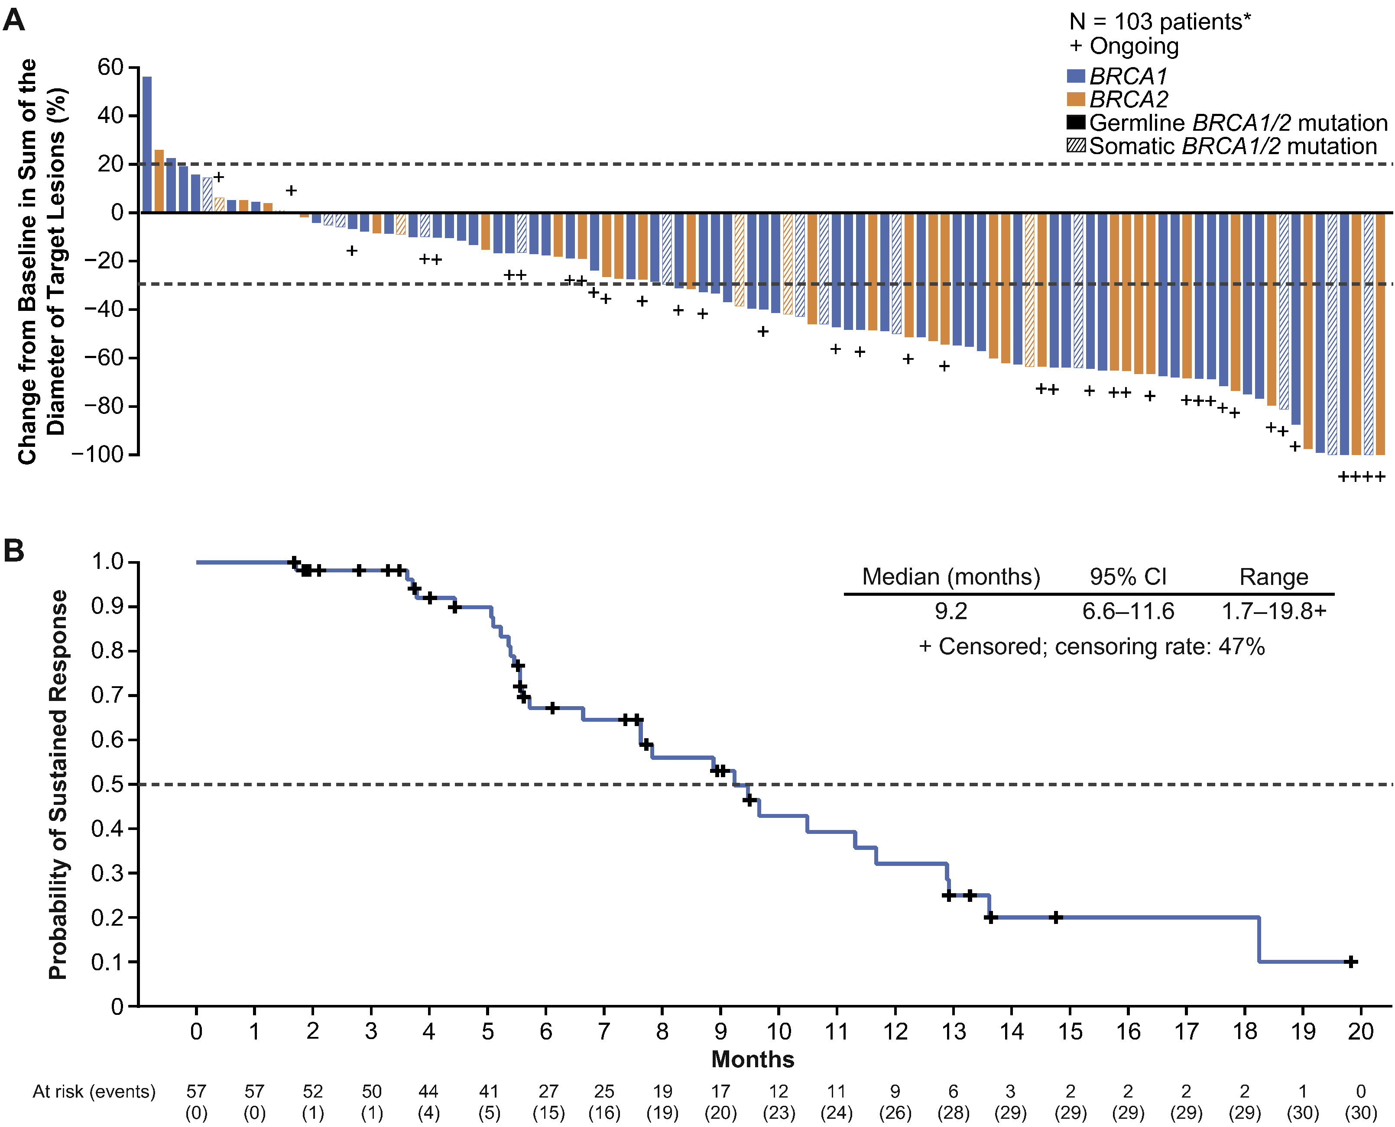
PARP Inhibitors in BRCA Mutated Tumors SECOND/THIRD LINE
Rucaparib 600 mg po bid
106 patients from study 10 and Ariel 2
All with BRCA 1 or 2 mutations
At least 2 prior chemotherapy lines
Platinum sensitive and resistant
RESPONSE RATE 54%
Duration of response
9 months
Oza, Gynecology Oncology, 2017

Slide 14
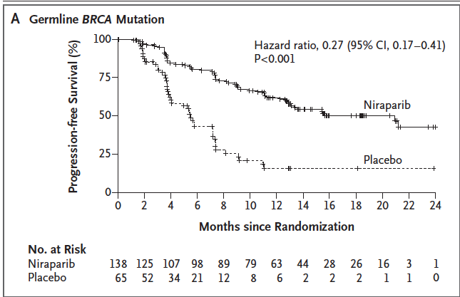
Niraparib 300 mg po qd
Platinum
based therapy
Treatment until disease progression
Placebo po qd
Third PARP inhibitor to be approved
Side effects include low blood counts, fatigue
Effects observed in BRCA mutated patients, but also in ALL patients
Mirza, NEJM, 2016
Notes:
Jonathan Ledermann presented results of maintenance olaparib therapy in women who had had at least a PR following platinum based chemotherapy for plat sensistive disease

Slide 15
PARP inhibitors vs. Chemotherapy SOLO 3 trial
Platinum Sensitive recurrent OC, BRCA 1 and 2 mutations
Penson, JCO, 2020

Slide 16
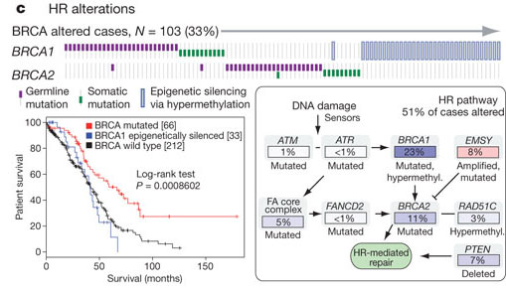
Beyond BRCA Mutations: Homologous Recombination Deficiency in Ovarian Cancer
53% of high grade serous OC characterized by HR deficiency
Nature, June, 2011

Slide 17
1.0
Olaparib 400 mg po bid
0.9
Hazard ratio 0.35
(P<0.00001)
0.8
0.7
Treatment until disease progression
Probability of progression-free survival
Platinum
based therapy
0.6
0.5
0.4
Placebo po bid
0.3
0.2
Placebo
0.1
Olaparib
0
0
3
6
9
12
15
18
Time from randomization (months)
Ledermann J et al. N Engl J Med 2012;366:1382–1392
Notes:
Jonathan Ledermann presented results of maintenance olaparib therapy in women who had had at least a PR following platinum based chemotherapy for plat sensistive disease

Slide 18
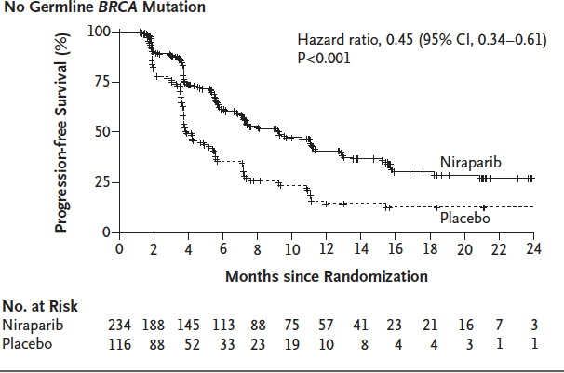
Niraparib 300 mg po qd
Platinum
based therapy
Treatment until disease progression
Placebo po qd
Unexpected results show positive effects of niraparib in tumors without
BRCA mutations; leading to its unrestricted FDA approval
Mirza, NEJM, 2016

Slide 19
First line Treatment: PRIMA trial (niraparib)

Slide 20
First Line Treatment PRIMA Trial (niraparib)

Slide 21
Who will respond to PARPi?
Tumors with BRCA 1,2 mutations
Other mutations in genes that regulate DNA damage response
Tumors with epigenetic changes in genes that control DNA repair (MLH1 methylation)
HR Deficient tumors
Platinum sensitive tumors
Research needed to find a good biomarker for response

Slide 22
Ian MacNeish, ASCO 2015

Slide 23
Rucaparib maintenance

Slide 24
Who does not respond to PARP inhibitors?
New mutations (BRCA, RAD51) that make tumors resistant
Upregulation of growth pathways that stimulate cancer cell growth (e.g. Wnt)
Loss of DNA repair mechanisms (Sheldin, PTIP).
Drug efflux
Area of outmost interest for research

Slide 25
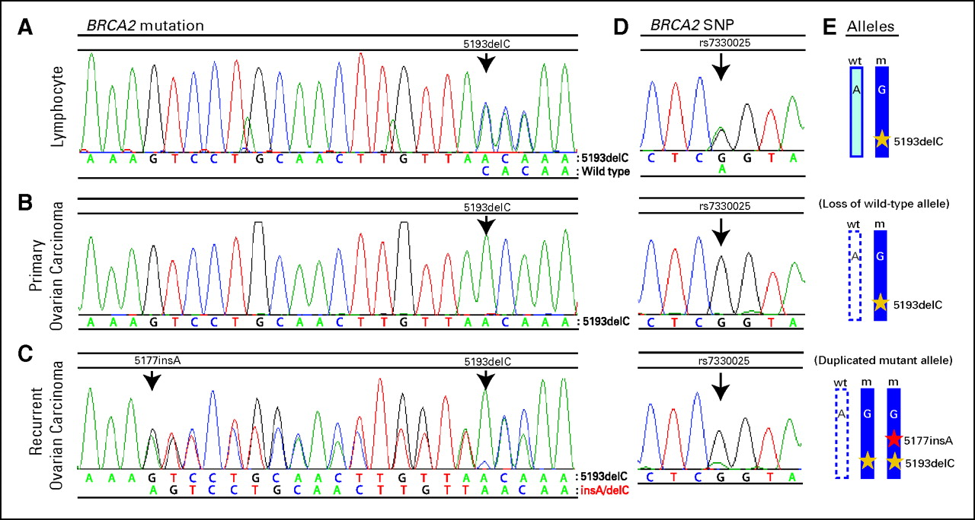
Who does not respond to PARP inhibitors?
Samples from individual with germline BRCA2 5193delC mutation demonstrating a secondary somatic mutation restoring BRCA2 in ovarian carcinoma.
Norquist B et al. JCO 2011;29:3008-3015

Slide 26
Can you take PARPi after PARPi?
Modest benefit (2 months) compared with control
Strategy only useful in patients with platinum sensitive tumors who respond to platinum again

Slide 27
Long Exposure to PARPi
22% of patients received maintenance olaparib for ≥5 years, reflecting the therapeutic benefit and manageable tolerability of olaparib
100
90
80
70
60
50
Patients exposed to treatment (%)
40
62
30
20
10
0
≥1 years
≥2 years
≥3 years
≥4 years
≥5 years
Olaparib (N=195)
Placebo (N=99)

Slide 28
Long exposure to PARPi
 | Olaparib (N=195) |  | Placebo (N=99)
 | Primary | Final | Primary | Final
Mean total treatment duration (SD), months | 17.4 (9.8) | 29.1 (24.7) | 9.0 (8.1) | 13.1 (18.6)
MDS/AML, n (%) During the safety follow-up period (TEAE) After the safety follow-up period (non-TEAE) | 4 (2) | 16 (8) 7 (4) 9 (5) | 4 (4) | 4 (4) 0 4 (4)
Pneumonitis, n (%) | 3 (2) | 3 (2) | 0 | 0

Slide 29
PARP inhibitor combinations
Combinations with chemotherapy are difficult (bone marrow suppression)
Combinations with immunotherapy
Combinations with anti-angiogenic drugs

Slide 30
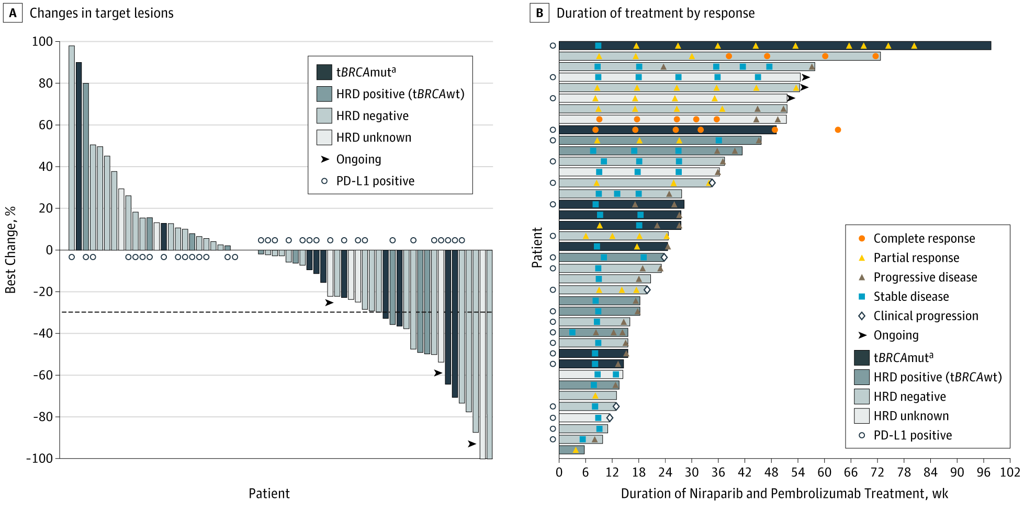
Niraparib and Pembrolizumab in Ovarian Cancer
JAMA Oncol. 2019;5(8):1141-1149. doi:10.1001/jamaoncol.2019.1048

Slide 31
Olaparib and Bevacizumab First Line PAOLA 1 trial
Ray Coquard, NEJM, 2020

Slide 32
Synergy between Bevacizumab and PARPi Highest
in HRD tumors: PAOLA1

Slide 33
PARP inhibitors take home message
New class of drugs very active in ovarian cancer
Three inhibitors approved: olaparib, rucaparib and niraparib
Slight differences in indication profiles
Differences in toxicity profiles
Highest activity in patients carrying BRCA mutations and HRD tumors
Now approved for use in the first line setting
Research is ongoing in the area of PARP inhibitor resistance and new combinations
PARP inhibitors and COVID-19: one of the safest options (no significant immunosuppression, less frequent visits)

Slide 34
THANK YOU

Slide 35
Side Effect Profiles and Management Strategies For PARP Inhibitors
Presented to: Insert relevant presenter information Calibri 16pt
Presented on: Month day, Year
Presented by: Insert relevant presenter information here
Presented on: October 2021
Presented by: Karen L Novak RN, MSN, ACNP-BC

Slide 36
LYNPARZA (OLAPARIB)
Indication for Use:
First line maintenance treatment for women with deleterious or suspected germline or somatic BRCA mutation with advanced epithelial ovarian, fallopian tube or primary peritoneal cancer who are in complete/partial response
Maintenance for recurrent advanced epithelial ovarian, fallopian tube or primary peritoneal cancer who had a complete/partial response to platinum based chemotherapy
For patients with deleterious or suspected germline BRCA with advanced epithelial ovarian, fallopian tube, or primary peritoneal cancer that have been treated with 3 or more prior lines of chemotherapy
Notes:
Deleterious mutations- genetic alteration that increases an individuals susceptibility or predisposition to a certain disease or disorder
Somatic mutation- an alteration in DNA that occurs after conception, somatic mutations can occur in any of the cells of the body except germ cells
Germline mutations- a gene alteration in a bodies reproductive cell that becomes incorporated in every cell in the body ( passed down from parents).
Cost of Lynparza per month: $14, 282

Slide 37
ZEJULA (NIRAPARIB)
Indications for Use:
Maintenance treatment for women with advanced epithelial ovarian, fallopian tube or primary peritoneal cancer in complete/partial response to first-line platinum based chemotherapy
Recurrent advanced epithelial ovarian, fallopian tube, or primary peritoneal cancer who had complete/partial response to platinum therapy
Patients with advanced ovarian, fallopian tube, or primary peritoneal cancer that have been treated with 3 or more prior chemotherapy regimens and whose cancer is associated with homologous recombination deficiency
A deleterious or suspected deleterious BRCA mutation or genomic instability who progressed > 6 months after response to last platinum based chemotherapy
Notes:
Niraparib is the cheapest of the parp inhibitors costing a mere $5650 per month

Slide 38
RUBRACA (RUCAPARIB)
Indications For Use:
Maintenance treatment for recurrent advanced epithelial ovarian, fallopian tube, and primary peritoneal cancer who are in complete or partial response to platinum –based chemotherapy
For the treatment of patients with deleterious BRCA mutation (germline and/or somatic)- associated with epithelial ovarian, fallopian tube, or primary peritoneal cancer who have been treated with 2 or more chemotherapies
Notes:
If you miss a dose or vomit a dose you should take your pills at your next scheduled time, do not make up the dose

Slide 39
LYNPARZA (OLAPARIB) Side Effect Profile
Grade 1-4 Toxicities Based on SOLO-1 and PAOLA-1 Trials
Nausea- 65%
Fatigue- 60%
Vomiting- 31%
Dyspepsia- 17% Diarrhea- 37%
Anemia-38%
Thrombocytopenia- 23%
Neutropenia- 34%
Abdominal pain- 45%
Renal Impairment- 47%
Diminished appetite/taste changes- 20%
Pneumonitis- 0.8%
Myelodysplastic syndrome- 1.5%
Notes:
Major side effects of from combined trials
For all 3 parp inhibitors mentioned nausea/vomiting/fatigue are the 3 biggest reported side effects
Pneumonitis and MDS continue to be rare side effects with < 3% of patients reporting any incidence
If you develop a dry persistent cough and shortness of breath report immediately as this is an early sign of pneumonitis
If you develop easy bruising/pinpoint red dots under the skin, worsening severe fatigue, worsening weakness, unusual paleness, please report those symptoms as well as they are an early sign of MDS

Slide 40
ZEJULA (NIRAPARIB)
Grade 1-4 Toxicities Based on PRIMA and QUADRA Trials
Nausea- 70%
Fatigue- 56%
Vomiting-40%
Anemia- 50%
Thrombocytopenia- 56%
Neutropenia- 34%
Dyspepsia- 18%
Constipation- 38%
Hypertension-6% (specific to Niraparib)
Myelodysplastic syndrome- 0.9%

Slide 41
RUBRACA (RUCAPARIB)
Grade 1-4 Toxicities based on ARIEL 2, ARIEL 3, and TRITON2 Trials:
Rash-43% avoid sunlight and sun exposures while on Rubraca (Rucaparib)
Nausea- 76%
Fatigue- 74%
Abdominal pain- 46%
Vomiting- 41%
Constipation- 38%
Diarrhea-32%
Anemia- 41%
Thrombocytopenia- 25%
Neutropenia- 20%
Hepatic impairment (elevated liver enzymes)- 29%
Notes:
Rubraca has increased skin toxicities- avoid sun exposures to avoid getting a dry erythematous rash on extremities and trunk.
If you miss a dose or vomit a dose you should take your pills at your next scheduled time, do not make up the dose

Slide 42
Side Effect Management Options
Nausea-Oral anti-emetic options: Lorazepam, Ondansetron, Granisetron, Prochlorperazine
Dyspepsia- TUMS, famotidine, omeprazole, dietary changes to avoid triggering foods
Fatigue- frequent naps, exercise, schedule important activities in the morning when energy levels are at their best, ask for help from support system
Constipation- senokot, miralax, Colace, magnesium citrate as needed/enema as needed
Shortness of breath- stop the PARP Inhibitor, present to clinic an exam and evaluation, CXR to assess the status of the lungs, consider oral steroid taper or initiation of an inhaler to assist with breath and refer to pulmonology as you may have pneumonitis
Hypertension- start low dose calcium channel blockers and diuretics if appropriate, daily home BP management, and refer patient to internist for further management of hypertension,
Rash- topical benadryl and hydrocortisone creams (1%) or prescription strength hydrocortisone cream (2%), if persistent refer to Onco Dermatology and consider Medrol dose pack
Persistent pancytopenia- persistent lowered white count, hemoglobin or platelets, worsening bruising and petechia, worsening fatigue - come in for repeat labs, exam and evaluation and referral to benign hematology
Dose reductions if necessary

Slide 43
LYNPARZA (OLAPARIB) Appropriate Dose Adjustments
Based on SOLO-1 and PAOLA-1 trials
Normal dose: 300mg (150mg tablets) take ii tablets by mouth twice daily with or without food
If renally impaired (CrCL 31-50) start with 200mg by mouth twice daily
Dose intolerance secondary to side effects:
Decrease dose to 250mg by mouth twice daily
Decrease dose to 200mg by mouth twice daily
Discontinue dose
Labs:
Before starting your medication and then monthly while on medication
**will do weekly or every other week CBC and CMP for majority of our patients because of previous exposure to chemotherapy
Notes:
If you miss a dose or vomit a dose you should take your pills at your next scheduled time, do not make up the dose

Slide 44
ZEJULA (NIRAPARIB) Appropriate Dose Adjustments
Based on PRIMA and QUADRA trials
If patients weight is < 170# or platelet count is < 150 the manufacturer recommends starting with 200mg I tablet by mouth daily
If patients weight is >170# or platelet count is > 150 the manufacturer recommends starting with 300mg I tablet by mouth daily
Take with or without food
If patient has moderate hepatic impairment the starting dose should be reduced to 200mg I tablet by mouth daily
Notes:
If you miss a dose or vomit a dose you should take your pills at your next scheduled time, do not make up the dose

Slide 45
ZEJULA (NIRAPARIB) Appropriate Dose Adjustments
Based on PRIMA and QUADRA trials
For persistent pancytopenia you should dose reduce as follows:
First dose reduction from 300mg to 200mg I tablet by mouth daily
Second dose reduction from 200mg to 100mg I tablet by mouth daily
Third dose reduction is discontinuation of the drug
Any grade 3 adverse reaction lasting > 28 days you should consider discontinuing the drug
If the patient can resolve the grade 3 adverse reaction < 28 days you can restart the drug but dose reduce by 100mg
If platelet count < 100 hold dose until > 100 then resume dose or if platelet count < 75 for > 28 days you can resume medication with 100mg dose reduction
Notes:
If you miss a dose or vomit a dose you should take your pills at your next scheduled time, do not make up the dose

Slide 46
ZEJULA (NIRAPARIB) Appropriate Dose Adjustments
Based on PRIMA and QUADRA trials
If Neutrophil count < 1000/mcl or HGB < 8.0 g/dl you should hold until Neutrophil count > 1500/mcl or HGB > 9.0 g/dl
Resume at 100mg dose reduction or discontinue if Neutrophil count and HGB do not recover > 28 days
**Obtain CBC and CMP weekly for 1 month and then monthly for the remainder of time on the PARP I
Notes:
If you miss a dose or vomit a dose you should take your pills at your next scheduled time, do not make up the dose

Slide 47
RUBRACA (RUCAPARIB) Appropriate Dose Reductions
Based on ARIEL 2, ARIEL 3, and TRITON2 trials
Starting dose is 600mg (300mg tablets) by mouth twice daily
Take with or without food
First dose reduction- 500mg by mouth twice daily
Second dose reduction -400mg by mouth twice daily
Third dose reduction- 300mg by mouth twice daily
Discontinue drug after third dose reduction
**CBC and CMP before treatment and then monthly
Notes:
If you miss a dose or vomit a dose you should take your pills at your next scheduled time, do not make up the dose

Slide 48
Not So Fun PARP Inhibitor Fact
Cost of PARP Inhibitors without patient assistance programs
Lynparza (Olaparib) $14,286 per month
Zejula (Niraparib) $5, 650 per month
Rubraca (Rucaparib) $16,808 per month
Notes:
If you miss a dose or vomit a dose you should take your pills at your next scheduled time, do not make up the dose

Slide 49
Questions?

Slide 50
Tumor Molecular Testing: Beyond BRCA and PARPs
Edward Tanner, MD
Division of Gynecologic Oncology

Slide 51
Tumor Molecular Testing
Tailor treatments to characteristics of each patient’s cancer (precision medicine)
The promise:
Find new/unexpected treatments
Avoid ineffective and toxic treatments
A work in progress…

Slide 52
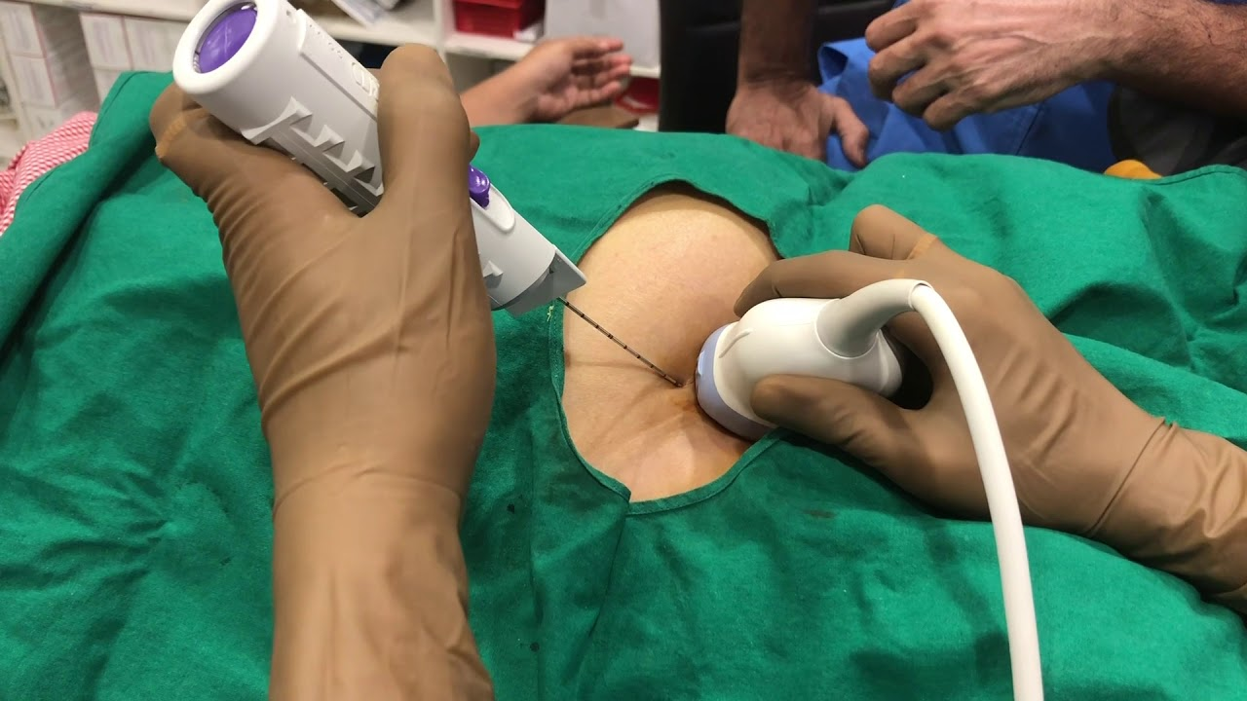
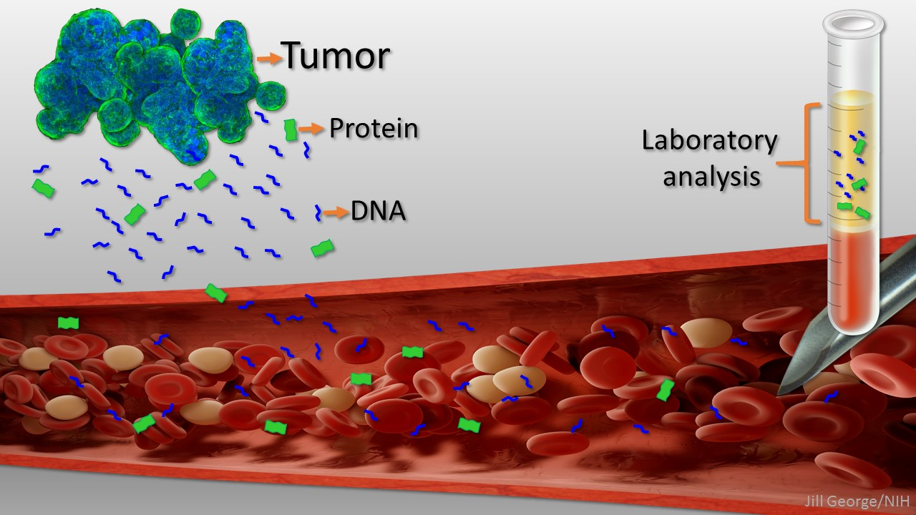
Somatic Mutation Testing
Must test the tumor
Direct tumor biopsy
Tumor cells in blood stream (liquid biopsy)

Slide 53
Somatic Mutation Testing: Next Generation Sequencing (NGS)
Several commercial tests available
General testing concepts:
Assess DNA of tumors
Assess RNA of tumors
Assess other functional aspects of tumor
Generally covered by insurance
And many more…
No specific
endorsements

Slide 54
How is this useful?
Not useful for all patients (yet)
Several ways to impact treatment:
Hereditary tumors and hereditary-like tumors
Response to new targeted drugs
Standard chemotherapy sensitivity
Clinical trial enrollment

Slide 55
Hereditary Tumors
BRCA mutations (hereditary and somatic)
Treatments: PARP inhibitors
Tumor types: breast, ovary, pancreas, prostate

Slide 56
Response to Specific Targeted Therapies
Two types of targets/therapies:
Tumor site independent
Tumor site dependent
FDA-approved tumor site independent treatments:
NTRK: entrectinib (NTRK inhibitor)
MMR deficient/MSI-H: pembrolizumab (checkpoint inhibitor)
FDA-approved ovarian cancer specific targeted therapies:
PARP inhibitors (HRD positive)

Slide 57
Tumor Site Independent Targeted Therapies
NTRK fusion mutations
Frequency: 2.2% of adult/peds solid tumors
Hard to assess true rate in ovarian cancer (low)
Entrectinib (NTRK inhibitor)
Three clinical trials: overall response rate → 79%
Responses are long: 35 month average
Treatment is tolerable
NTRK fusion mutations now included in most NGS platforms

Slide 58
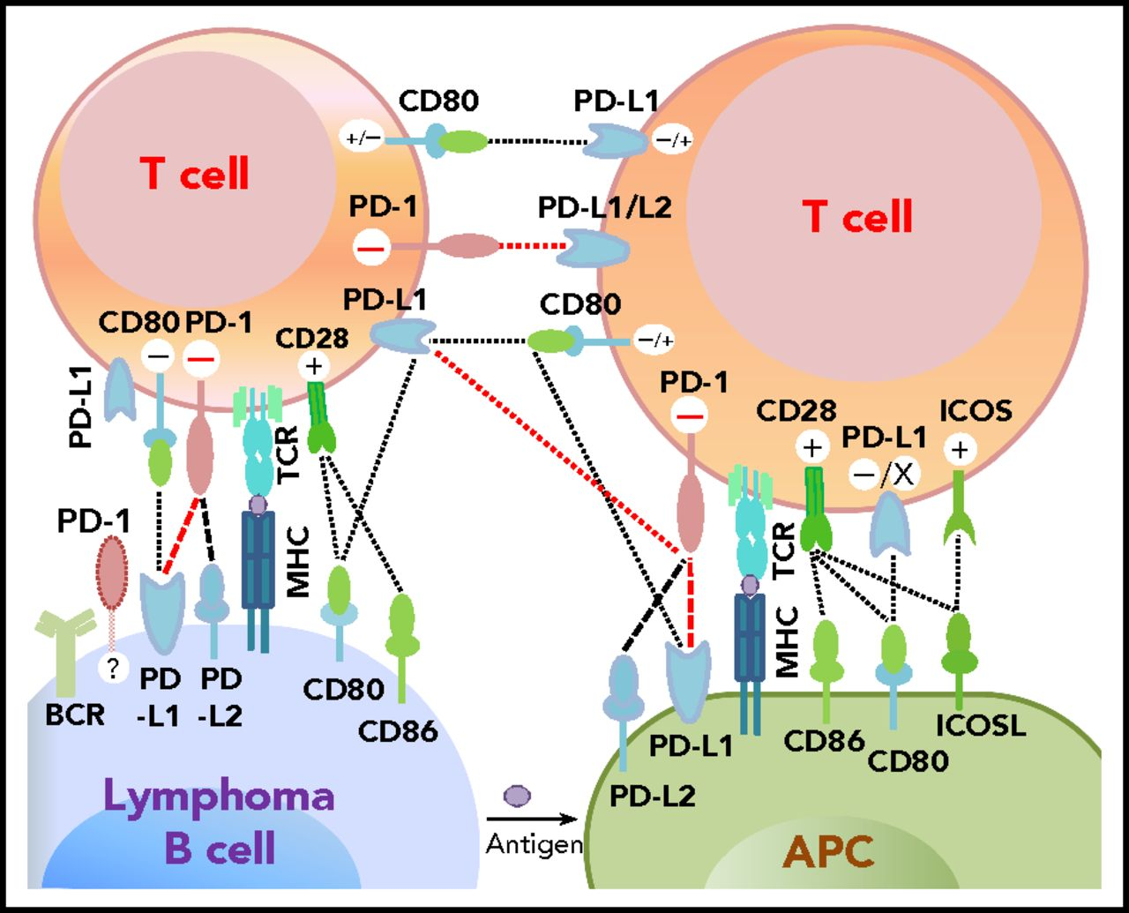
Tumor Site Independent Targeted Therapies
DNA MMR deficient/MSI-H tumors/high TMB
Frequency in ovarian cancer: 2%
Non-serous histology: up to 20%
Pembrolizumab (checkpoint inhibitor)
Overall response rate → 29%
Responses are long lasting (57% > 12 months)
Other indications: PD-1+ cervix, gastric, and lung cancers (not ovary)

Slide 59
Tumor Site Dependent Targeted Therapies
One specifically for ovarian cancer:
Outcome of inability to repair DNA damage:
Homologous recombination deficiency (HRD)
BRCA mutations → inability to repair DNA damage → sensitivity to PARP (look at cause of problem)
HRD → large genome rearrangements → sensitivity to PARP (look at effect of problem)
50% of women with advanced ovary ca have HRD
Germline/somatic BRCA mutation: 20%
HRD by other mechanisms: 30%

Slide 60
Tumor Site Dependent Targeted Therapies
Olaparib & bevacizumab:
PAOLA-1 trial:
First line chemotherapy & bevacizumab with planned bevacizumab maintenance for 12 months
Randomized to olaparib (2 years) versus placebo
Progression free survival in HRD patients:
Olaparib: 37.2 months
Placebo: 17.7 months
Olaparib approved in combination with bevacizumab for maintenance when given with bevacizumab following partial/complete response to 1st line chemotherapy in HRD ovarian cancer patients (even if no BRCA mutation)

Slide 61
Tumor Site Dependent Targeted Therapies
Lots of tumor site specific treatments outside ovarian cancer:
Her-2: trastuzumab (Herceptin) for breast and uterine cancers
BRAF/MEK: MEK inhibitors (low grade ovarian cancer, melanoma, some lung cancers)
EGFR: EGFR-TKI instead of chemotherapy ( non-small cell lung cancer)
DNA MMR retained: pembro/lenvatinib (endometrial cancer)

Slide 62
Tumor Site Dependent Targeted Therapies
Some promising treatments are not yet ready for routine use for ovarian cancer:
HDAC inhibitors: possible mutations → ARID1A (clear cell?), p53 (esp. serous tumors)
WEE1 inhibitors: possible mutations → p53
Gemcitabine +/- adavosertib: PFS 4.6 versus 3.0 months (94% p53+ tumors)
Many more being tested

Slide 63
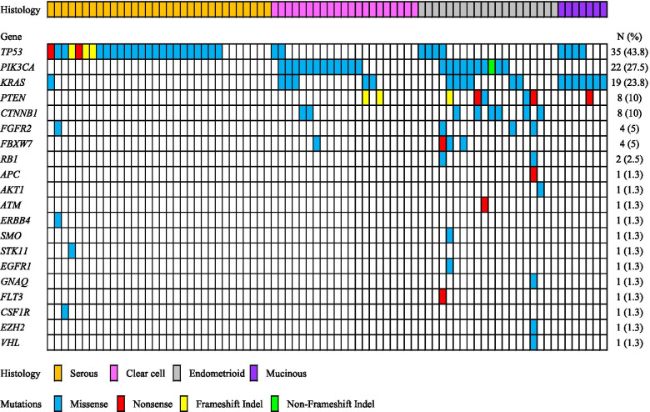
Tumor Site Dependent Targeted Therapies
Do the mutations match up with drugs?
Many mutations occur infrequently

Slide 64
Clinical Trials
May find mutations that qualify for a trial
Disease specific trials
Non-disease specific trials (more common)
Often early phase trials
NGS reports often list available trials at the time that the test was ordered
Patients may need to travel for trials

Slide 65
How Can I Use This Information?
Ask your doctor about tumor testing:
What kinds of tumor testing is appropriate for my tumor?
Is tissue available?
If not, would biopsy be possible?
If not, is liquid biopsy appropriate?
Are clinical trials available?

Slide 66
How Can I Use This Information?
Ask your doctor about clinical trials available based on molecular testing:
Clinical trial options change over time so ask again if there are mutations identified
You can find your mutations and search for trials on clinicaltrials.gov using the mutation as a search term

Slide 67
QUESTIONS?

