Slide 1
Ovarian Cancer Care and COVID-19
Daniela Matei, MD
Edward Tanner, MD

Slide 2
Disclosures
No disclosures

Slide 3
Objectives
Discuss impact of COVID-19 on patients with ovarian cancer
Update on new treatments for ovarian cancer and how these may be impacted by COVID-19
Review impact of COVID-19 on patients receiving standard ovarian cancer treatments

Slide 4
Impact of COVID-19 for Ovarian Cancer Patients
COVID-19 Impacts Entire Disease Spectrum
Diagnosis
Surgery
Systemic treatment
Surveillance
Notes:
COVID has impacted

Slide 5
Impact of COVID-19 for Ovarian Cancer Patients
Diagnosis
Diagnosis delay
Fear of going to provider
Testing unavailable
COVID-19 illness
Offices closed

Slide 6
Impact of COVID-19 for Ovarian Cancer Patients
Diagnosis – Lessons Learned
COVID did lead to diagnosis delays in the spring
Will this impact cancer survival?
46% reduction in new cancer diagnoses
Kaufman HW. JAMA Network Open, 2020.

Slide 7
Impact of COVID-19 for Ovarian Cancer Patients
Diagnosis - Lessons Learned
Symptoms of ovarian cancer are often missed even under normal circumstances
Very important for providers to listen to patients when symptoms are present:
Abdominal bloating/pressure
Fullness/inability to eat
Change in bowels
Telemedicine may bridge gap of face-to-face appointments in some cases

Slide 8
Impact of COVID-19 for Ovarian Cancer Patients
Surgery
Surgery deferred in many patients during early COVID surge:
Reduced OR capacity due to ICU needs
Lack of testing
Concern for COVID illness during postoperative recovery
Concern for COVID infection of hospital staff during high risk procedures (intubation, laparoscopy)

Slide 9
Impact of COVID-19 for Ovarian Cancer Patients
Surgery – Lessons Learned
Surgical capacity was drastically curtailed but urgent cases such as ovarian cancer surgery continued
Surgical capacity has now returned to baseline but we have made a lot of changes to improve safety
Limited data suggest patients undergoing surgery for gyn cancers are not at increased risk of COVID-19 infection
ORs
become ICUs

Slide 10
Impact of COVID-19 for Ovarian Cancer Patients
Surgery – Lessons Learned
All patients now undergo COVID testing 48-72 hours prior to surgery
Universal masking in hospital
N95/eye wear during high risk procedures or patients who are COVID+/COVID unknown → reduce staff exposure/infecting other patients while asymptomatic
Risk of mortality from COVID during surgical recovery is likely increased but preoperative testing will hopefully identify patients during early/asymptomatic phase

Slide 11
Impact of COVID-19 for Ovarian Cancer Patients
Systemic Treatment
Concern for increased risk of severe illness if COVID infection occurs during treatment
Initial data from China during early phase of pandemic:
205 patients from January to early March admitted with COVID-19
20% mortality
Higher risk with:
Chemotherapy within 30 days
Hematologic malignancies
Very few patients with ovarian cancer → no deaths
Study likely overstates risks due to only looking at patients admitted to hospital and lower testing rates at this time
Yang K. Lancet Oncology, 2020.

Slide 12
Impact of COVID-19 for Ovarian Cancer Patients
Systemic Treatment
Concern for increased risk of severe illness if COVID infection occurs during treatment
Risks may be different depending on the type of treatment patients are receiving
Despite COVID-19 pandemic, a lot of good news to share about ovarian cancer treatments!

Slide 13
Impact of COVID-19 for Ovarian Cancer Patients
Systemic Treatment – Lessons Learned
Risks of ovarian cancer treatments may be different:
Standard chemotherapy (carboplatin, paclitaxel, etc)
VEGF inhibitors (bevacizumab)
Immunotherapy (pembrolizumab)
PARP inhibitors

Slide 14
Impact of COVID-19 for Ovarian Cancer Patients
Systemic Treatment – Lessons Learned
Risks of standard ovarian cancer chemotherapy drugs:
Decrease white blood cell number/function
Increased risk of infection
COVID-19: decreased ability to fight secondary infections, especially pneumonia
Decreased platelets
Increased risk of bleeding and blood clots
COVID-19: increased risk of blood clots
COVID testing of all patients prior to
starting chemotherapy

Slide 15
Impact of COVID-19 for Ovarian Cancer Patients
Systemic Treatment – Lessons Learned
Early results of COVID-19 survival in women with gynecologic cancers from NYC are more reassuring:
121 COVID+ women, 46 with ovarian cancer
14% risk of hospitalization
10 developed severe COVID-19
Surgery and standard chemotherapy not associated
with increased risk of hospitalization/death
Some caveats:
Early phase of pandemic → less testing
Study only shows treatment not associated
with increased risk, not the cancer itself (but
hopefully not)
Lara OD. Cancer, 2020.

Slide 16
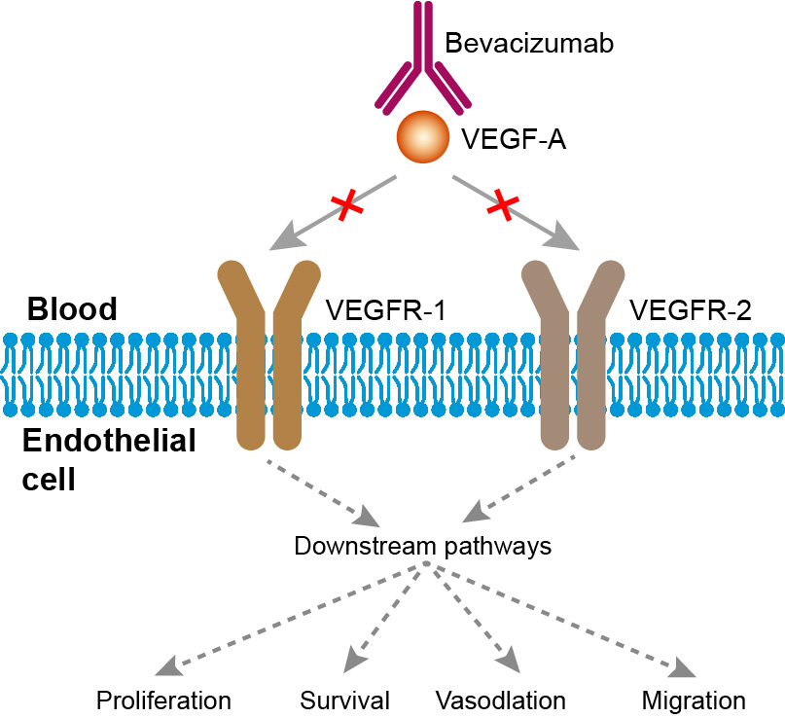
Impact of COVID-19 for Ovarian Cancer Patients
Systemic Treatment – Lessons Learned
Risks of VEGF inhibitors (bevacizumab):
Block blood vessel growth
No significant impact on standard immune cell function (white blood cells, etc.)
Increased risk of bleeding and clots
COVID-19 associated with higher levels of circulating VEGF
High VEGF levels are linked to pulmonary edema and respiratory distress
Hypothesis: reducing VEGF could decrease severity of COVID infection → trial ongoing in China as therapy for severe COVID

Slide 17
Impact of COVID-19 for Ovarian Cancer Patients
New Treatments
PARP inhibitors
Immunotherapy
Review some treatment updates and potential COVID-19 risks

Slide 18
DNA Repair—What is PARP?

Slide 19
PARP enzyme repairs single strand DNA breaks
PARP inhibitor

Slide 20
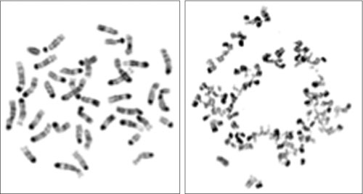
PARP inhibition in BRCA deficient cells
BRCA intact
BRCA mutated
BRCA2-mutant cells treated with a PARP inhibitor undergo massive chromosomal crisis due to the defect in DNA repair mechanisms.
Banerjee, Nature Reviews Clinical Oncology, 2010

Slide 21
1.0
Olaparib 400 mg po bid
0.9
Hazard ratio 0.35
(P<0.00001)
0.8
0.7
Treatment until disease progression
Probability of progression-free survival
Platinum
based therapy
0.6
0.5
0.4
Placebo po bid
0.3
0.2
Placebo
0.1
Olaparib
0
0
3
6
9
12
15
18
Time from randomization (months)
Olaparib was the first approved PARP inhibitor
Side effects include: fatigue, anemia, nausea
Recent conversion from capsules to tablets: easier to tolerate
Ledermann J et al. N Engl J Med 2012;366:1382–1392
Notes:
Jonathan Ledermann presented results of maintenance olaparib therapy in women who had had at least a PR following platinum based chemotherapy for plat sensistive disease

Slide 22
Survival by BRCA mutated status
1.0
0.9
0.8
0.7
0.6
Proportion of patients progression-free
0.5
0.4
0.3
Olaparib BRCAm
0.2
Placebo BRCAm
0.1
0
0
3
6
9
12
15
Time from randomization (months)
Highest benefit in patients with BRCA mutated tumors

Slide 23
Rucaparib in Ovarian Cancer
Second PARP inhibitor to be approved in BRCA mutated tumors
Best effects observed in BRCA mutated tumors, but benefit also noted
in patients identified using a genetic test.
Impressive response rates in tumor with BRCA mutations (80%)

Slide 24
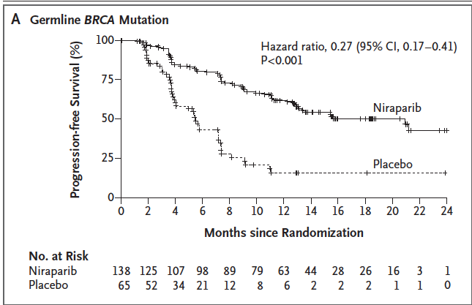
Niraparib 300 mg po qd
Platinum
based therapy
Treatment until disease progression
Placebo po qd
Third PARP inhibitor to be approved
Side effects include low blood counts, fatigue
Effects observed in BRCA mutated patients, but also in ALL patients
Mirza, NEJM, 2016
Notes:
Jonathan Ledermann presented results of maintenance olaparib therapy in women who had had at least a PR following platinum based chemotherapy for plat sensistive disease

Slide 25
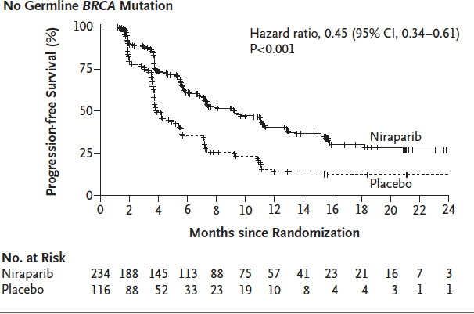
PARP inhibitors beyond BRCA mutations
Unexpected results show positive effects of niraparib in tumors without
BRCA mutations; leading to its unrestricted FDA approval
Mirza, NEJM, 2016

Slide 26
PARP Inhibitors in the upfront setting

Slide 27
PARP inhibitors vs. Chemotherapy SOLO 3 trial

Slide 28
Ongoing PARP inhibitors Clinical Trials
GOG3005: Carboplatin + paclitaxel +/- veliparib after surgery (No BRCA mutation selection)—accrual completed
NRG GY004: Olaparib, olaparib + cediranib vs. standard of care chemotherapy for platinum sensitive recurrent ovarian cancer
NRG GY005: Olaparib, olaparib + cediranib vs. standard of care chemotherapy for platinum resistant ovarian cancer
FIRST trial: Niraparib in upfront setting (BRCA mutated and not mutated)
PAOLA trial: olaparib and bevacizumab in the upfront setting (BRCA mutated and not mutated)
Other combinations: PARP inhibitors and immunotherapy

Slide 29
PARP inhibitors take home message
New class of drugs very active in ovarian cancer
Three inhibitors approved: olaparib, rucaparib and niraparib
Slight differences in indication profiles (active treatment vs. maintenance treatment)
Differences in toxicity profiles
Highest activity in patients carrying BRCA mutations
A new test may become available to identify patients who could respond to PARP inhibitors in the absence of a BRCA mutation.
Research is ongoing

Slide 30
The future is here
FIRST and PAOLA Trial being reported this weekend
at ESMO in Barcelona—anticipation is high!
Combination niraparib+bevacizumab vs. niraparib alone in ovarian cancer
ASCO 2019

Slide 31
PARP inhibitors: Questions for the future
Which PARP inhibitor to use?
Which patients benefit form PARP inhibitors and when?
Can PARP inhibitors be combined with other drugs?
How toxic are PARP inhibitors?
Are there long term side effects?
Do tumors become resistant to PARP inhibitors?
What options are there beyond the PARPs?

Slide 32
Immunotherapy: How does the immune system work?

Slide 33
How does the immune system work?

Slide 34
Mechanism by which tumor cells evade the immune system

Slide 35
How to unblock anti-tumor immunity: Anti-PD1
Examples: Pembrolizumab approved for lung cancer, melanoma, renal cancer,
Nivolumab

Slide 36
How to unblock anti-cancer immunity anti-PDL1
Examples: atezolizumab—approved for bladder cancer

Slide 37
How to unblock anti-cancer immunity anti-PDL1
Anti-PD1 inhibitor
Anti-PD1 inhibitor

Slide 38
Immunotherapy in Ovarian Cancer
Avelumab: anti PD-L1
Recurrent ovarian cancer
N=75
Response rate: 8 (10%)
Stable disease: 44%
Serious toxicity: 6
Pembrolizumab: anti PD1
Recurrent ovarian cancer
N=26
Response Rate: 3 (11%)
Stable disease: 23%
Serious toxicity: 2
Modest activity: need to boost effects of immunotherapy by using novel combinations
Mary Disis, ASCO 2015
Andrea Varga, ASCO 2015

Slide 40
Novel combinations with immunotherapy at Northwestern University and Univ. of Chicago
Hypothesis: Use of drugs that affect the genomic make up of tumors can elicit immune responses to enhance effects of immune therapy.
Trial: An open label phase II trial of guadecitabine and pembrolizumab in platinum resistant recurrent ovarian cancer:
Activate
Tumor cells
Activate immune cells
Daniela Matei, PI

Slide 41
Phase II study of pembrolizumab in combination with carboplatin and paclitaxel for advanced endometrial adenocarcinoma Big Ten Cancer Research Consortium BTCRC-GYN15-013
Hypothesis:
Combination chemotherapy and immunotherapy is more effective than chemotherapy alone for patients with advanced endometrial cancer.
Study design:
Standard chemotherapy + pembrolizumab in recurrent or advanced endometrial cancer
Objectives:
To estimate the response rate
To determine the toxicities
To measure immune response in tumor samples
PI: Dr. Pineda/Matei

Slide 42
Immunotherapy-take home message
New class of drugs very active in cancer
Toxicity profiles includes immune effects (rash, arthritis, diarrhea)
Efficacy in gynecologic tumors is modest at this time
Patients who respond have long remissions
Duration of treatment remains unclear
Research ongoing to identify combinations that may boost the effects of immunotherapy in ovarian cancer and to define ways to find patients likely to benefit from immunotherapy.

Slide 43
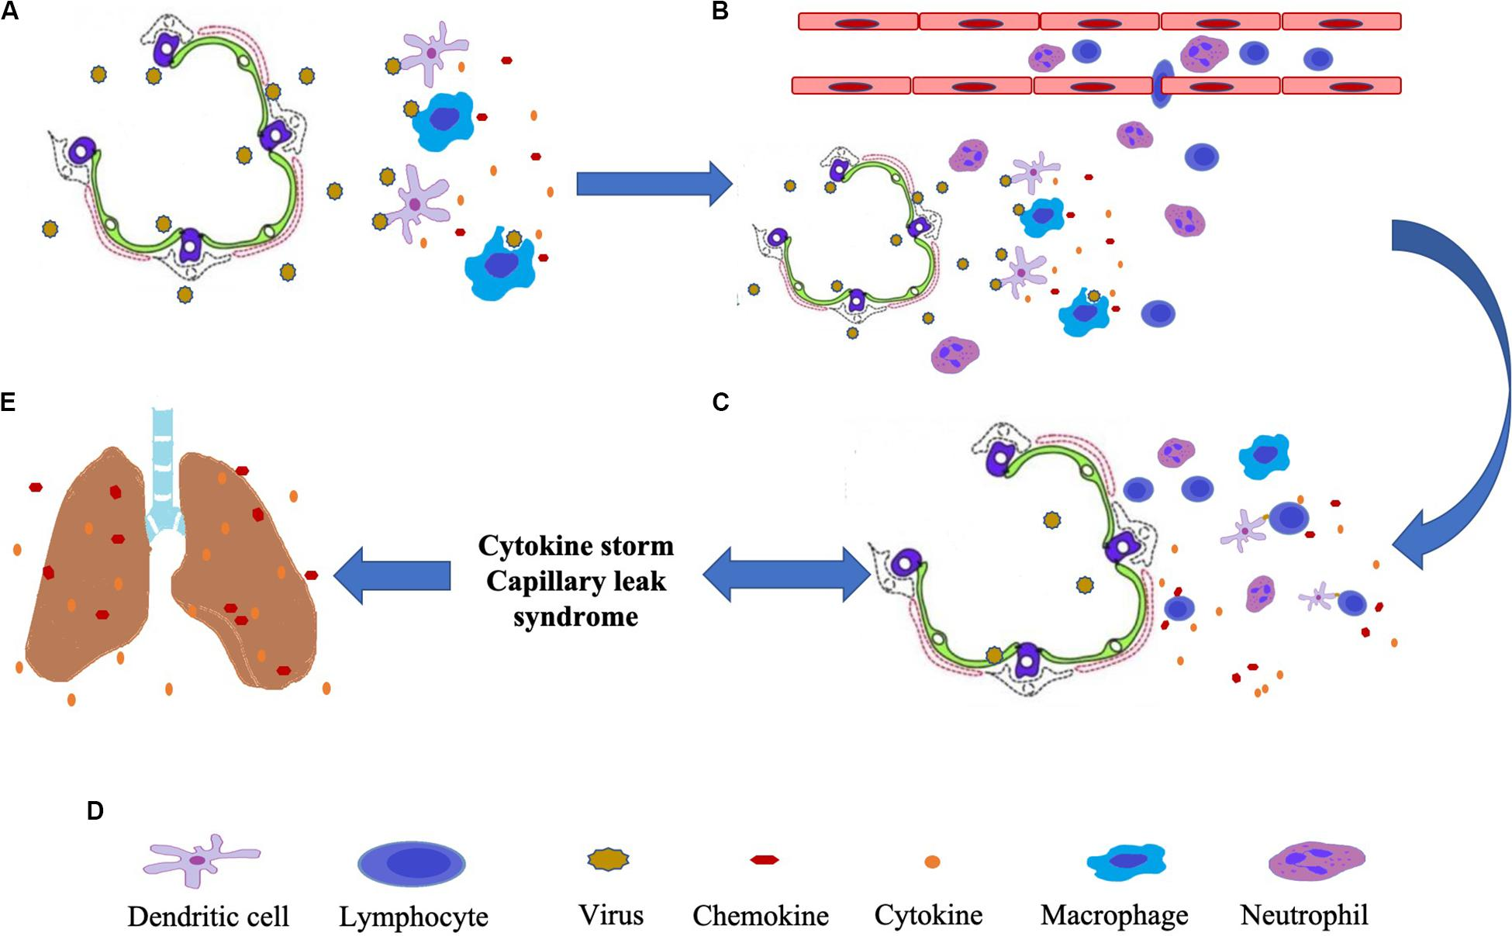
Impact of COVID-19 for Ovarian Cancer Patients
Systemic Treatment – Lessons Learned
Pembrolizumab may increase the severity of COVID-19 infection
Study from New York City:
Immunotherapy associated with 3.5 fold increased risk of hospitalization/death with COVID-19 infection
Why would immunotherapy
increase severity of COVID-19
infection?
Cytokine storm – autoimmune response?

Slide 44
Impact of COVID-19 for Ovarian Cancer Patients
Systemic Treatment – Lessons Learned
All patients receive COVID testing before beginning chemotherapy
Limiting visitors during treatment sessions
Visitor screening
Low threshold for re-testing

Slide 45
Impact of COVID-19 for Ovarian Cancer Patients
Surveillance
Clinic visits and testing increase exposure
Can we perform some surveillance with telemedicine?
Balancing risks of exposure versus early detection of recurrence and managing patient symptoms

Slide 46
Impact of COVID-19 for Ovarian Cancer Patients
Surveillance – Lessons Learned
Protecting patients in clinic:
Universal masking
Eyewear for providers
Universal symptom and temperature screening
Telemedicine visits
Effectiveness
Patient preference
Utility in surveillance setting
When are patients out of increased COVID risk with a history of cancer?

Slide 47
THANK YOU

