Slide 1
Have no Fear- Help is Here SEXUAL HEALTH AFTER GYNECOLOGIC CANCER
Traci Kurtzer MD & Rajal Patel MD
Center for Sexual Medicine and Menopause
Northwestern Medicine

Slide 2
Sexual Health after Treatment for Gynecologic Cancer
Immediate:
Physical effects
Psycho-social effects
Short Term:
Role of Hormones
Ongoing physical and psychosocial effects
Long Term:
Anatomic changes

Slide 3
Immediate Cancer Treatment Effects
Physical
Psycho-social
Post op “pelvic rest”
Post op pain
Fatigue/Malaise
Tx side effects
Focus on treatment/recovery
Fear/Partner avoidance
Depression/anxiety

Slide 4
Sexual Health after Treatment for Gynecologic Cancer
Immediate:
Physical effects
Psycho-social effects
Short Term:
Role of Hormones
Ongoing physical and psychosocial effects
Long Term:
Anatomic changes

Slide 5
Hormones
Many aspects of gynecologic cancer care can lead to deficiencies in estradiol, progesterone, testosterone:
Uterine and Ovarian cancer - surgical treatment and/or chemotherapy
Prophylactic BSO for BRCA mutations
Chemotherapy for breast cancer
SERMS/Aromatase inhibitors for breast cancer
Vasomotor symptoms => disrupted sleep, low energy
Decreased stimulation of the sex drive centers in the brain
> Metabolic changes/Weight gain
Decreased arousal (engorgement and lubrication) and orgasm
Vulvo-vaginal dryness, atrophy and dyspareunia (pain with sex)

Slide 6
Low Libido
Low body self image
Low Testosterone
Low energy
Painful Sex
Diminished Orgasm

Slide 7
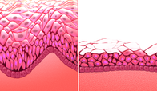
Causes of Painful Sex/Intercourse
1. Genitourinary Syndrome of Menopause (GSM)
Thinning of the vulvar and vaginal mucosal wall leading to abrasions, micro-lacerations, fissures with friction and pressure from intercourse
Decreased natural lubrication increases dryness and friction during penetrative intercourse or with touch
These changes also occur in lower urinary tract (urethra) which can increase symptoms of irritated voiding and risk for UTI
Clitoral atrophy/Decreased orgasm => lack of positive reinforcement for drive
2. Vaginal Stenosis or Shortening
3. Pelvic Floor Muscle Tension
Photo VVA histology

Slide 8
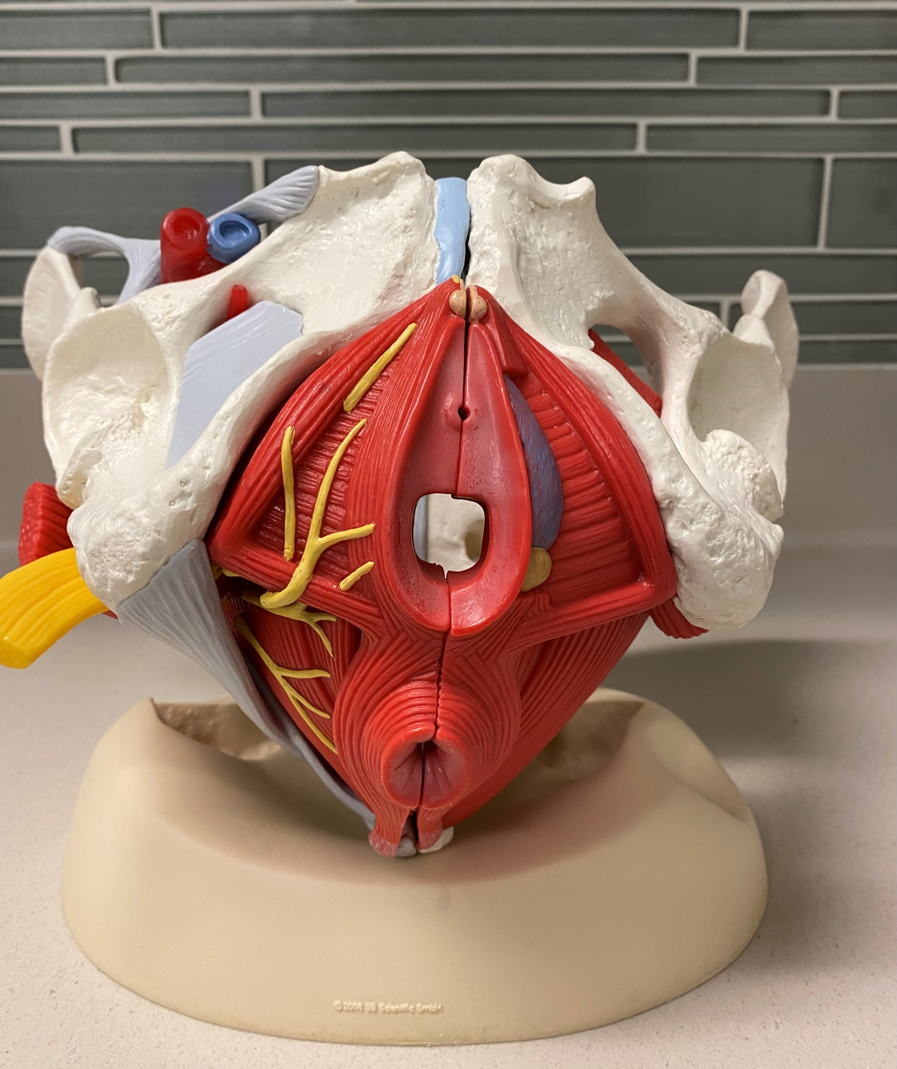
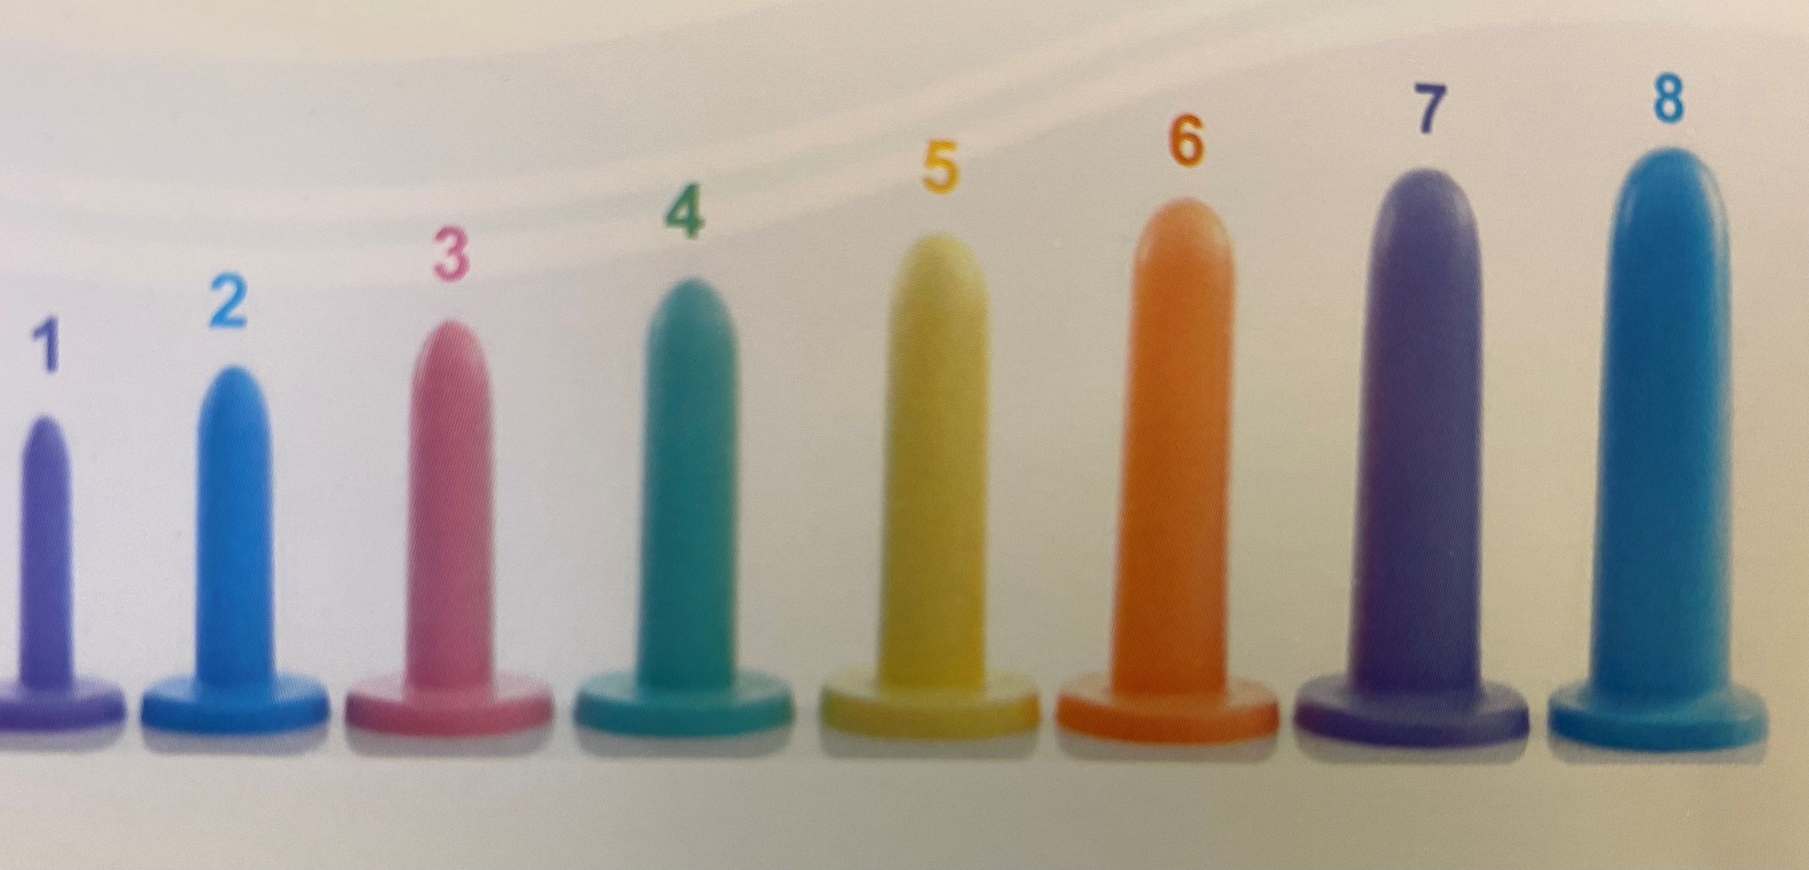
Treatments
Painful Intercourse
Vaginal dryness/GSM/VVA
- Vaginal/vulvar moisturizers
- Vaginal estradiol
- Vaginal DHEA
- Oral SERM- ospemifene
- Vulvovaginal laser therapy
Post-op shortening/stenosis
Vaginal dilators
Pelvic floor tension
- Pelvic floor PT

Slide 9
Treatments for Low Libido
Treat hormone deficiency symptoms for improved sleep, energy, weight
Low dose estradiol
SSRI/SSNRIs
Testosterone *
Gabapentin *
Testosterone *
Stellate ganglion block *
Acupuncture (limited studies) *
CBD/THC ? *
Treat painful intercourse
GSM/VVA
Stenosis/shortened vagina
Pelvic floor muscle tension
Treat Inhibited Drive Centers
- Sex therapy
- Psychotherapy
- Trauma therapy
- Medications
* Not FDA approved
Hormone Deficiency
Inhibited Drive Centers
Painful Intercourse

Slide 10
Sexual Health after Treatment for Gynecologic Cancer
Immediate:
Physical effects
Psycho-social effects
Short Term:
Role of Hormones
Ongoing physical and psychosocial effects
Long Term:
Post surgical changes

Slide 11
Surgical /Radiation Anatomic Sequelae
High grade squamous epithelial lesion of Vulva
Adenocarcinoma cervix
Radiation changes from childhood cancer therapy

Slide 12
Center for Sexual Medicine and Menopause Lavin Suite 2450 312-694-9676 www.sexmedmenopause.nm.org

