Slide 1
Immunotherapy in Endometrial Cancer: Expanding Horizons
Emily Hinchcliff MD MPH
Assistant Professor, Gynecologic Oncology
Northwestern University Feinberg School of Medicine
Robert H Lurie Comprehensive Cancer Center

Slide 2
OUTLINE
Genetic testing: You and Your tumor
How testing impacts the treatment of endometrial cancer
Immunotherapy
Side effects to watch for
Clinical trials – are clinical trials right for you?
A quick reminder: MyActivity Study

Slide 3
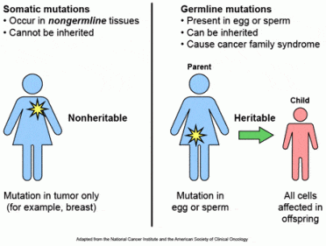
Mutation types

Slide 4
What is the Importance of Genetic Testing?
  Germline Testing
  Can learn whether you have a genetic condition that runs in the family and can be passed to your children
  Can learn your risk for other cancers (i.e. colon and ovary) and implement cancer prevention strategies
  Somatic Testing
  Can determine the potential immunogenicity of tumors
  Can discover targetable mutations
  Certain mutations can impact prognosis
  Assess eligibility for clinical trials that are open to select tumor mutations

Slide 5
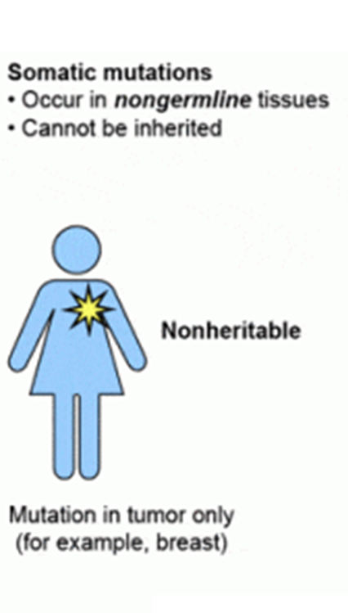
Mismatch Repair Testing
Type of testing: Somatic Testing
What is tested: Specifically looks for mutations in 4 genes (MLH1, MSH2, MSH6, PMS2)
When is it done: Analysis is performed routinely from primary surgical/biopsy specimen
Significance:
  Mismatch Repair is deficient (MMRd) in 20-40% of endometrial cancers.
  Certain mutations can be associated with Lynch Syndrome
Importance:
  MMRd tumors may respond better to immune therapies
  Certain mutations should warrant germline testing for Lynch Syndrome

Slide 6
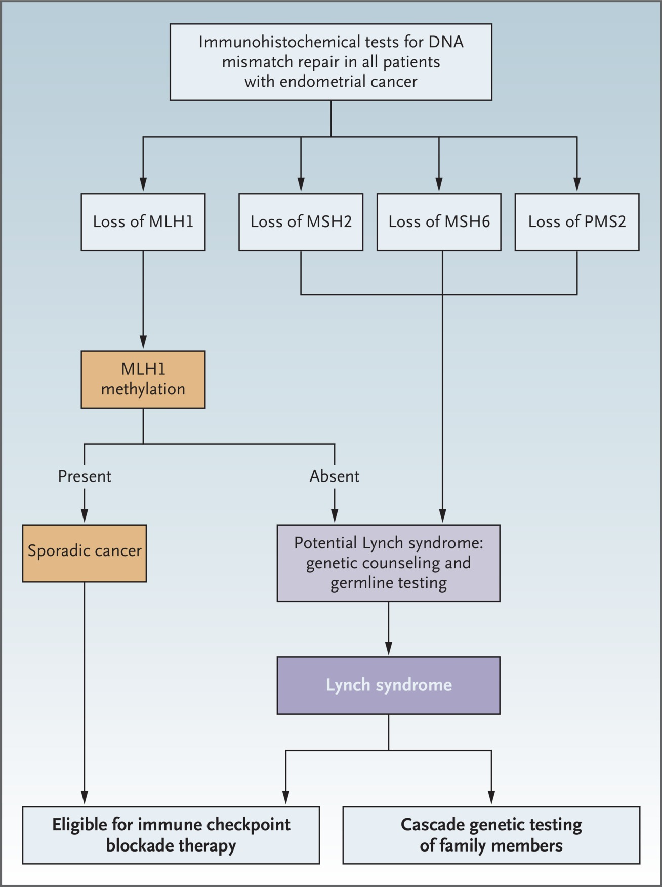
Mismatch Repair Testing
Type of testing: Somatic Testing
What is tested: Specifically looks for mutations in 4 genes (MLH1, MSH2, MSH6, PMS2)
When is it done: Analysis is performed routinely from primary surgical/biopsy specimen
Significance:
  Mismatch Repair is deficient (MMRd) in 20-40% of endometrial cancers.
  Certain mutations can be associated with Lynch Syndrome
Importance:
  MMRd tumors may respond better to immune therapies
  Certain mutations should warrant germline testing for Lynch Syndrome
Lu KH, Broaddus RR. N Engl J Med 2020;383:2053-2064

Slide 7
Next Generation Sequencing (NGS)
Type of testing: Somatic Testing
What is tested: Uses a commercial panel to look for mutations in dozens of genes
When is it done: Analysis is performed at the request of your oncologist. It is ordered from a prior surgical/biopsy specimen (*usually no need for any more biopsies).
Significance:
  Unclear at this time
  May offer new treatment options
    Certain therapies target specific mutations
  May provide prognostic information
  May open eligibility to clinical trials

Slide 8









Somatic Testing Panels (aka Next Generation Sequencing)

Slide 9
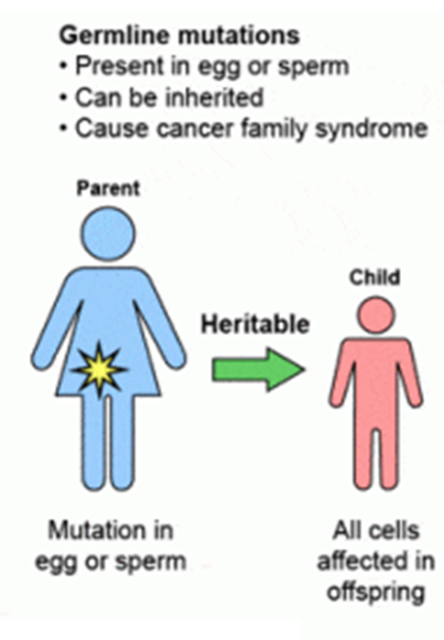
Germline Mutations
Germline Testing: Lynch Syndrome)
Type of testing: Germline Testing
What is tested: Blood or Saliva
When is it done: Analysis is performed selectively for at risk patients.
  It is usually ordered after consultation with a Genetics Counselor
  Strong family history of cancer
  Concern for Lynch Syndrome based on MMR testing
Significance:
  Lynch Syndrome is found in 2-3% of patients with endometrial cancer.
Importance:
  Patients with Lynch Syndrome are at risk for other cancers (colorectal, stomach, ovary, pancreas, liver, kidney)
  Children have a 50% chance of having Lynch Syndrome as well

Slide 10


Germline Testing Panels

Slide 11
Now, to turn to the main topic of the day:
Immunotherapy in Endometrial Cancer

Slide 12
Precision Medicine
The goal: Tailor treatments to genetic changes in each patient’s cancer
The hope:
  Find new treatments
  Avoid ineffective and toxic treatments
The current status: A work in progress

Slide 13
How is this useful
Not (yet) useful for all patients
Currently several classes of treatments:
  BRCA (and BRCA-like) mutations: PARP
  Immunogenic tumors: immunotherapy
  Targeted therapies to specific mutations
  Clinical trial enrollment

Slide 14
Immunogenic tumors
Several types:
  Lynch genes (MLH1, MSH2, MSH6, PMS2)
  High PD-1 expression
  High tumor mutation burden
Treatments: checkpoint inhibitors

Slide 15
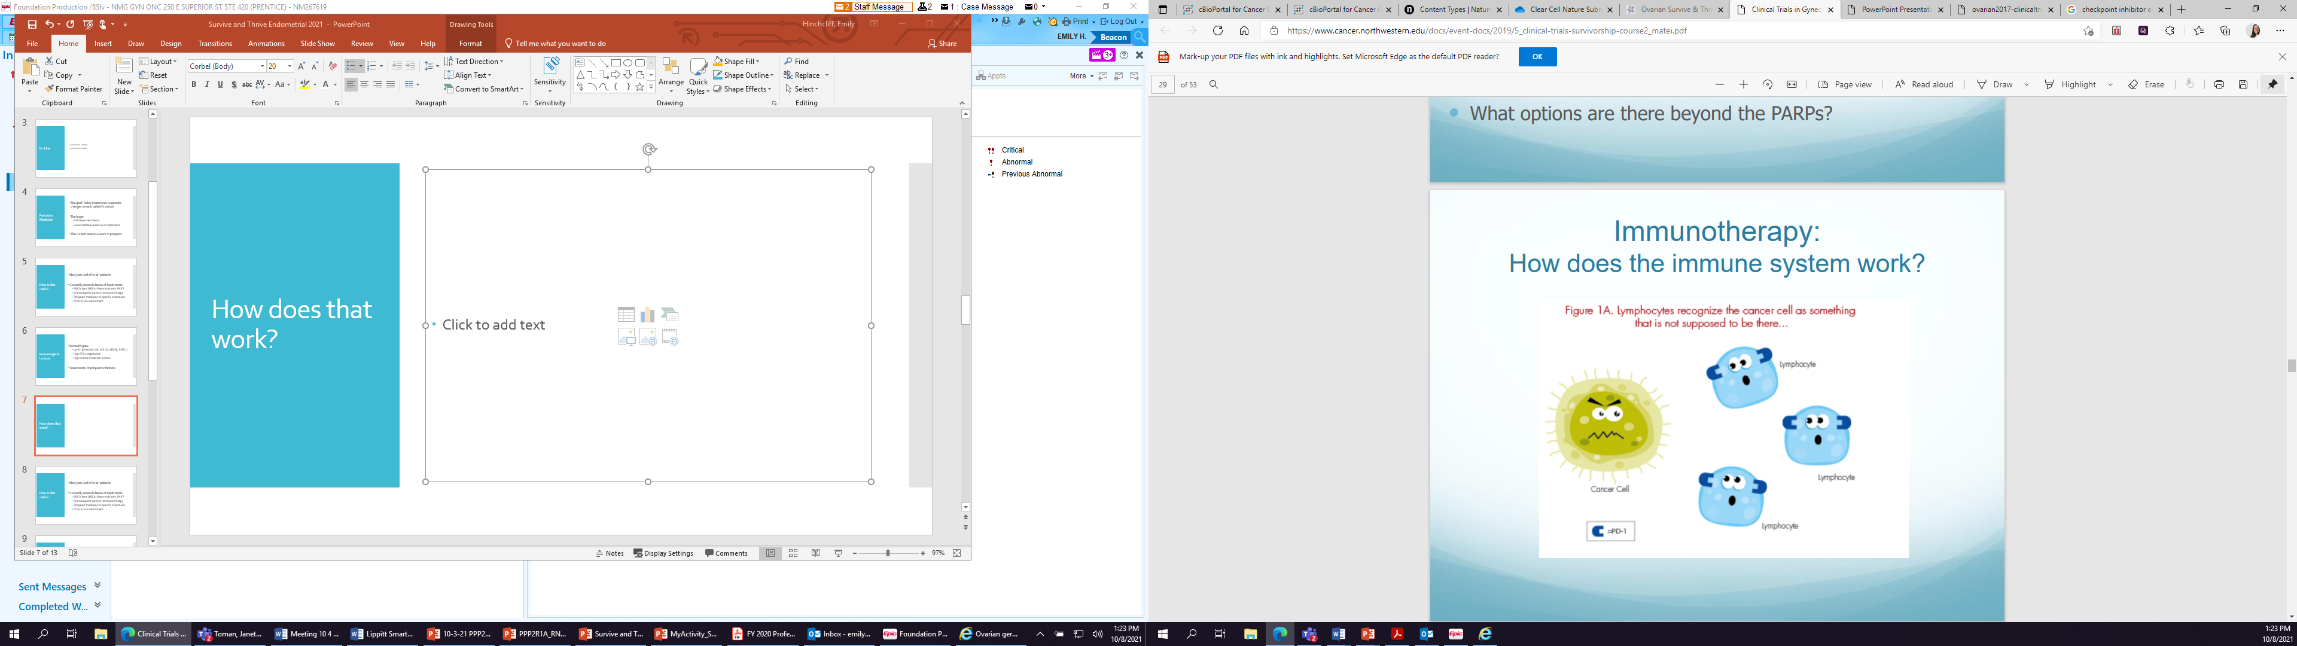
Immunogenic:
PD1/PDL-1
Lymphocytes (immune cells) recognize the tumor as abnormal

Slide 16
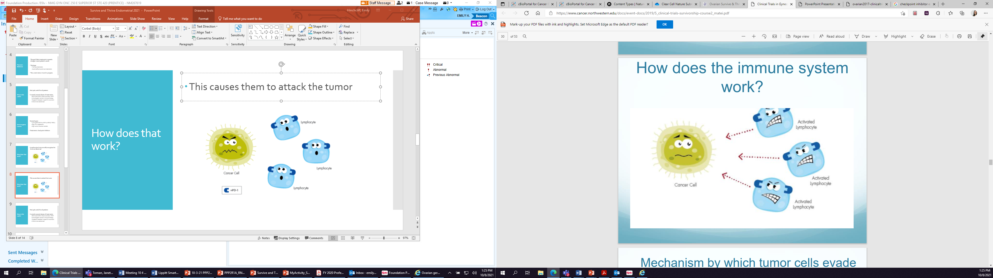
Immunogenic:
PD1/PDL-1
This causes them to attack the tumor

Slide 17
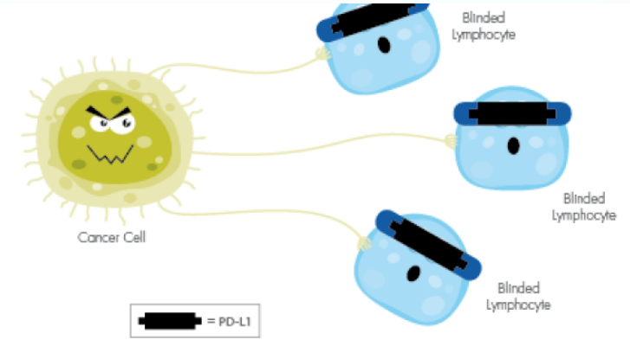
Immunogenic:
PD1/PDL-1
But tumors can cloak themselves from the immune system to avoid recognition
Notes:
Immunohistochemical studies have detailed PD-1 and PD-L1 expression levels (40%–80% in endometrioid, 10%–68% in serous, and 23%–69% in clear cell subtypes, respectively) in endometrial carcinomas

Slide 18
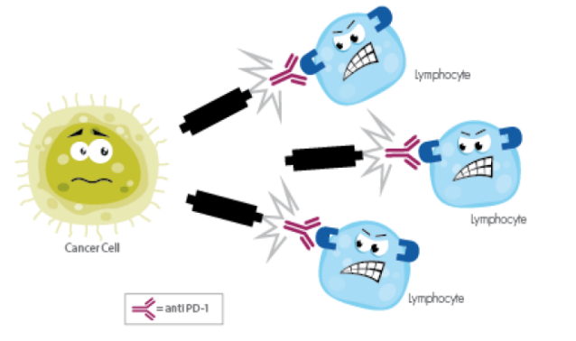
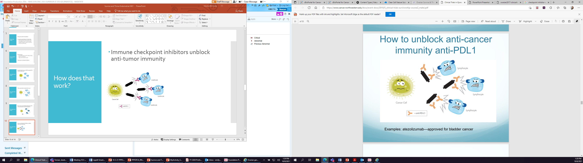
Immunogenic:
PD1/PDL-1
Immune checkpoint inhibitors unblock anti-tumor immunity
Examples: Pembrolizumab, Nivolumab, Dostarlimab
Examples: Atezolizumab, Durvalumab

Slide 19
Treatment
Common: Expression of PD-L1 is high in endometrial cancer
  40-80% in endometrioid
  10-68% in serous
  23-69% in clear cell
BUT, for treatment based on PD-L1 positive status alone, benefit of immune checkpoint blockade is generally modest
Notes:
Important to note:
PD-L1–positive tumors, regardless of MSI status, treated with ICB is generally modest. In a phase Ib (KEYNOTE-028) study of pembrolizumab in advanced PDL1–positive advanced solid tumors, the 24 patients with recurrent metastatic endometrial cancer had an ORR of 13% (three patients with partial response) and an additional 13% (three patients) achieved stable dise

Slide 20
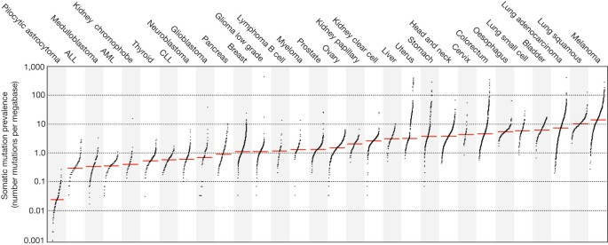
Immunogenic:
Tumor mutation burden (TMB)
Increased mutations lead to increased immune response to tumor

Slide 21

Immunogenic:
Tumor mutation burden (TMB)
Increased mutations lead to increased abnormalities – and therefore increased immune response to tumor

Slide 22
Immunogenic:
Mismatch repair
Mismatch repair deficiency (dMMR)
Microsatellite instability (MSI)
Successful = tumor survival
MMR complex
MMR deficient
Unsuccessful = increased mistakes (ie MSI)

Slide 23
Immunogenic:
Mismatch repair
Increased mistakes lead to increased immune response to tumor
MMR deficient
Unsuccessful = increased mistakes
Notes:
When considering therapeutic targets, it is important to note that endometrial cancer was recently shown to have the highest prevalence of MSI across 30 human cancer types,28 and approximately 30% of primary endometrial cancers are MSI-H and 13% to 30% of recurrent endometrial cancers are MSI-H or dMMR

Slide 24
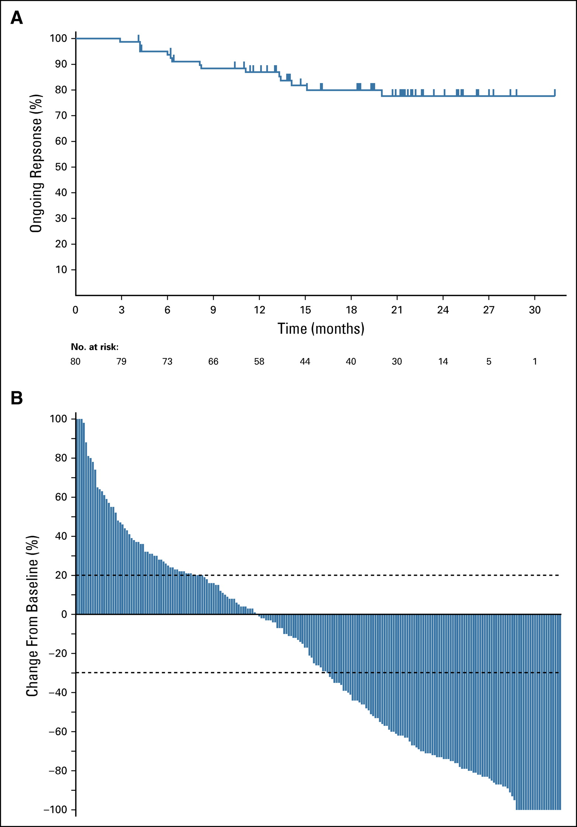
Treatment: MSI/dMMR
KEYNOTE-158: Multiple tumor types
Response rate 57%
Potentially prolonged response
Notes:
KEYNOTE 158 - (49 endometrial)
Subsequent studies of single agent checkpoint have shown similar results: 42.3% had a complete response (disappearance of tumor) or a partial response (shrinkage of tumor) to treatment with Jemperli (dostarlimab). For 93% of responders, the response lasted for six months or more

Slide 25
FDA approval
The first tumor agnostic approval ever!
Currently approved in endometrial cancer for MSI/dMMR:
  Pembrolizumab
  Dostarlimab
Notes:
Based on results from 5 multicohort trials

Slide 26
But what about if my tumor isn’t MSI-high?
Combination: Lenvatinib, Pembrolizumab
Lenvatinib
Lenvatinib inhibits these tumor growth signaling pathways
Also seems to combat immune suppression
Tumor growth, angiogenesis (blood vessels), tumor environment
Notes:
Women treated with chemotherapy previously

Slide 27
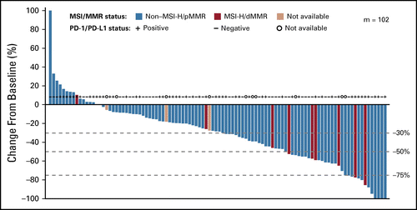
Treatment:
MSS
Overall response rate: 38%
Responses seen independent of MMR/MSI and PD1/PDL1 status
Benefit in many histologic types (eg. serous, clear cell)
Notes:
Women treated with chemotherapy previously
Keynote 775:

Slide 28
What’s next?
Combination of immunotherapy with chemotherapy
  NRG-GY018: Carbo/taxol + Pembro vs placebo
  RUBY: Carbo/taxol + Dostarlimab vs placebo
  AtTEND: Carbo/taxol + Atezolizumab vs placebo
Comparison of Lenvatinib/Pembro to chemotherapy
  LEAP-001: Len/Pem vs Carbo/taxol
Combination of immunotherapy with other targeted agents or therapies
  PARP inhibitors
  VEGF inhibitors
  Other tumor signaling pathways
  Radiation
Notes:
Northwestern has trials in the recurrent space (GY018) and upfront (eg in combination with radiation)

Slide 29
Take Home Message
Entirely new class of drugs with anticancer activity
  Especially beneficial in immunogenic tumors
  Combination therapy can improve efficacy for non-immunogenic tumors
  Those who respond can have long remissions
Toxicity profiles include immune effects (more to come next!)

Slide 30
Now to turn it over to Nancy Anderson

Slide 31
Side Effect Profile and Management
Lenvatinib & Pembrolizumab
in Recurrent Endometrial Cancer
Presented to: Insert relevant presenter information Calibri 16pt
Presented on: Month day, Year
Presented by: Insert relevant presenter information here
Presented to: Strive & Thrive 2021
Presented on: October 16, 2021
Presented by: Insert Nancy J. Anderson, APRN, CNP

Slide 32
Recurrent Endometrial Cancer
Lenvatinib (Lenvima) & Pembrolizumab (Keytruda)
Patients with a Long platinum free interval
  Chemotherapy - for patients who have relapsed with a treatment free interval of > 6 months.
Patients with a short platinum free interval
  Lenvatinib & Pembrolizumab: for patients who have relapsed with a treatment free interval following carboplatin and paclitaxel of < 6 months, we suggest Lenvatinib & Pembrolizumab.
Notes:
This afternoon, I am going to address the possible side effect profile of Lenvatinib and Pembrolizumab.
Currently, we evaluate the patient for her recurrence with labs, imaging and clinical exam.
We review her treatment history and assess when she was last treated.
We will ask which patients are candidates for Lenvima and Pembrolizumab?
Long platinum free interval – Chemotherapy
Short platinum free interval

Slide 33
Recurrent Endometrial Cancer
Lenvatinib & Pembrolizumab
Keynote-775/Study 309: Randomized Clinical Trial: Evaluated Pembrolizumab & Lenvatinib
  Evaluated Lenvatinib and Pembrolizumab versus treatment with (doxorubicin versus paclitaxel). This trial was conducted in 827 patients with advanced EC that had progressed on prior platinum based chemotherapy (697 patients had proficient MMR tumors and 130 of whom had dMMR tumors.
  Subset of patients with proficient MMR tumors, Lenvatinib and Pembrolizumab resulted in noted improvements in progression free survival, overall survival and overall risk reduction when compared to single agent Doxorubicin versus Paclitaxel chemotherapy.
  The more common side effects were found to be hypertension (64%), hypothyroidism (57%), diarrhea (54%) and nausea (50%).
  Lenvatinib plus pembrolizumab had a manageable safety profile that was consistent with the safety profiles of each drug (when given alone).

Slide 34
Lenvatinib and Pembrolizumab
Endometrial Cancer
Indications for Use:
  Accelerated FDA approval for Pembrolizumab & Lenvatinib based on the results of the randomized clinical trial.
  When your tumor is NOT microsatellite instability-High (MSI-H) or dMMR (Mismatch Repair Gene deficient)
  You have disease progression following prior systemic therapy (chemotherapy) in any setting. For example: Paclitaxel and Carboplatin
  When patient is not a candidate for surgery or radiation.
Notes:
What makes a patient a candidate for use of Lenvatinib and Pembrolizumab?
The indications for use are listed here.

Slide 35
Recurrent Endometrial Cancer
Lenvatinib (Lenvima) and Pembrolizumab (Keytruda)
Chemo Agent
Dosage Regimen
Lenvatinib (Lenvima)
Pembrolizumab (Keytruda)
14-20 mg by mouth daily until disease progression or unacceptable toxicity
  Monitor weekly labs for 1-2 cycles.
  Preferred starting dose of 14 mg with Endometrial cancer
200 mg IV day 1 every 21 days (3 weeks) until disease progression or unacceptable toxicity, or up to 24 months in patients without disease progression.
Notes:
The typical dose of Lenvatinib in endometrial cancer is 14 mg po daily, as we found that patients can tolerate this dose with less adverse events/side effects, as well as stay on this medication for a longer period of time.
We monitor labs weekly for 1-2 months pending lab results and specific side effects.

Slide 36
Lenvatinib (Lenvima) & Pembrolizumab (Keytruda)
Management
Chemo Agent
Lenvima
Chemo Agent
Pembrolizumab
May be held for one week
Repeat labs: determine if issue has resolved. For example, liver function, anemia, low platelets, kidney function.
  Lab schedule: weekly for 1-2 months
  CBC (anemia, low platelets)
  CMP: (monitor liver & kidney function)
  TSH – monitor thyroid levels.
Manage symptoms
Determine dose reduction
  Reduce from preferred starting dose of 14 mg to 10 mg po daily.
  No dose reduction for Pembrolizumab
  May be held until symptoms improve/resolve.
  May need steroids to counteract a specific adverse reaction
  Determine discontinuation of Pembrolizumab
    Grade 3-4 Adverse event/toxicity.
Notes:
The possible side effect may result in need to hold treatment for one week, and repeat labs in 1 week.
We assist patient to manage the symptoms and then determine if a dose reduction is necessary.

Slide 37
Endometrial Cancer
Lenvima (Lenvatinib) Possible Side Effect Profile:
Classification: Receptor Kinase Inhibitor of VEGFR
Common side effects
  High Blood Pressure
  Fatigue
  Diarrhea
  Muscle or Joint Pain and Headache
  Nausea and/or Vomiting
Less Common Side effects:
  Thyroid Hormone levels
  Heart Problems: abnormal heart rhythm call QT prolongation; monitor EKG
  Electrolyte imbalance
  Blood Clots
  Osteonecrosis of Jaw: consider evaluation with dentist prior to start of Lenvima. Monitor pain, swelling or infection of the gums.
  Bleeding
  Hand Foot Syndrome
  Decrease in Appetite or Taste Changes
  Wound Healing can be slowed
    Stop treatment 1-3 weeks prior to and after any necessary surgical procedure.
Notes:
Timely Identification of Treatment-Related Side Effects/Adverse Events

Slide 38
Possible Side Effects of Pembrolizumab (Keytruda)
Possible Immune Reactions
Diarrhea/Intestinal problems (colitis, inflammation of the bowel)
Thyroid Function changes: monitor TSH with each treatment cycle
Bowel obstruction or perforation: worsening abdominal pain, lack of bowel movement and NOT passing gas).
Skin Reactions: Rash; itching; skin blistering/peeling; painful sores; fever or flu-like symptoms, swollen glands
Lung problems (pneumonitis, inflammation of the lung)
Liver problems: hepatitis, inflammation of the liver
Brain and/or nerve problems: headaches, drooping eyelids, double vision, trouble swallowing, weakness in arms, legs, or face, numbness tingling in the hands/feet
Kidney problems (kidney inflammation or failure)
Eye problems
Heart problems Inflammation in the heart muscle (rare).

Slide 39
Possible Side Effects of Pembrolizumab (Keytruda) con
Continued
Fatigue
  Very common when undergoing treatment for cancer
  May need to adjust your daily schedule.
  Encouraged to continue an exercise routine in a effort to maintain/improve your energy
Allergic Reactions
  Patients can have an allergic reaction to this medication
  Report any signs of shortness of breath, congestion, difficulty breathing, chest pain, rash, itchiness, flushing or a decrease in your blood pressure
  You are monitored closely before, during and after administration of pembrolizumab.

Slide 40
Recurrent Endometrial Cancer
Lenvatinib (Lenvima) & Pembrolizumab (Keytruda)
Possible side effects:
Frequency of side effects: Any Grade
Hypertension 64%
Hypothyroidism 57%
Diarrhea 54.2%
Nausea 49.5%
Decreased Appetite 44.8%
Vomiting 36.7%
Fatigue 33.0%
Arthralgias 30.5%
Proteinuria 28.8%
Anemia 26.1%
Constipation 25.9%
Neutropenia (low WBCs) 7.4%

Slide 41
Side Effect: Hypertension (Elevated Blood Pressure)
Lenvatinib (Lenvima) & Pembrolizumab (Keytruda)
Lenvatinib increases the chances of hypertension
  As a result of its drug class of anti-angiogenesis inhibitors
  Caused by the influence of VEGF on nitric oxide and blood vessel dilation (which is now blocked).
Hypertension can occur in 64% of patients.
Control blood pressure prior to starting Lenvatinib
  Anti-hypertensive medication(s)
Monitor Blood Pressure after 1 week, then every 2 weeks for the first 2 months, then monthly thereafter during treatment. Monitor at home.
Withhold and resume at a reduced dose when hypertension is better controlled or permanently discontinue.
Meet with PCP to manage your BP prior to treatment and during treatment.

Slide 42
Side Effects: Thyroid
Hypothyroid as a result of Lenvatinib (Lenvima) & Pembrolizumab ( Keytruda)
Step One: Monitor
  Monitor TSH (thyroid stimulating hormone)
Step Two:
  Continue to monitor for hypothyroidism & begin hormone replacement therapy (Levothyroxine).
  Possible interruption for hyperthyroidism based on severity. Initiate hormone replacement or medical management of hyperthyroidism.
  Withhold treatment for grade 2-4 endocrine issues.
Step Three: Follow-up
  Monitor TSH (thyroid stimulating hormone)

Slide 43
Side effects: Colitis
Diarrhea/Abdominal Discomfort
Step One: Monitor
  Monitor for sign/symptoms of Diarrhea/Colitis, Abdominal discomfort
  Note increased diarrhea or bowel movements (more than usual), increased # of stools.
  Blood in stool/mucus, dark tarry stools,
  Severe abdominal discomfort
Step Two: Manage
  Withhold for grade 2 or 3 diarrhea/colitis.
  If more than 5 days or recurs – consider corticosteroids.
    1-2 mg /kg/day of prednisone or equivalent, followed by a taper for grade 2 or higher
Step Three: Permanently discontinue for grade 4 diarrhea or colitis.

Slide 44
Side Effects: Pneumonitis
Lenvatinib (Lenvima) & Pembrolizumab (Keytruda)
Step One: Monitor
  Monitor for signs/symptoms of pneumonitis
  Evaluate for pneumonitis (new or worsening cough, shortness of breath)
Step Two: Manage
  Withhold for grade 2 Pneumonitis
  Permanently hold for grade 3 or 4 Pneumonitis.
  Administer steroid: Dose of 1-2 mg/kg/day of prednisone, followed by a taper for grade 2 symptoms or higher.
Step Three: Follow-up

Slide 45
Side Effects: Gastrointestinal
All Grades:
  Diarrhea 55%
    Report symptoms: Number of stools per day and consistency of stools
    BRAT diet – banana, white rice, apples, toast
    Imodium AD for diarrhea (over-the-counter
    Dietary evaluation: eliminate foods which you are more sensitive (spicey, high-fat)
  Nausea 49%
    Report symptoms: frequency of vomiting.
    Eliminate foods that increase your nausea- consider cooler foods, eat blander foods.
    Consider anti-nausea medications: Prochlorperazine (Compazine) and/or Odansetron (Zofran)
  Vomiting 37%
    Report symptoms: frequency of vomiting.
    Consider anti-nausea mediations: Prochlorperazine (Compazine) and/or Odansetron (zofron) ODT
  Stomatitis 35%
    Rinse with baking soda/warm water after meals and bedtime
    Consider stomatitis cocktail if having difficulty with soreness in your mouth or open areas.
Notes:
Report any symptoms which do not improve.

Slide 46
Side Effects: Gastrointestinal (continued)
All Grades:
  Abdominal Pain 34% - may experience worsening abdominal discomfort/pain. Report to your oncology team.
  Constipation 27% -
  Consider stool softeners and/or laxatives. Review your symptoms and bowel regimen with your oncology team. You should have bowel movement every 1-2 days. Drink 32-64 ounces of water per day!
Notes:
Report any symptoms which do not improve.

Slide 47
In Conclusion:
Levatinib (Lenvima) and Pembrolizumab (Keytruda)
We are encouraged that immunotherapy is an option for patients that are non-MSI-H/dMMR endometrial cancer.
Levatinib/Pembrolizumab:
Improves survival in Advanced Endometrial Cancer.
Notes:
In conclusion: We are encouraged that Lenvatinib/Pembrolizumab improves the survival of our patients with Advanced Endometrial Cancer.

Slide 48
Thank you!

Slide 49
What are clinical trials?
Clinical trials are research studies that explore whether a treatment or device is safe and effective for humans
  May show which medical approaches work best for certain illnesses or groups of people
Clinical trials produce the best data available for health-care decision making
The purpose of clinical trials is research, so the studies follow strict scientific standards
  Protect patients, produce reliable study results

Slide 50
Types of trials
Interventional trials
  A new intervention (drug, device, test, procedure) is tested
  There are potential risks (eg side effects)
  There are potential benefits (eg survival)
  Informed consent goes over those risks/benefits
Observational trials
  Collect data or tissue that is already available
  Questionnaires, surveys
  Low risk, but may have little benefit to participant
  Can lead to new ideas

Slide 51
Trial phases
Phase I
  Tested in humans for the first time
  Goal: determine tolerable dose
  Toxicity and efficacy are NOT known
  High risk, benefit is unknown (response rates <10%)
  All participants receive the drug
  Usually open to many cancer types, any prior therapies

Slide 52
Trial phases
Phase II
  Dose and toxicity are known
  Goal: testing efficacy in specific diseases
  Risk is smaller, benefit higher
  All participants receive the drug
  May require additional testing (biopsies, scans)
  Usually strict enrollment criteria

Slide 53
Trial phases
Phase III
  Dose and toxicity are known
  Efficacy in specific disease is known (Phase II)
  Goal: definitive proof before FDA approval
  Randomized:
    Some participants receive intervention, others receive control (approved treatment or placebo if no approved treatment exists)
Phase IV
  Dose, toxicity, efficacy in specific disease all known
  FDA approval granted
  Post approval observation and data collection

Slide 54
Are clinical trials for you?
Benefits:
  Access to new drugs, not available otherwise
  Potential benefit (unknown)
  Advance knowledge, help future patients have access to novel therapies
Risks/Cons:
  Potential toxicities
  Potential lack of benefit (unknown)
  Time commitment, additional testing not part of standard of care

Slide 55

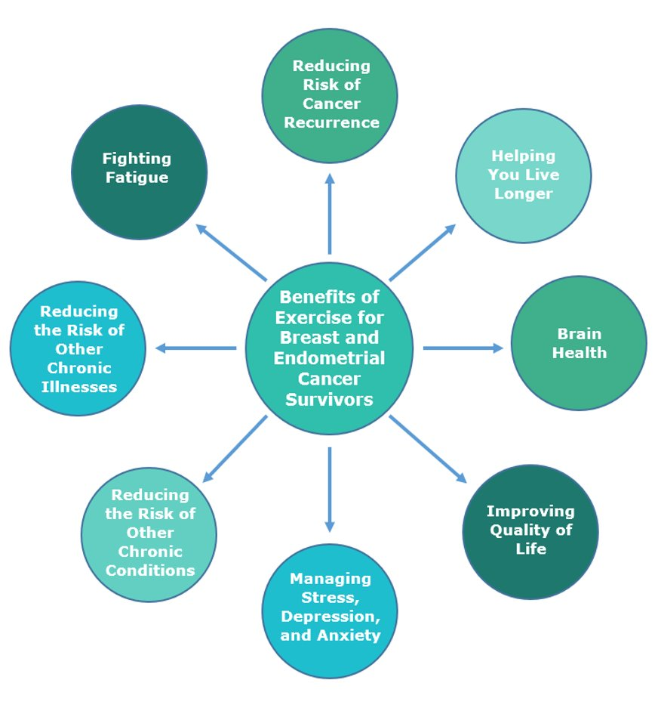

Slide 56

About the MyActivity Study
All participants will be provided with a Fitbit that is linked to their electronic health record, MyNM (MyChart).
You will receive weekly feedback on your physical activity progress via a MyNM message.
  Information on your progress will also be available to the MyActivity Study Team and your oncology care team.
There are two phases of the MyActivity Study:
  Phase 1 is comprised of a 6-month physical activity initiation period.
  Phase 2 involves a 6-month physical activity maintenance period.
Notes:
*Read slide

Slide 57
Who to Contact
The MyActivity Study is funded by the National Cancer Institute. It is being conducted by the Exercise and Health Lab in the Department of Preventive Medicine at Northwestern University Feinberg School of Medicine (led by Dr. Siobhan Phillips) and the Wisconsin Physical Activity Epidemiology Lab in the Department of Kinesiology at University of Wisconsin-Madison (led by Dr. Lisa Cadmus-Bertram).
If you are interested in participating in MyActivity, please contact the research team by email at myactivity@northwestern.edu or call 312-503-2719

