Slide 1
Navigating cancer during the time of Covid
Timothy Pearman, PhD, ABPP
Director, Supportive Oncology
Professor, Department of Medical Social Sciences and Psychiatry & Behavioral Sciences
Robert H. Lurie Comprehensive Cancer Center
Northwestern University Feinberg School of Medicine

Slide 2
Objective
Provide a framework for understanding difficult emotions and thoughts in managing cancer during the time of a global pandemic and discuss approaches to help manage them.

Slide 3
Complicated feelings, like anger, guilt, uncertainty, are very common in the cancer experience. These feelings are also expectable during the Covid crisis.
However, we often don’t talk about them enough.

Slide 4
Attitudes

Slide 5
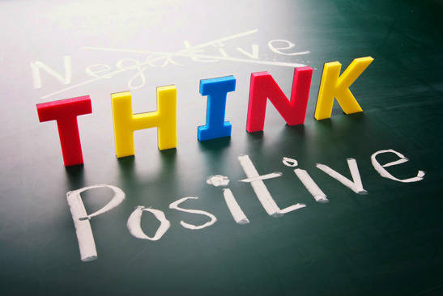

Slide 6
It is psychologically healthy to have both painful and complicated feelings alongside feelings like gratitude and happiness when coping with cancer.

Slide 7
How do we typically cope?

Slide 8
Problem-Solving
Very common, generally adaptive
Focuses on dealing with the cause of a problem by reducing or eliminating the source of stress
However, this strategy is most effective when stressors are controllable.

Slide 9
What can we do differently?

Slide 15
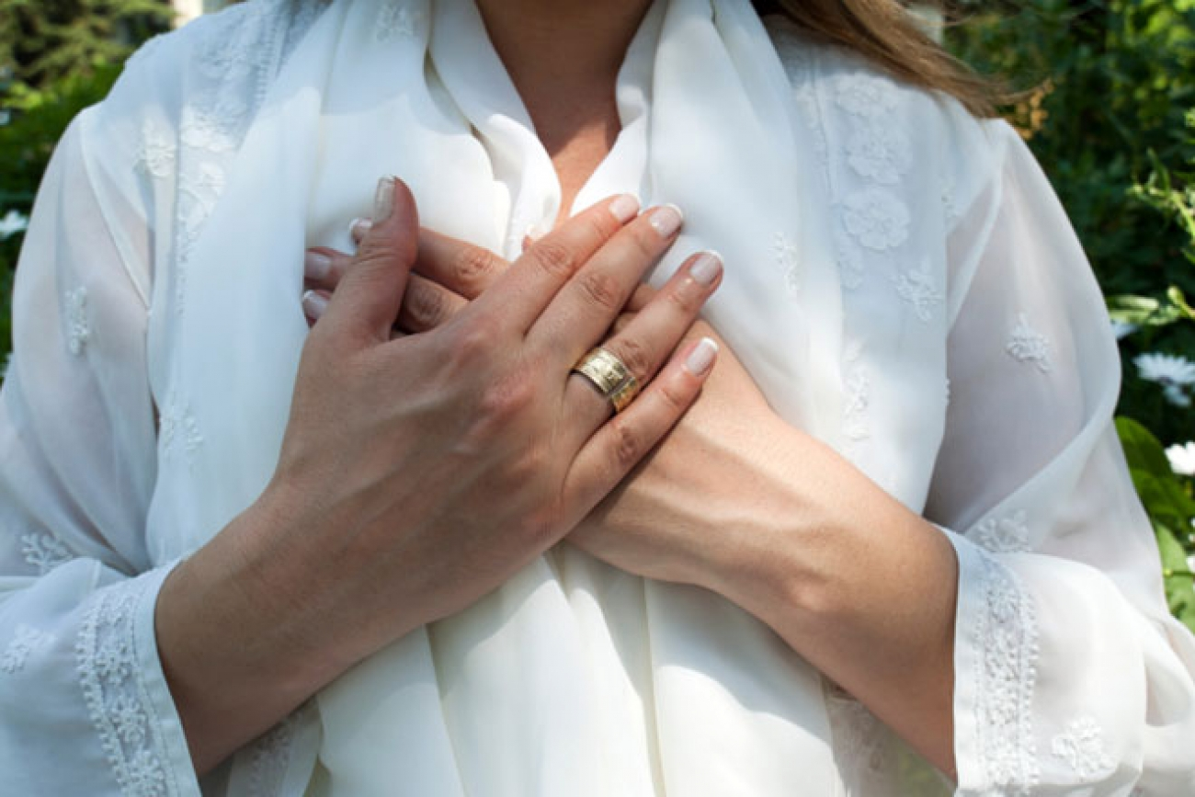
Self-Compassion
Compassion is not finite or zero sum
Difficult emotions and thoughts can, and often do, co-exist with gratitude

Slide 16
If your compassion does not include yourself,
it is incomplete.
- Jack Kornfield

Slide 17
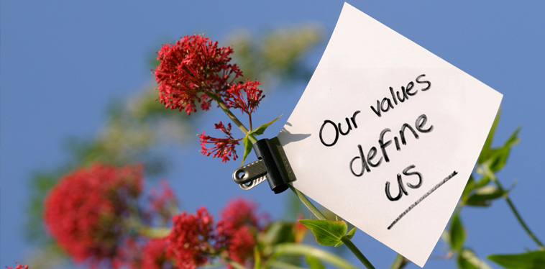
Clarify Priorities
What have I learned about
my values and what’s important?
myself and my strengths?
what I want more of in my life? less of?

Slide 18
Creating Meaning
Choose a life domain that is high priority
Choose a value to pursue in this domain
Develop goals, guided by the value
Take action

Slide 19
Being Present

Slide 20
Mindfulness is paying attention, on purpose, in the present, and non-judgmentally, to the unfolding of experience moment to moment.
- Jon Kabat-Zinn

Slide 21
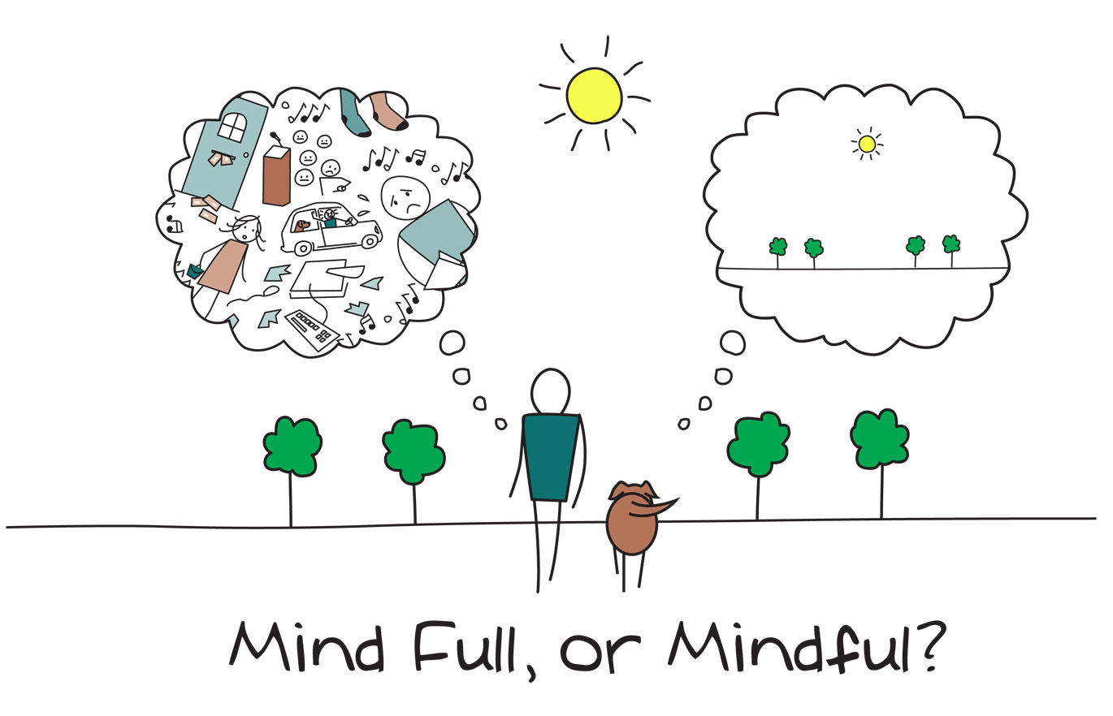

Slide 22
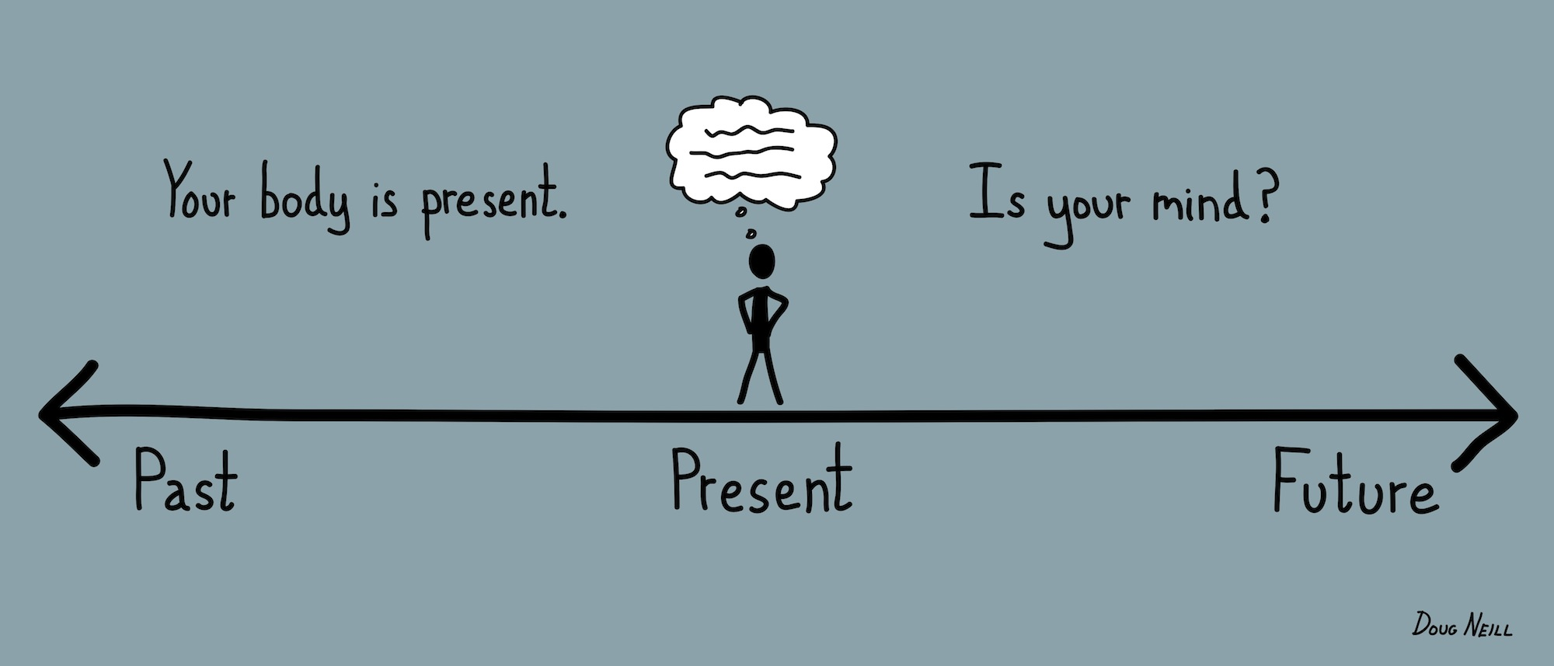
Being Present
Be still and bring your attention to your breath
Slow breathing and do a body scan
Notice thoughts and feelings without judgment

Slide 23
Being Present
Creates awareness of your experience
Allows room for difficult feelings without judgment
Helps manage stress
Facilitates self-compassion

Slide 24
Summary
Honor and understand complicated feelings
Cultivate self-compassion
Identify values and strengths to create meaning
Be mindful and connect to the present moment
Reach out for more help

