Slide 1
The Pathology of Gynecologic Cancers
Amanda L. Strickland, MD
Department of Pathology
Division of Gynecologic Pathology

Slide 2
Disclosures
Dr. Strickland receives compensation for expert witness consultation.

Slide 3
The power of pathology (who we are, what we do)
The study of disease
Gross, microscopic, immunologic, molecular examination of organs, tissues, whole bodies (anatomic pathology)
Laboratory analysis of body fluids and tissues (clinical pathology)
Notes:
Photo sources: Northwestern pathology website

Slide 4
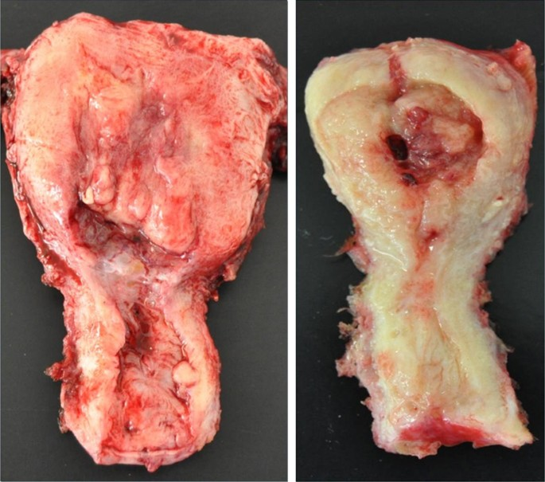
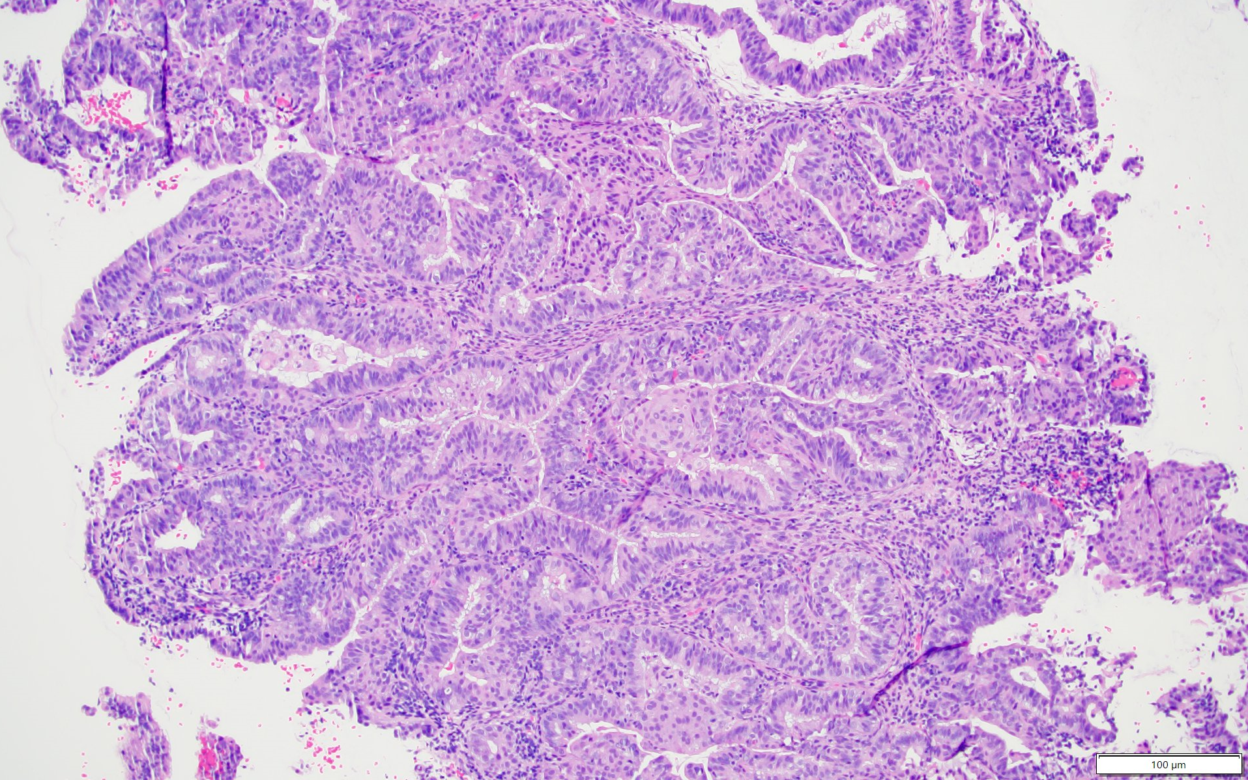
The process of pathology- from tissue to diagnosis
Notes:
Surgery: northwestern medicine
Slide creation: https://www.criver.com/insights/fast-precise-slide-preparation
Gross photo: Gatius & Matias-Guiu. Modern Pathology volume 29, pagesS45–S58 (2016)
Histo: my photo
Tissue sample taken from patient (bx or resection in OR)
Specimen fixed in formalin to harden the tissue
Fixed tissue processed with series of alcohols to further dry and then embedded in paraffin to create a solid block
Thin slice of tissue cut from block, mounted on a glass slide, and stained
Pathologist examines the tissue section under the microscope and renders diagnosis

Slide 5
An overview of select gynecologic cancers
Cervix
Squamous cell carcinoma, adenocarcinoma
Uterus
Endometrial carcinoma (endometrioid, serous, clear cell), endometrial stromal sarcoma (low grade vs high grade), carcinosarcoma, leiomyosarcoma
Ovary
Epithelial tumors (serous/mucinous borderline tumor, serous carcinoma (low grade vs high grade), mucinous carcinoma, endometrioid carcinoma
Notes:
NCI https://visualsonline.cancer.gov/details.cfm?imageid=8262

Slide 6
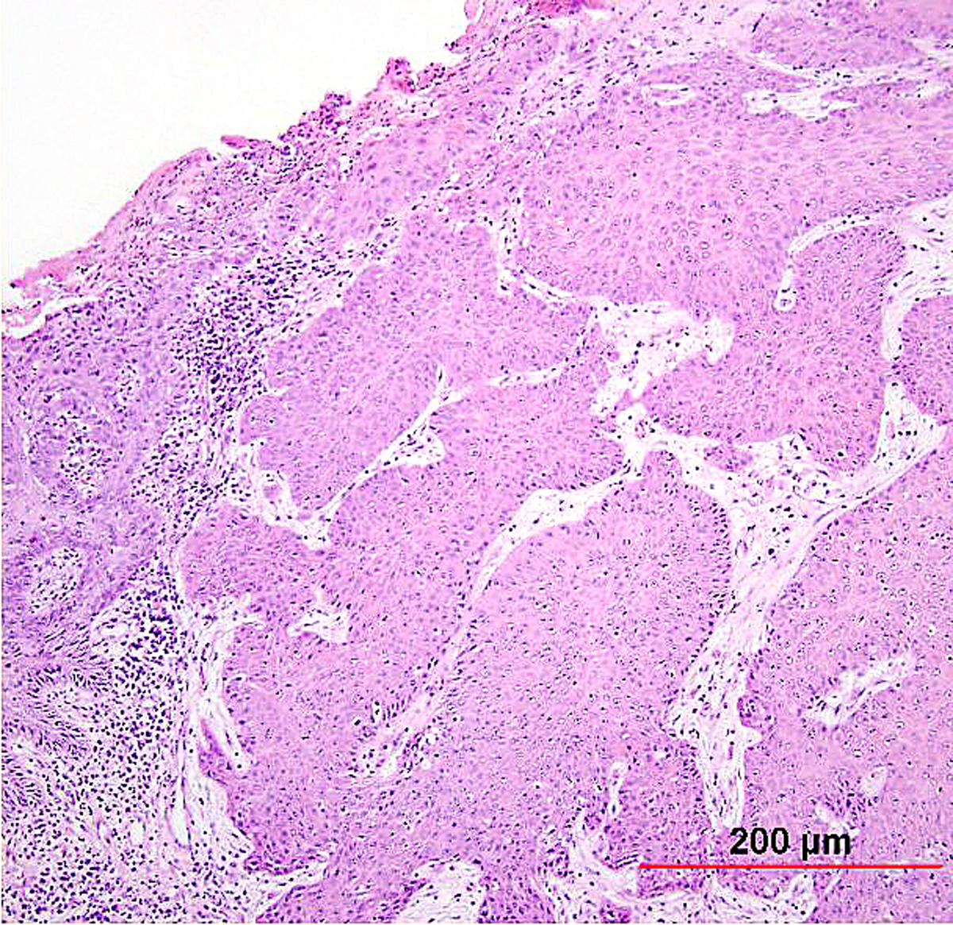
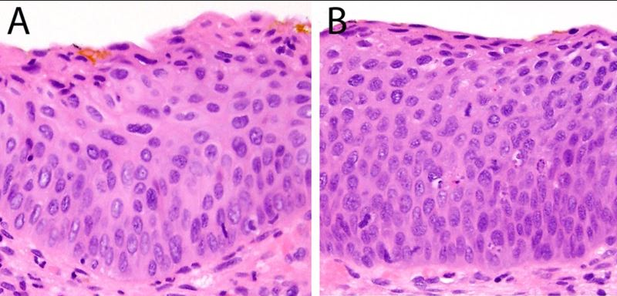
Squamous cell carcinoma of the cervix
HPV
Precancerous lesions
Histology
Notes:
Pathogenesis- HPV, smoking and HIV strong influences
Precancerous lesions
Histology
Images sources: https://www.glowm.com/section-view/heading/Pathology%20of%20Cervical%20Carcinoma/item/230

Slide 7
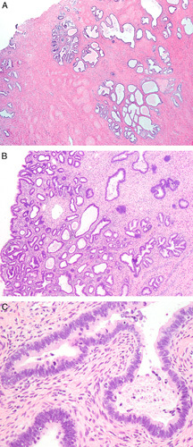
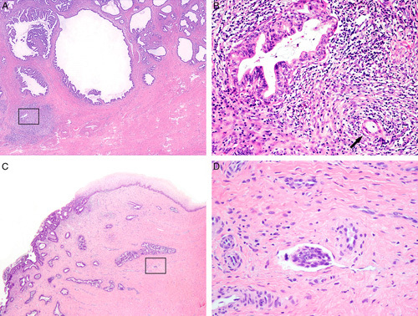
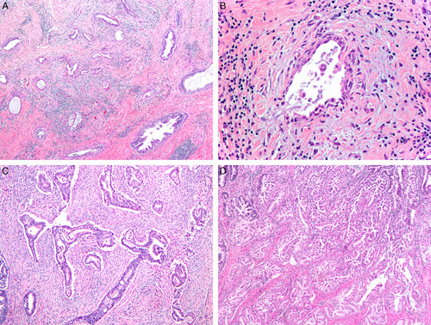
Cervical adenocarcinoma
HPV
Precancerous lesions
Silva patterns
Notes:
Images source: Alvarado-Cabrero et al, Int J Gynecol Pathol. 2021 Mar; 40(Iss 2 Suppl 1): S48–S65.

Slide 8
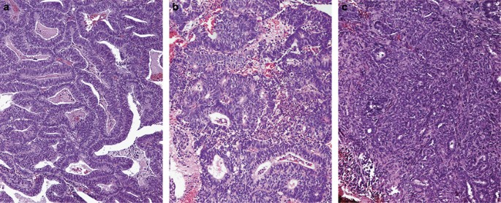
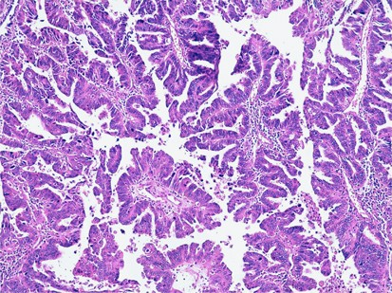
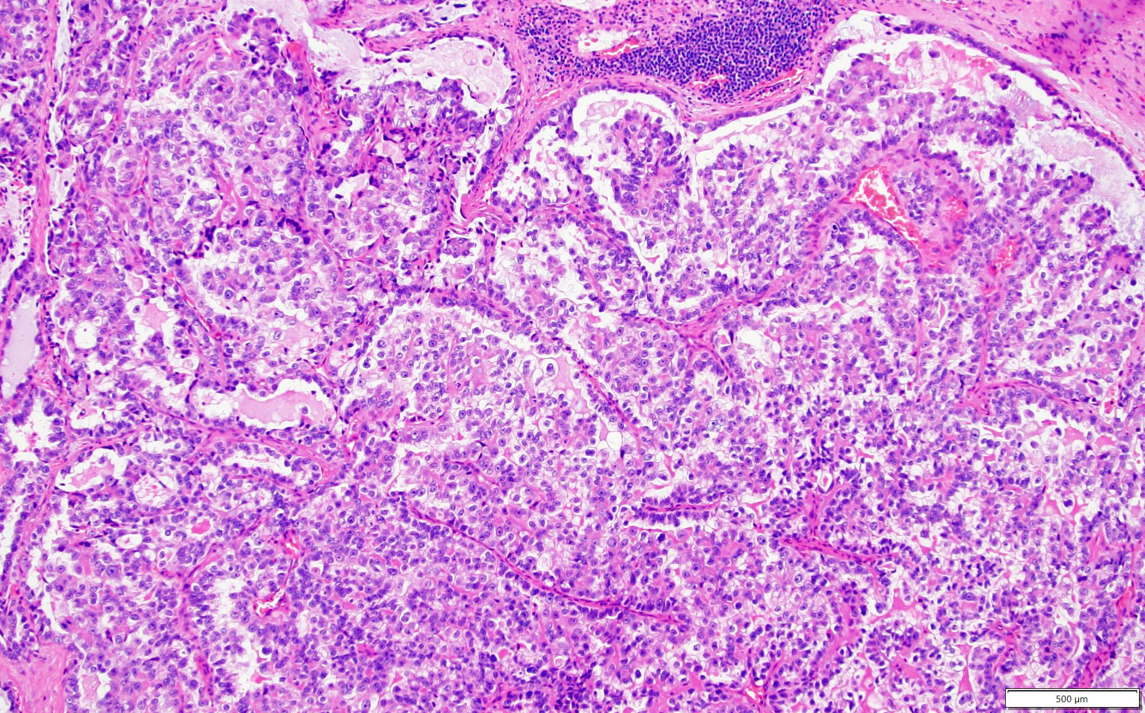
Uterus- Endometrial carcinoma
Endometrioid
Serous
Clear cell
Notes:
Endometrioid- unopposed estrogen, POLE
Serous- TP53 mutation
Image sources: endometrioid Malpica. Modern Pathology volume 29, pagesS29–S44 (2016)
CCC my pic
ESC Gatius & Matias-Guiu. Modern Pathology volume 29, pagesS45–S58 (2016)

Slide 9
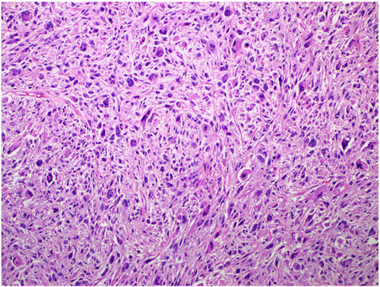
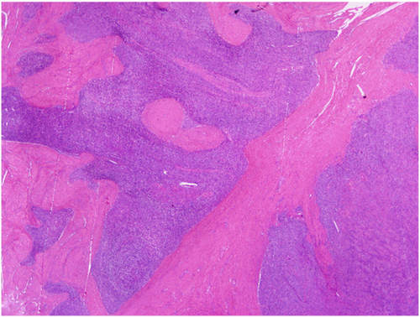
Mesenchymal tumors
Leiomyosarcoma
Endometrial stromal sarcoma
Notes:
LMS and LGESS: Prat & Mbatani, IJGO, 2015. Vol 131, Iss S2, S105-S110.

Slide 10
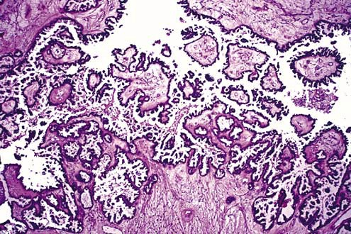
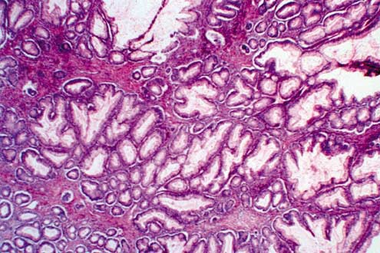
Ovary- Epithelial borderline tumors
Serous borderline tumor
Mucinous borderline tumor
Histology
Histology
Notes:
Both photos from Hart. Modern Pathology volume 18, pagesS33–S50 (2005)

Slide 11
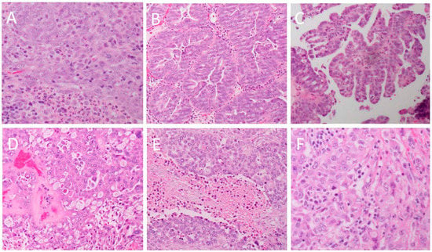
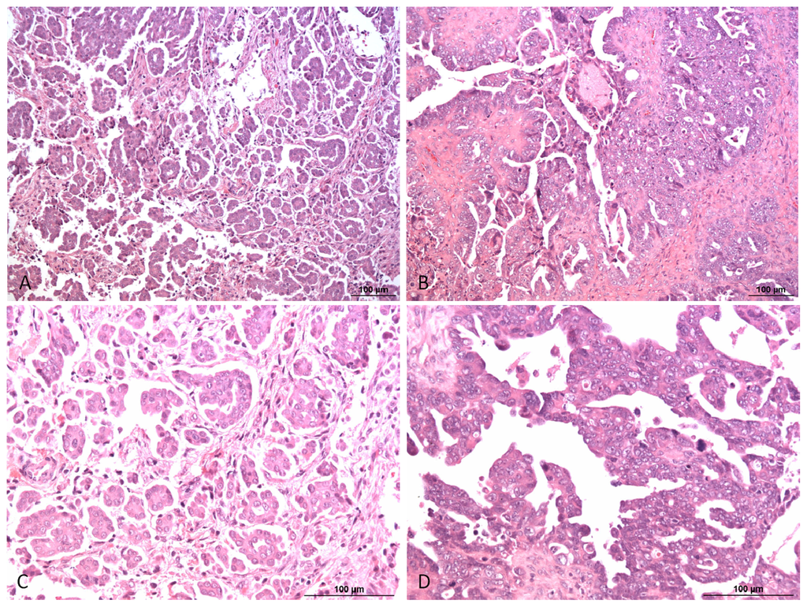
Serous carcinoma
High grade
Low grade
Pathophys
Histology
Pathophys
Histology
Notes:
High grade: Lisio et al. Int. J. Mol. Sci. 2019, 20(4), 952; https://doi.org/10.3390/ijms20040952
Low grade: Smolle et al. Int. J. Mol. Sci. 2013, 14(5), 9536-9555; https://doi.org/10.3390/ijms14059536

Slide 12
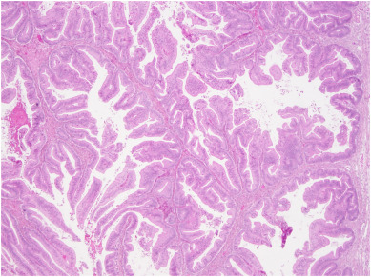
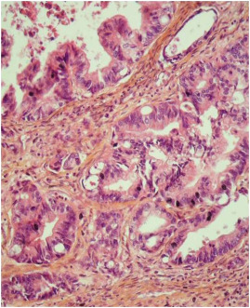
Mucinous carcinoma
Expansile pattern
Invasive pattern
Notes:
Both from Gouy et al. Gynecologic Oncology Reports. Vol 22, Nov 2017, pp21-25.

Slide 13
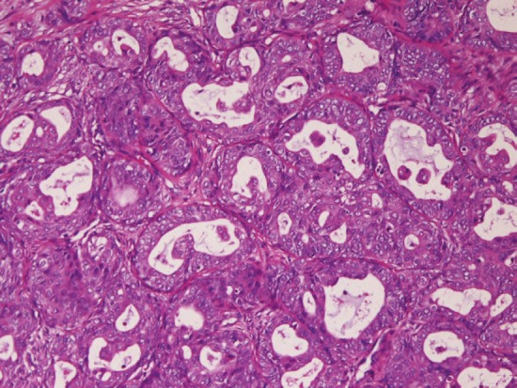
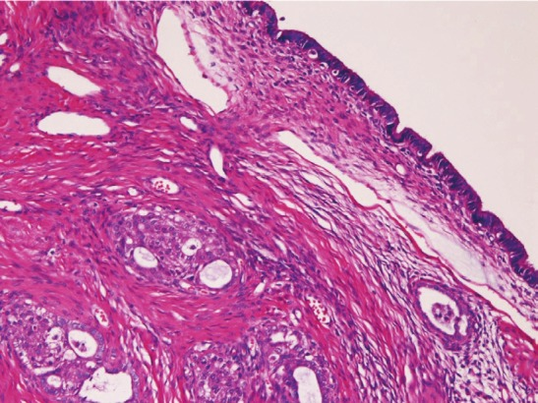
Endometrioid carcinoma
Notes:
LG endometrioid ovarian ca and endometriosis: Terada. Int J Clin Exp Pathol. 2012; 5(9): 924–927.

Slide 14
The clinicopathologic correlation
Recurrence versus new process
Notes:
How do we tell if someone has a recurrence or new cancer based on a biopsy

Slide 15
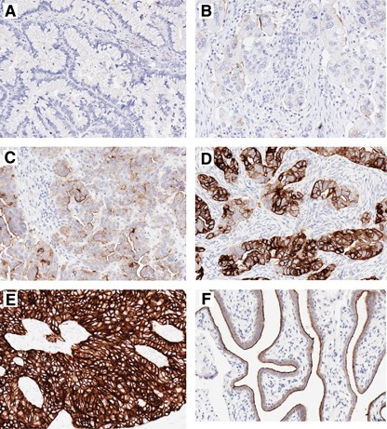
The role of ancillary studies- IHC
Folate receptor alpha (FOLR1)
Diagnostic, therapeutic, prognostic information
Eligibility for clinical trials
Biological behavior
Notes:
Immunohistochemical staining of FOLR1. (A) No staining in a mucinous carcinoma. (B) Strong staining of 1–50% of tumour cells in a high-grade serous carcinoma. (C) Strong staining of >50% of tumour cells with predominant membranous localisation in a high-grade serous carcinoma. (D) Strong staining of 50–90% of tumour cells with cytoplasmic staining (and membranous staining still present) in a high-grade serous carcinoma. (E) Strong staining of >90% of tumour cells with cytoplasmic staining in a high-grade serous carcinoma. (F) Strong staining of >50% of epithelial cells with predominant membranous localisation in normal fallopian tube. Kobel et al. British Journal of Cancer volume 111, pages2297–2307 (2014)
How we use IHC for prognosis?
IHC and treatment options
FOLR1, MMR, PD-1, ER/PR,
malignant transformation of borderline tumors to invasive cancer

Slide 16
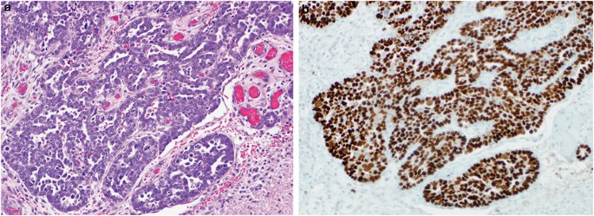
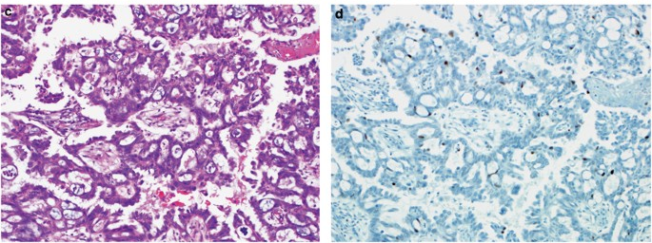
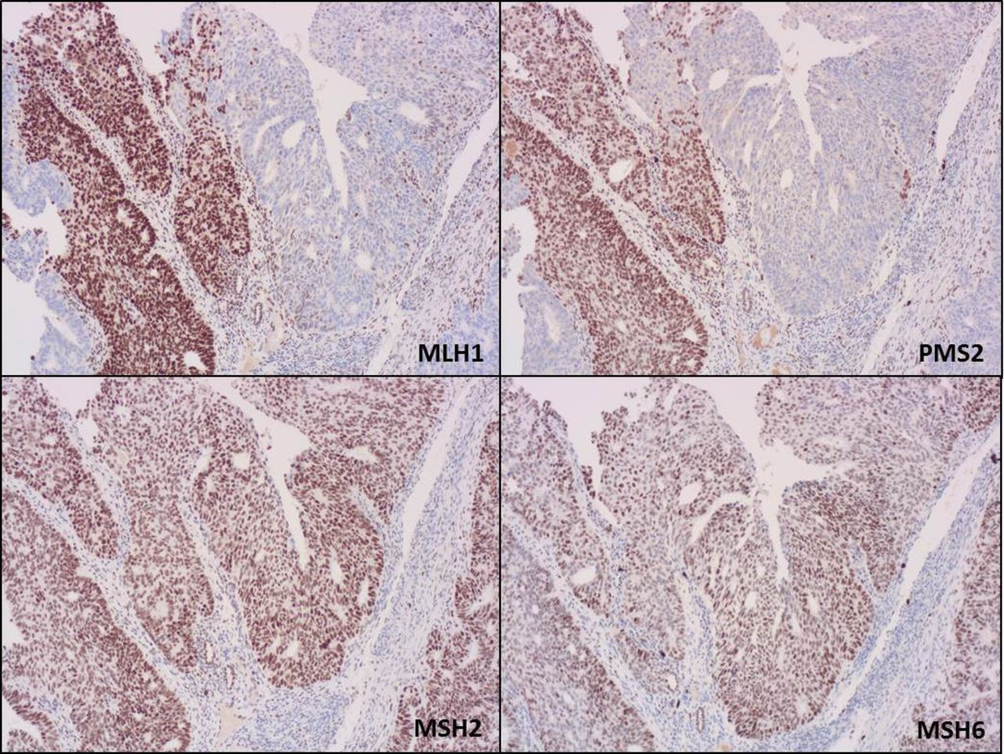
The role of ancillary studies- IHC
p53
Mismatch repair protein (MMR)
Estrogen receptor (ER) Progesterone receptor (PR)
Notes:
Immunohistochemical staining of FOLR1. (A) No staining in a mucinous carcinoma. (B) Strong staining of 1–50% of tumour cells in a high-grade serous carcinoma. (C) Strong staining of >50% of tumour cells with predominant membranous localisation in a high-grade serous carcinoma. (D) Strong staining of 50–90% of tumour cells with cytoplasmic staining (and membranous staining still present) in a high-grade serous carcinoma. (E) Strong staining of >90% of tumour cells with cytoplasmic staining in a high-grade serous carcinoma. (F) Strong staining of >50% of epithelial cells with predominant membranous localisation in normal fallopian tube. Kobel et al. British Journal of Cancer volume 111, pages2297–2307 (2014)
How we use IHC for prognosis?
IHC and treatment options
FOLR1, MMR, PD-1, ER/PR,
malignant transformation of borderline tumors to invasive cancer

Slide 17
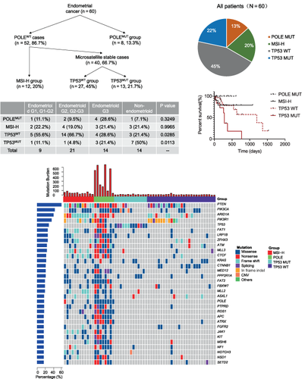
The role of ancillary studies- molecular testing
Next Generation Sequencing
Clinically relevant information
Notes:
Molecular testing- test the tumor for its genetic profile. This information can be used for several purposes: diagnostic (what about the tumor), therapeutic (how to treat the tumor), and prognostic (information about how we can expect the tumor to behave)

Slide 18
Division of Gynecologic Pathology
Amanda L. Strickland, MD
Elisheva Shanes, MD
Jian-Jun Wei, MD (Division Chief)
Luis Z. Blanco, Jr, MD
Jorge Novo, MD
Jenna Purdy, MD
Indu Agarwal, MD (not pictured)
Notes:
Molecular testing- test the tumor for its genetic profile. This information can be used for several purposes: diagnostic (what about the tumor), therapeutic (how to treat the tumor), and prognostic (information about how we can expect the tumor to behave)

Slide 19
Your healthcare team
Notes:
Molecular testing- test the tumor for its genetic profile. This information can be used for several purposes: diagnostic (what about the tumor), therapeutic (how to treat the tumor), and prognostic (information about how we can expect the tumor to behave)

Slide 20
Questions?
Notes:
Molecular testing- test the tumor for its genetic profile. This information can be used for several purposes: diagnostic (what about the tumor), therapeutic (how to treat the tumor), and prognostic (information about how we can expect the tumor to behave)

