Slide 1
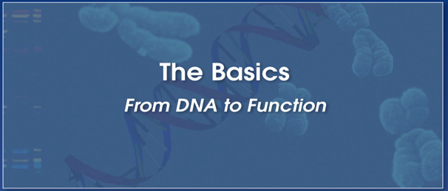







Editing genetic information to model and target human diseases
Mazhar Adli, Ph.D.
Associate Professor,
Director, Center for Genome Engineering,
Robert H. Lurie Comprehensive Cancer Center,
Feinberg School of Medicine, Northwestern University
www.adlilab.org adli@northwestern.edu @MazharAdli

Slide 2

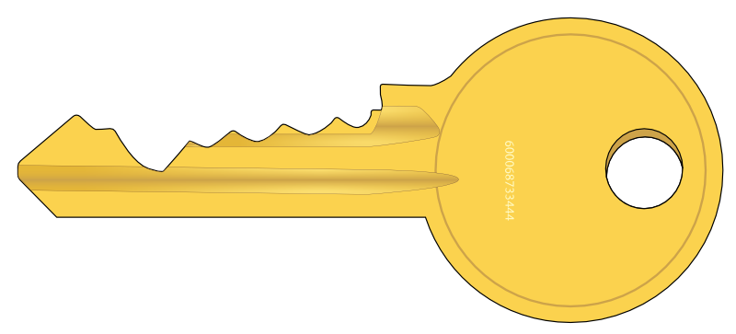
Genomic information is no longer a “read only” file !
For very long time, we were only able to “read” genetic information!
Now, we are able to “write” and “rewrite” it n living cells and organisms
Genome editing tools

Slide 3
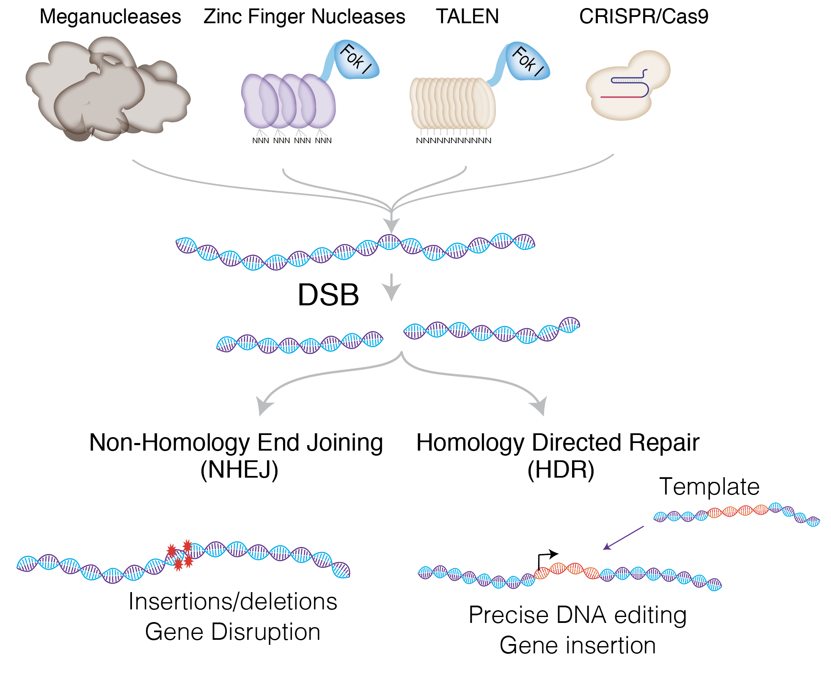
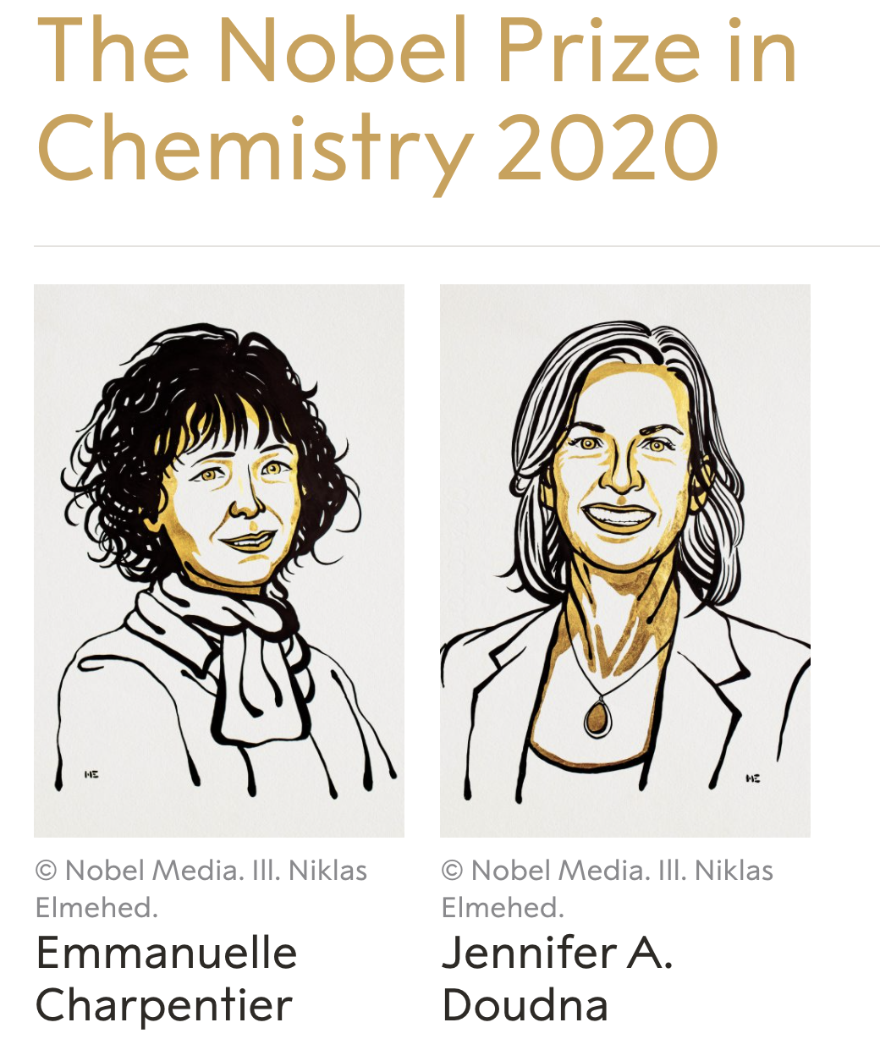


Genome Editing toolbox is expanding!
1990s
1995
2008
2012
A
B
Adli, Nature Communications, 2018

Slide 4
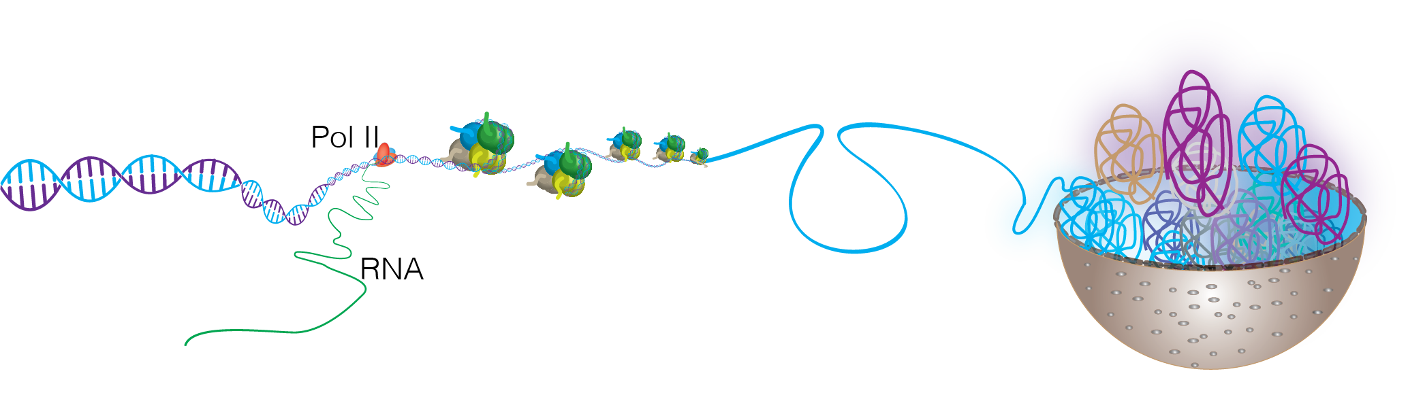
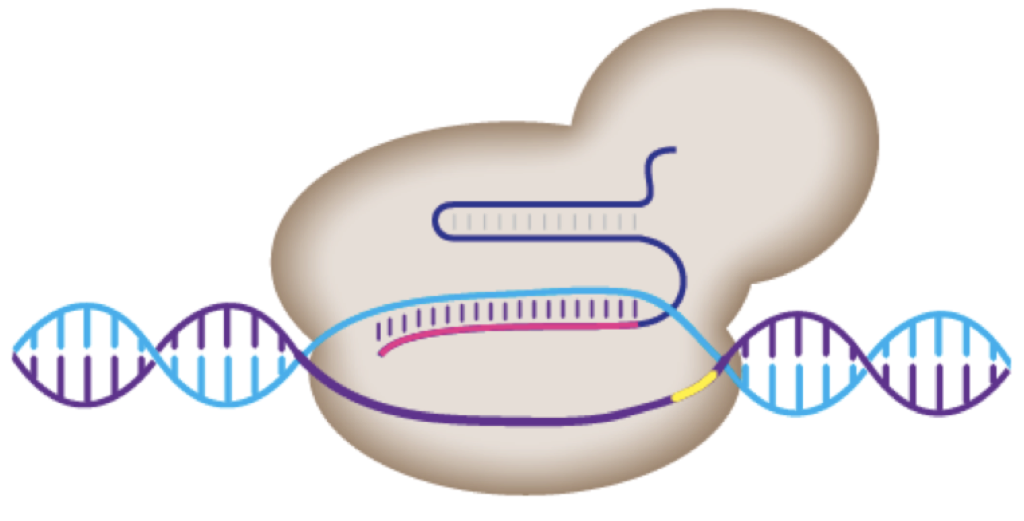
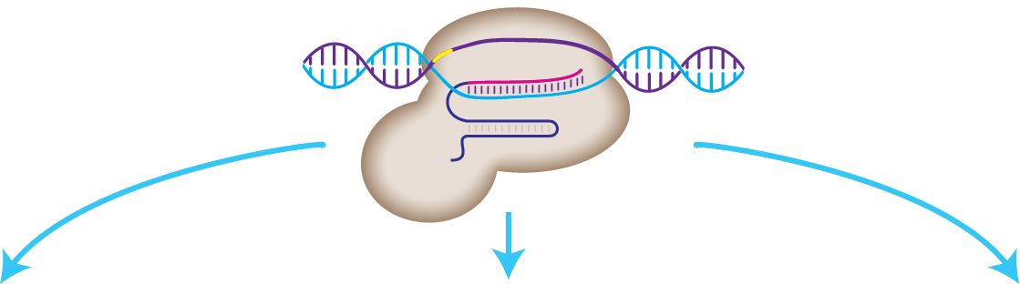

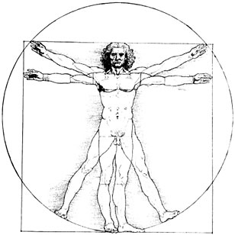
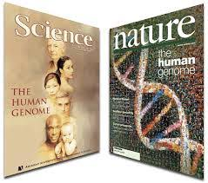

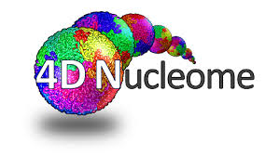

Understanding genome function
in normal and disease settings
CRISPR
Human Genome Project
ENCODE/REMC
4D Nucleome
Good understanding of organization
Function??
Disease State
?

Slide 5
We use CRISPR to
Identify the functions of human genes
Model genetic abnormalities in cancer and other diseases
Discover novel tumor suppressors and synthetic lethal drug combinations
Discover drivers of chemoresistance in cancer

Slide 6
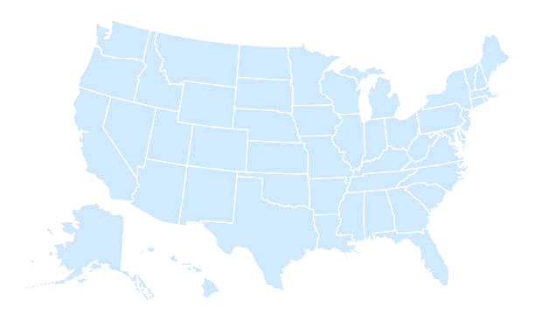
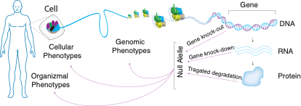
Molecular Phenotypes of Null Alleles
in Cells (MorPhic) Consortium
Goal: Generate a catalog of null allele phenotypes for all human genes
Pluripotent
Stem Cell
Northwestern University
Center for Genome Engineering
Mazhar Adli (PI)
Phase 1
Target 1000 protein coding genes.
The null allele should be generated in a multicellular system.
Use standardized assays that enable comparison across genes.
Assays should include informative molecular and cellular phenotypes.
Optimize and scale up null allele generation methods for all genome

Slide 7
Modeling Fibroid rumors through
precise genome engineering with CRISPR

Slide 8
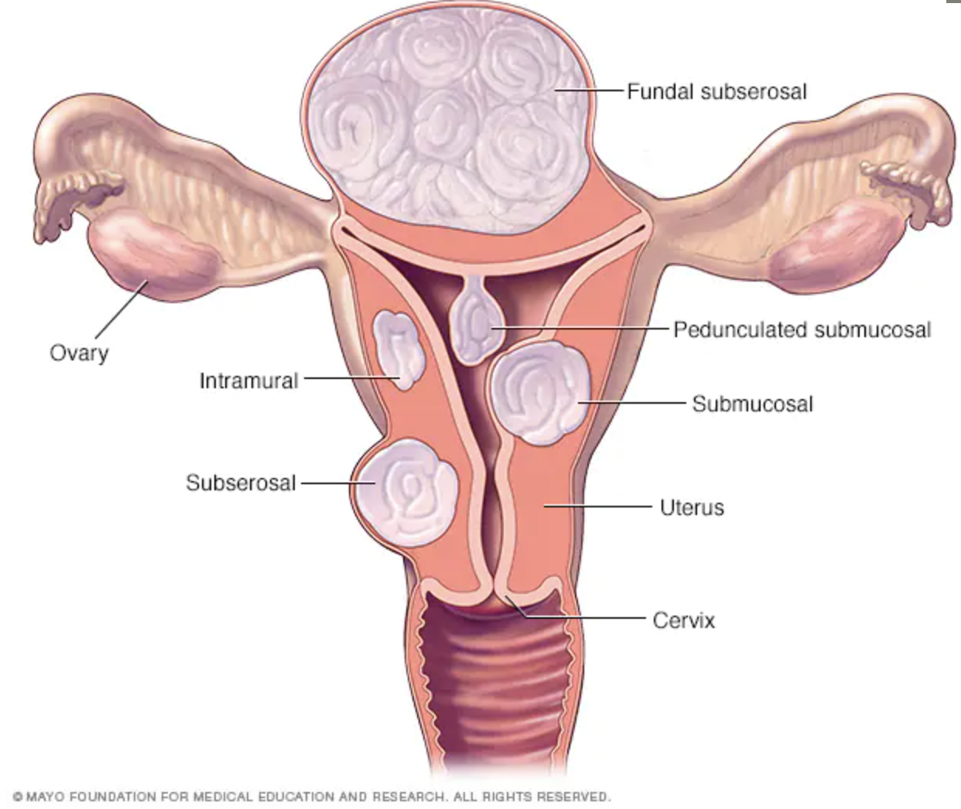
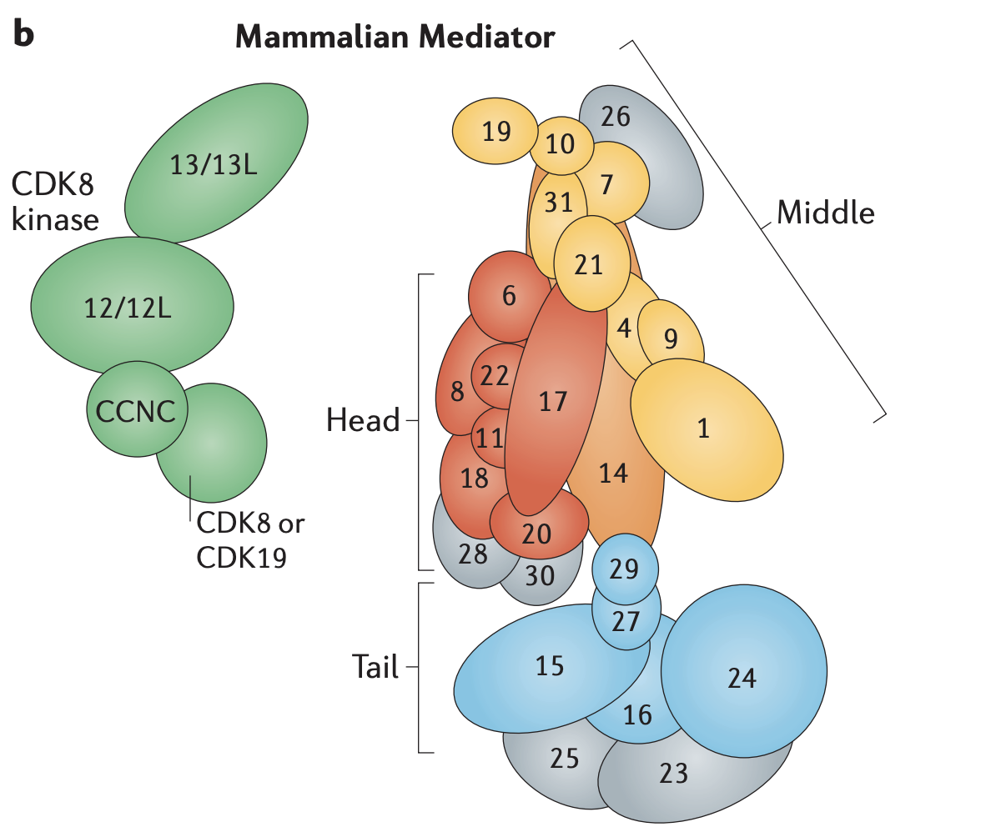
Genome Engineering to model the genetics of Uterine fibroids
Most common tumors; by age 50 -->70-80% of women will have had at least one.
Severe symptoms develop in 15 to 30% of these women.
  Severe pain, uterine bleeding, anemia, defective embryo implantation, pregnancy loss, preterm labor.
  No actionable target, surgery is the only option, cost ~ $6-30 B in the US!
MED12 exon 2 hotspot mutations drive UF in >70 % of patients!
Cell line models can not be generated because mutant cells die out!
MED12 (the Mediator Complex Subunit 12) is a part of 26-subunit transcriptional regulator complex!
Most mutations in MED12 gene alter a specific amino acid (Glycine) at 44th position.
MED12
Soutourina et al, Nature Rew. Cell Biology, 2018

Slide 9
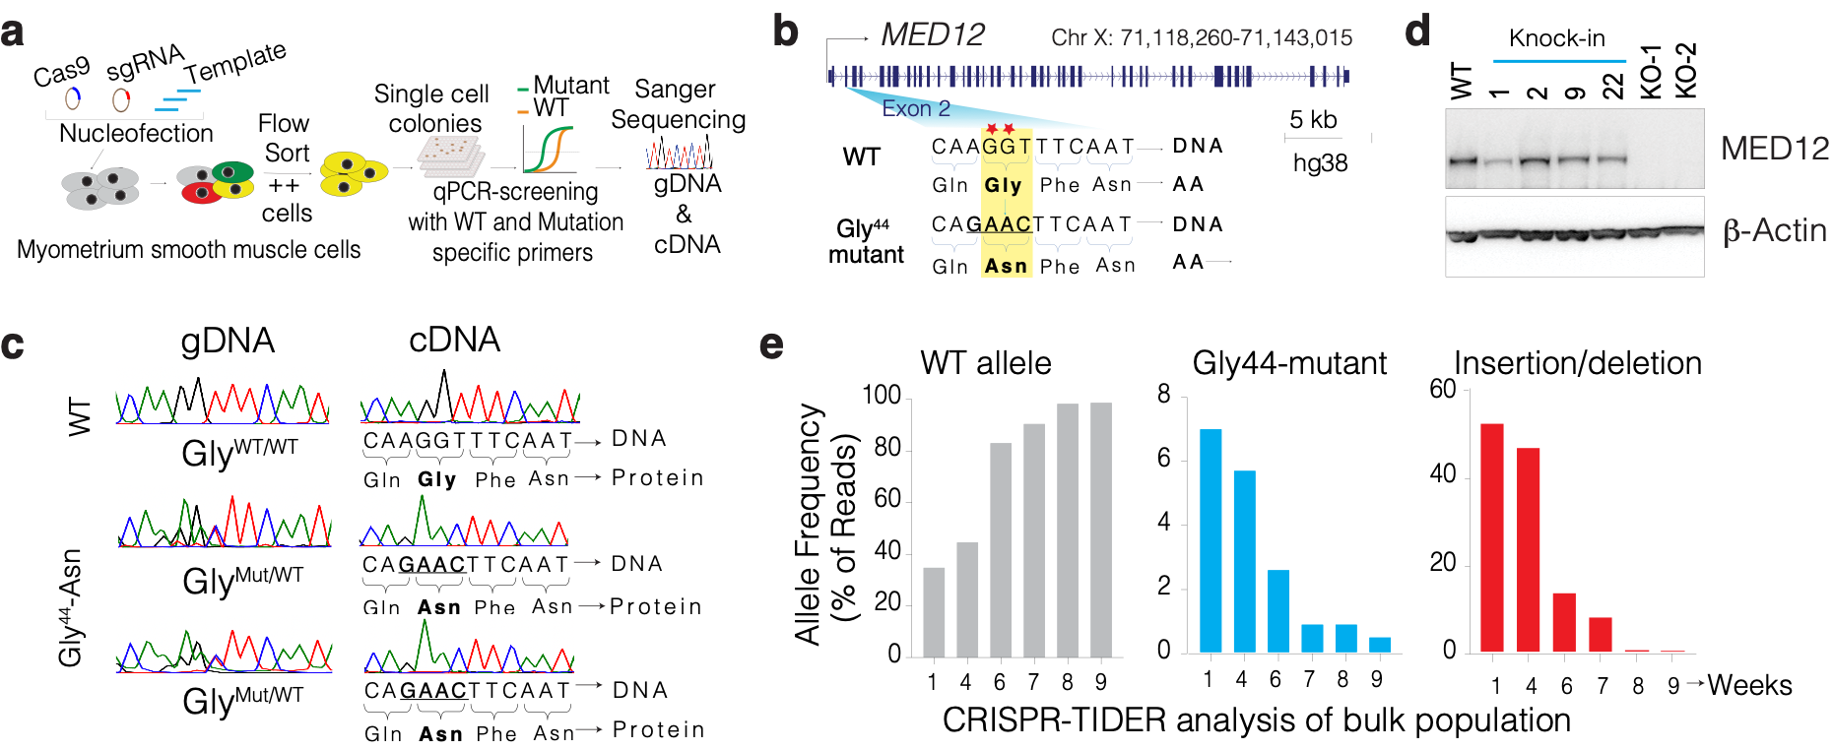
Precise CRISPR engineering of Gly 44 mutations in MED12
Cells with MED12 Gly44 mutations proliferate less in 2D but more in 3D
2D monolayer
3D spheroids

Slide 10
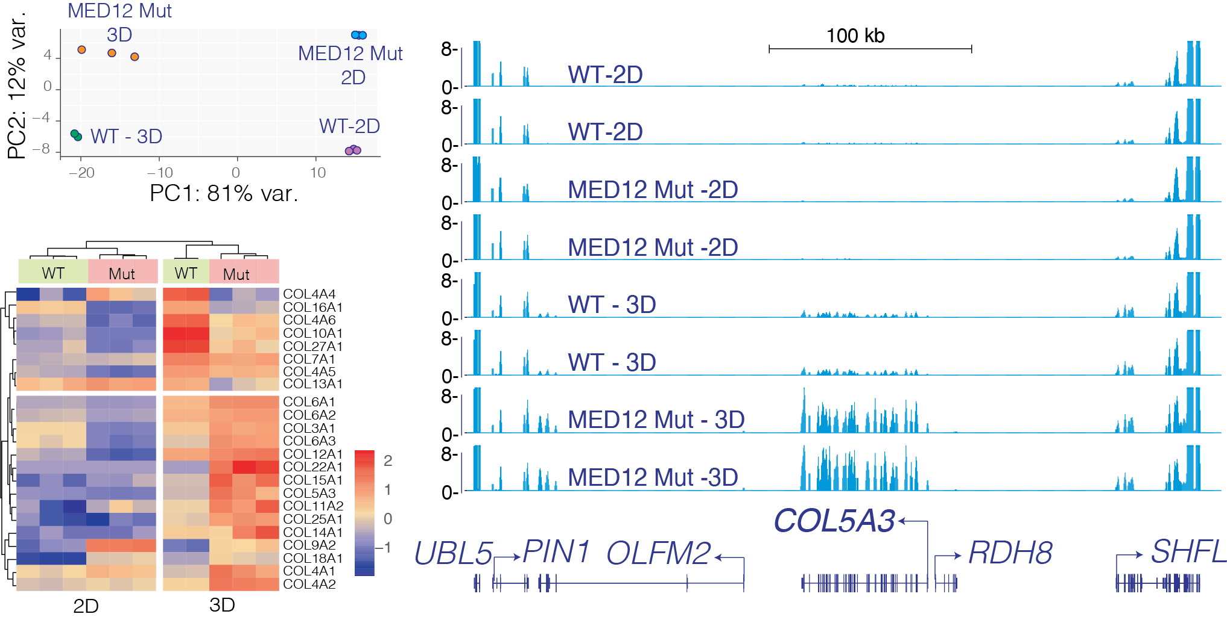
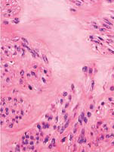
Engineered MED12 cells express higher collagens and larger tumors
Higher collagen and ECM deposition is a hallmark of fibroid tumors
In vivo tumors
Uterine Fibroid tumor
ECM
Kidney capsule
In vivo collagen production
Trichrome staining
Butukcelebi et al, Nature Communications, 2023

Slide 11
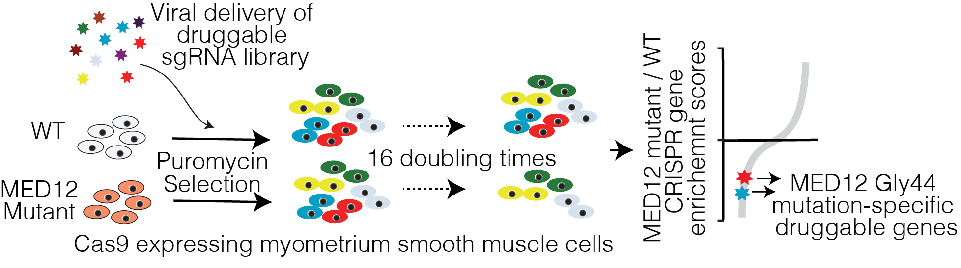
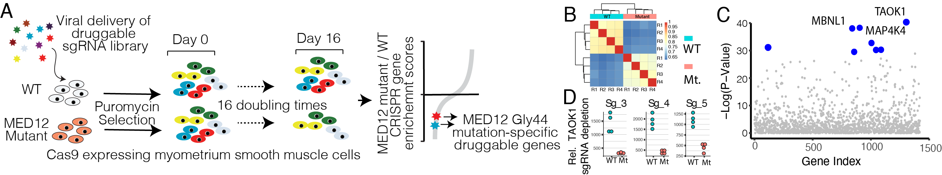
Future direction:
Druggable-genome screening to identify MED12-mutation specific vulnerabilities

Slide 12
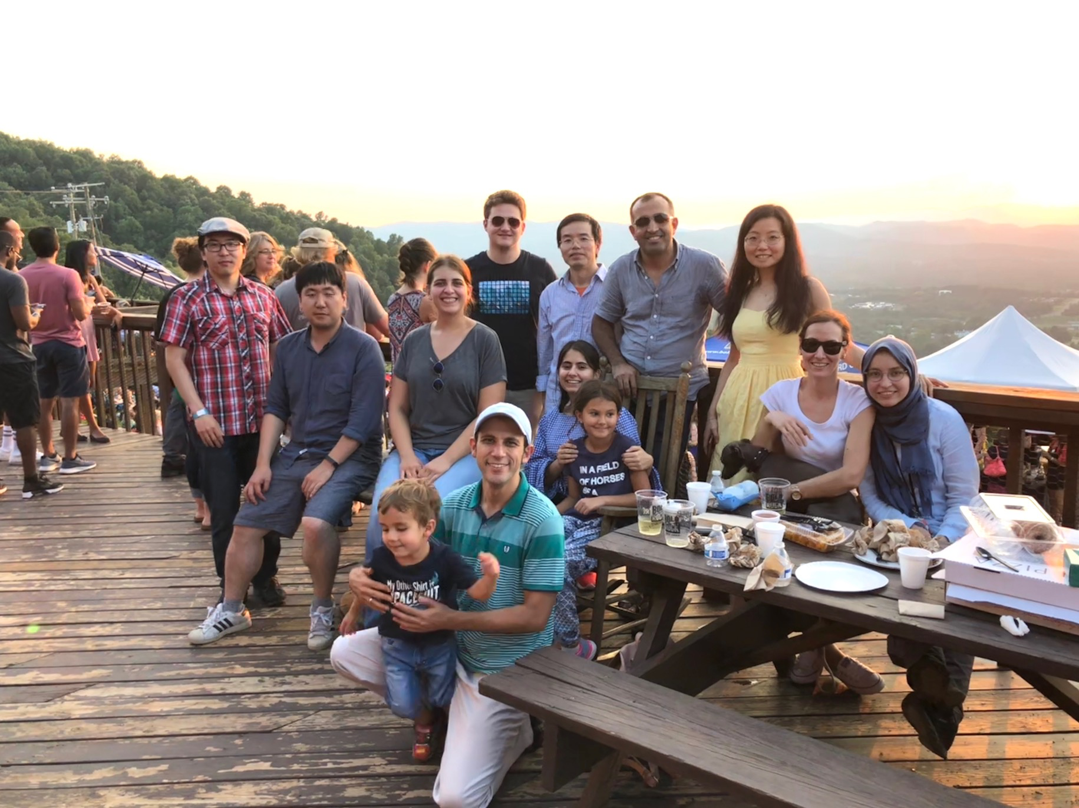
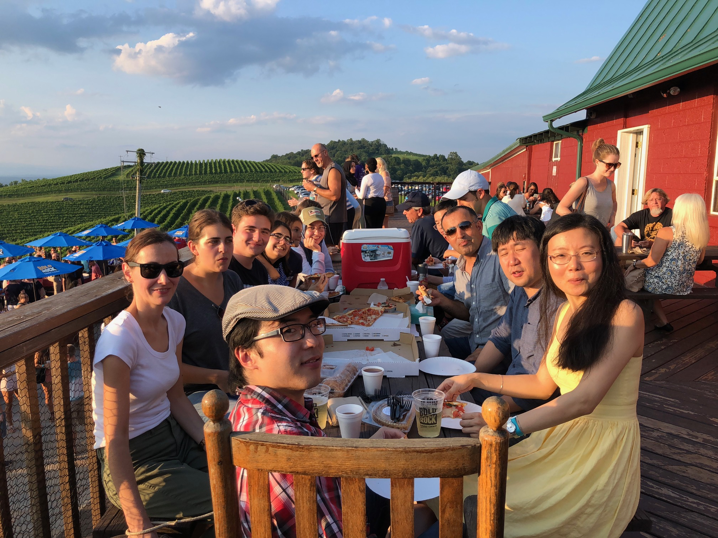

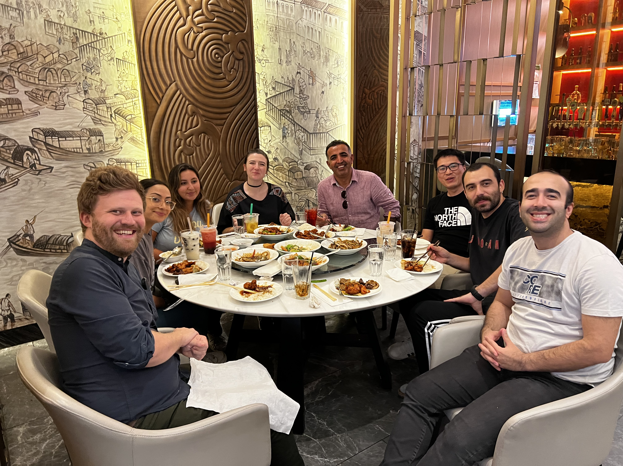
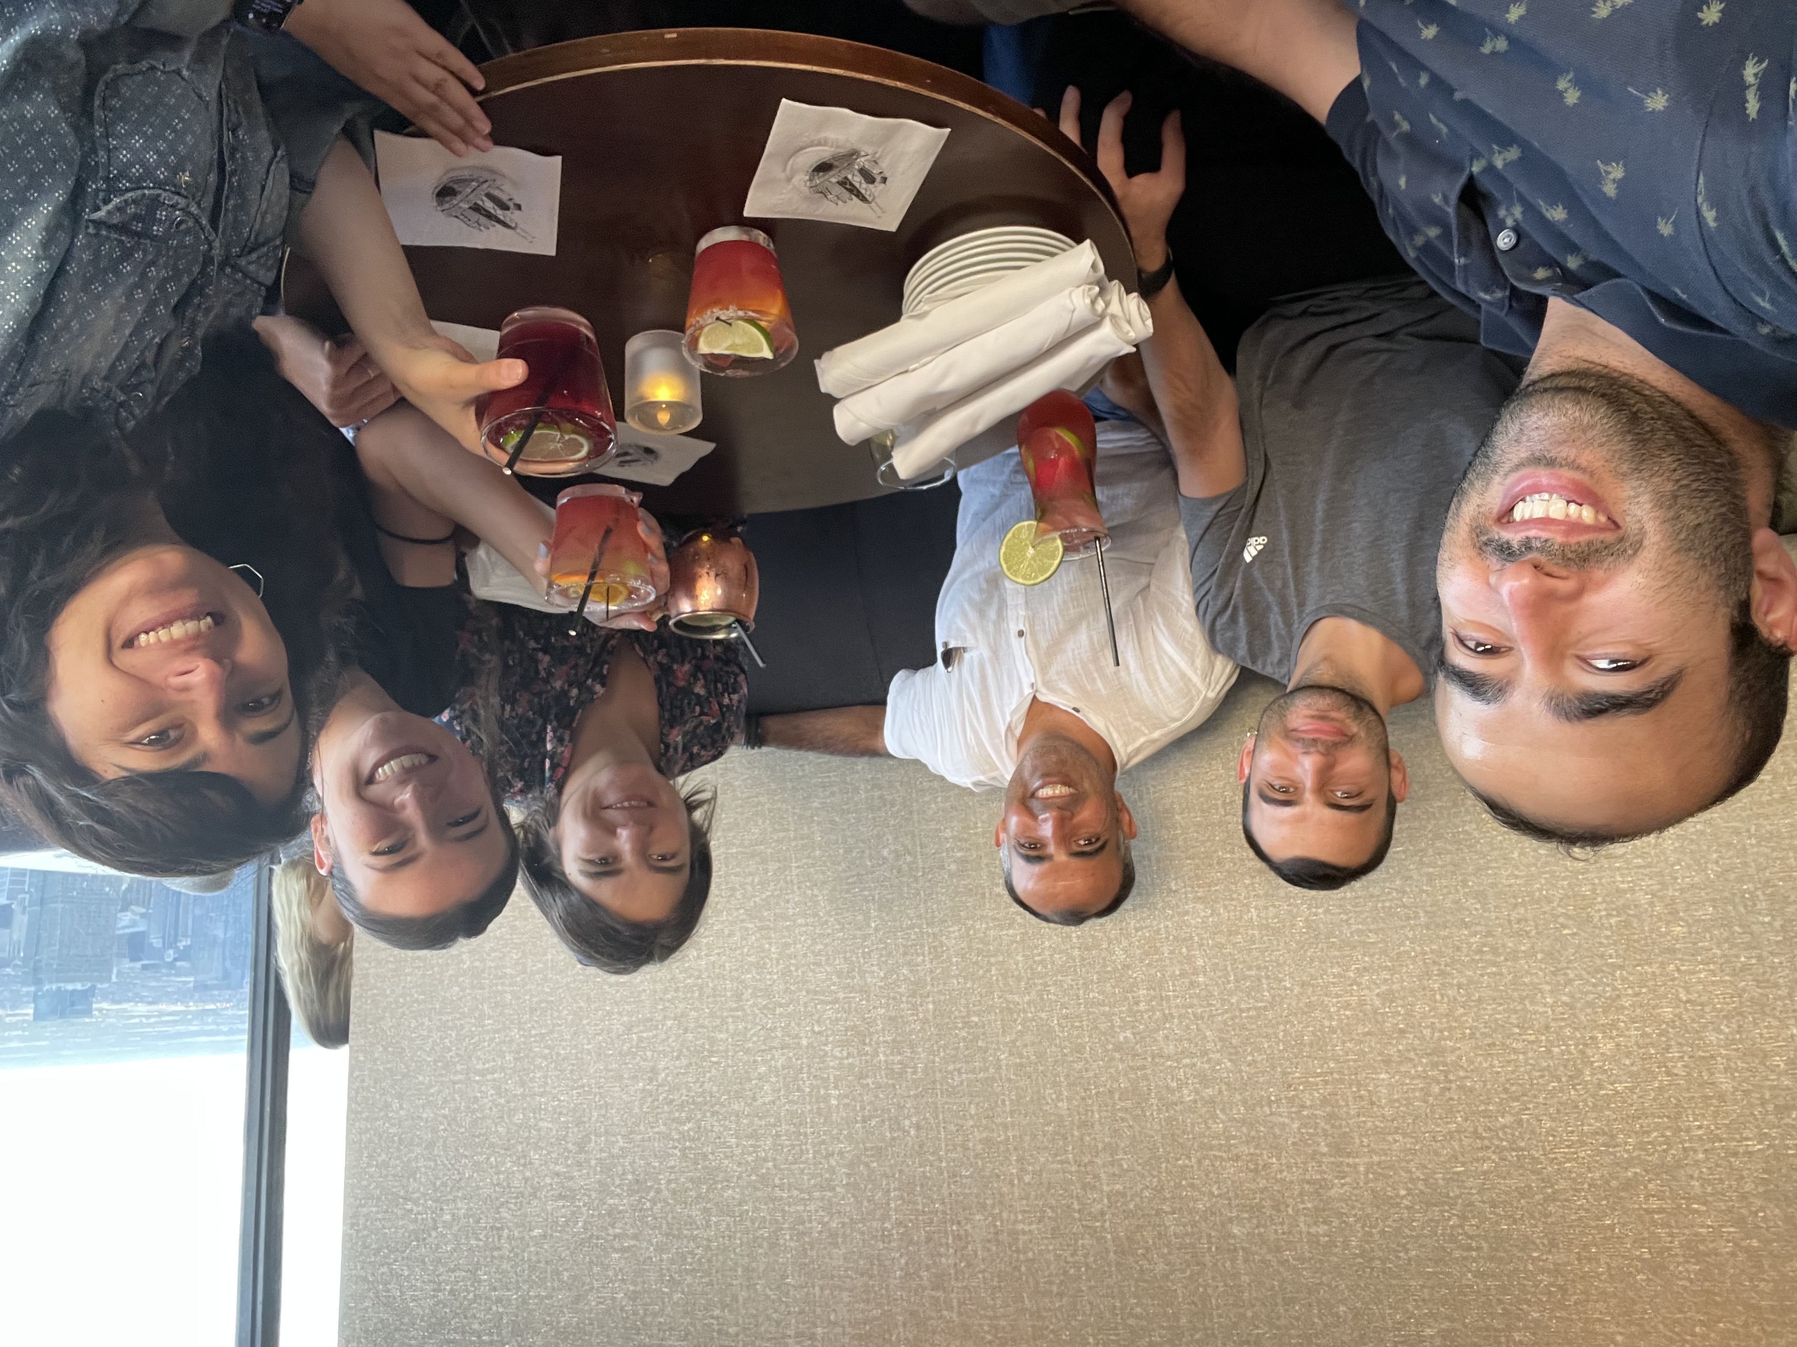


Adli lab members
Alexandra Griffin, PhD
Fidan Seker, PhD
Kadir Buyukcelebi, MD
Tao Bai, PhD
De Xing, PhD
Zahra Paylakhi, PhD
Fatih Abdula, MD
Gina Kirshammer, PhD
Hoda Elkafas, PhD
Alex Duval
Harun Ozturk
Ozlem Neyisci
Neda Abbaszadeh
Yasemin Kingham
Daye Son
Acknowledgements
Previous:
NSF MCB-1715183
Pinn Scholar Award
V Scholar Award
Funding (Co-I)
R01 DK11828701
P50 DK09637307
R01 DK11671801
DP3 DK11190601
R01 ES022759 05
Funding
UM1HG012649
R01CA267544
U54CA268084
Reaumond Scholar
R01CA211648
Collaborators
Serdar Bulun (Northwestern)
Ping Yin (Northwestern)
Jian Jai Wei (Northwestern)
Feng Yue (Northwestern, MorPhic)
Paul Burridge (Northwestern, MorPhic)
adli@northwestern.edu
www.adlilab.org
@MazharAdli

