Slide 1
Molecular Classification of Endometrial Cancer: Implications for Clinical Practice
Emma L Barber, MD, MS
Assistant Professor
Northwestern University, Feinberg School of Medicine

Slide 2
Endometrial Cancer Epidemiology
Most common gynecologic cancer in the US^{[a]} and Europe^{[b]}
Represents approximately 90% of all uterine cancers, while 10% are sarcomas^{[c]}
Majority are diagnosed at stage I; disease is frequently symptomatic at early stages^{[a]}
US^{[a][c]}
~66,570 women will be diagnosed with uterine cancer in the US in 2021 (3.5% of all new cancer cases)
~12,940 deaths will occur from uterine cancer in the US in 2021 (2.1% of all cancer deaths)
Global^{[d]}
According to GLOBOCAN cancer statistics, there were an estimated 417,367 new cases and 97,370 deaths attributed to uterine cancer worldwide in 2020
GLOBOCAN, Global Cancer Incidence, Mortality, and Prevalence.
a. SEER. 2021. Accessed November 30, 2021. https://seer.cancer.gov/statfacts/html/corp.html; b. Ferlay J, et al. Eur J Cancer. 2013;49:1374-1403; c. American Cancer Society. Updated January 12, 2021. Accessed November 30, 2021. https://www.cancer.org/cancer/uterine-sarcoma/about/key-statistics.html; d. IARC. 2020. Accessed November 30, 20201. https://gco.iarc.fr/today/data/factsheets/cancers/24-Corpus-uteri-fact-sheet.pdf
Notes:
Timecode:
Abbreviations
References

Slide 3
Endometrial Cancer Has Traditionally Been Classified into 2 Pathological Types
Type I endometrial cancer is typically associated with good prognosis, while type II is associated with poor prognosis¹
Characteristics of Type I and Type II Endometrial Cancers^{2,3}
Characteristic | Type I | Type II
Histology | Endometrioid | Non-endometrioid (serous, clear-cell, undifferentiated including carcinosarcomas)^{3,4}
Grade | Usually low | Usually high
Stage | Often early | Often advanced
Etiology | Unopposed estrogen | Sporadic
Hormone receptor expression | Positive | Negative
Genomic stability³ | Diploid, frequent MSI | Aneuploid
Common mutations | PTEN | p53
These classifications have been used for the past 3 decades, but they do not fully capture the wide range of clinical, genetic, and molecular characteristics of endometrial cancers¹
MSI = microsatellite instability.
1. Morice P, et al. Lancet. 2016;387:1094-108. 2. Llobet D, et al. J Clin Pathol. 2009;62:777-85. 3. Binder PS, et al. Women’s Health (Lond). 2014;10:277-88. 4. Remmerie M, et al. Int J Mol Sci. 2018;19:2380.
Notes:
Speaker Notes:
Endometrial cancer has traditionally been classified into 2 pathological types
Type I endometrial cancers are typically low-grade endometrioid cancers that exhibit microsatellite instability and have a good prognosis¹⁻³
In contrast, type II endometrial cancers are typically non-endometrioid, high-grade cancers and have a poor prognosis¹⁻³
References:
Morice P, et al. Lancet. 2016;387:1094-108.
Llobet D, et al. J Clin Pathol. 2009;62:777-85.
Binder PS, et al. Women’s Health (Lond). 2014;10:277-88.

Slide 4
Principles of Molecular Analysis of EC
Pathology and Genomics in Endometrial Carcinoma
POLE sequencing
No POLE hotspot mutation
POLE hotspot mutation
DNA MMR protein immunohistochemistry
POLE
Expression lost
Expression retained
p53 immunohistochemistry
Normal/wild-type pattern
Aberrant/mutant pattern
MSI-H
Copy number low
Copy number high
MMR, mismatch repair; MSI-H, microsatellite stability high.
NCCN. Guidelines. Uterine neoplasms. V1.2022. November 4, 2021. Accessed November 30, 2021.

Slide 5
Endometrioid Endometrial Cancer Molecular Classifications
POLE ultramutated
MSI hypermutated
Copy number low
Copy number high
Ultrahigh somatic mutation frequency; MSS; frequent mutations in the exonuclease domain of POLE; high ASNS and CCNB1 expression
Represents ~7% of endometrioid tumors
Best prognosis
High mutation rate and few copy number alterations; high rate of MLH1 promoter methylation; high phospho-AKT; low PTEN expression; frequent PIK3CA mutations co-occurring with PTEN mutations
Represents ~39% of endometrioid tumors
High frequency of mutations in CTNNB1, KRAS, SOX17; frequent PIK3CA and PIK3R1 mutations co-occurring with PTEN mutations; elevated levels of progesterone receptor and RAD50 expression
Represents ~49% of endometrioid tumors
Greatest transcriptional activity; frequent TP53 mutations; decreased levels of phospho-AKT; mutually exclusive PIK3CA, PIK3R1, and PTEN mutations
Represents ~9% of endometrioid tumors
Worst prognosis
MSS, microsatellite stable.
Cancer Genome Atlas Research Network. Nature. 2013;497:67-73.

Slide 6
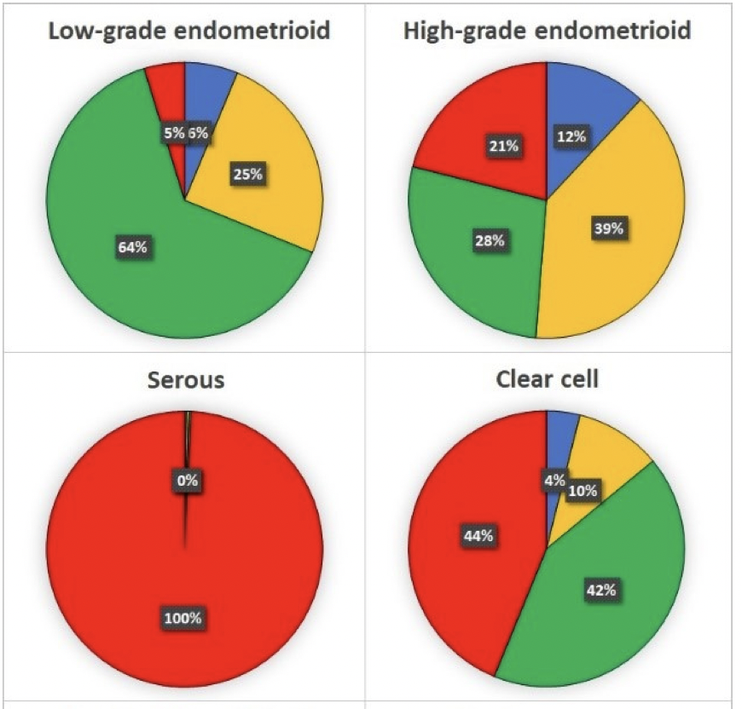
Molecular Subtypes by Histology
https://www.ncbi.nlm.nih.gov/pmc/articles/PMC8198052/pdf/cancers-13-02623.pdf

Slide 7
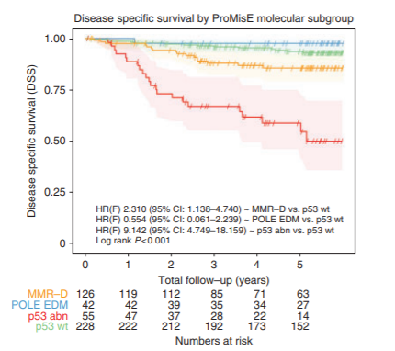
Proactive Molecular Risk Classified for Endometrial Cancer ProMisE
abn, abnormality; EDM, exonuclease domain mutation; MMR-D, mismatch repair deficiency; wt, wild type.
Kommoss S, et al. Ann Oncol. 2018;29:1180-1188.
Notes:
PROMISE 88% endometrioid

Slide 8
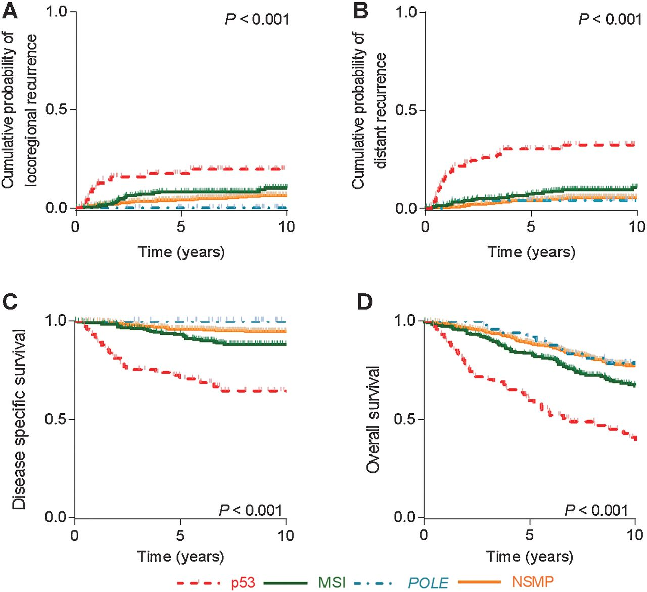
PORTEC and GOG210
Clin Cancer Res. 2016;22(16):4215-4224. doi:10.1158/1078-0432.CCR-15-2878
Cosgrove CM. An NRG Oncology/GOG study of molecular classification for risk prediction in endometrioid endometrial cancer. Gynecol Oncol: 2017

Slide 9
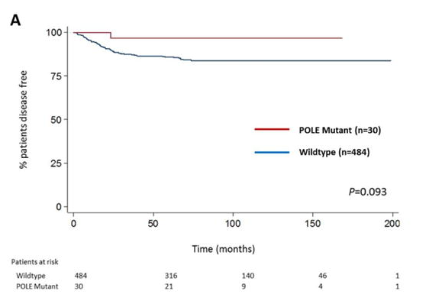
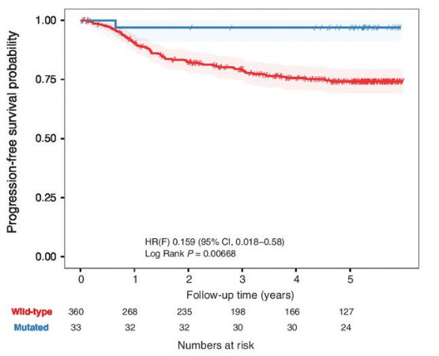
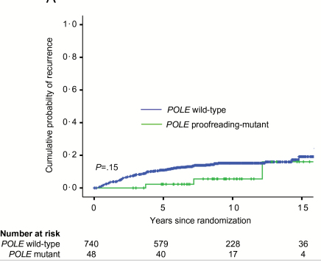
POLE Mutation
4-8% of endometrial cancers
Mutations in exonuclease domain of DNA polymerase episilon
High mutational burden
Obtain via sequencing – exons 9, 13, 14
Good prognosis, 98% survival in TCGA data
Retrospective series with decreased recurrence in POLE mutated cases
Tend to be lower risk endometrioid tumors, but have been found in serous and grade 3 tumors
P=0.15
P=0.006
P=0.093
Billingsley (2016) Cancer , Church (2014) JNCI, Talhouk (2015) Br J Cancer, McConechy (2016) Clin Can Res, Talhouk (2017) Cancer

Slide 10
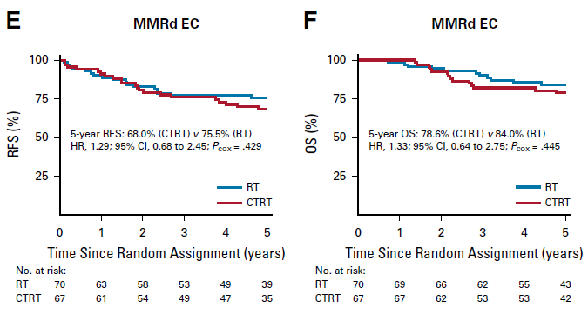
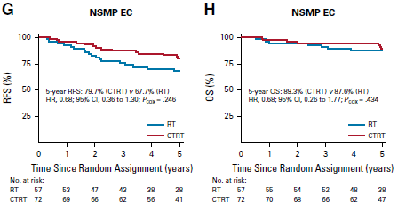
MSI-H or dMMR
PORTEC-3
20-40% of endometrial cancer
Intermediate prognosis group
Can be either MSI or dMMR – rare cases where these may not be concordant
dMMR – IHC for 4 proteins MLH1, MSH6, PMS2, MSH2
Gene sequencing – length of microsatellites compared to normal, NGS
Biomarker predictive of response to immunotherapy
Possible chemoresistance
Castillo et al 2020 J Clin Oncol 38:3388-3397
NSMP: Non- Specific Molecular Profile. NSMP includes pMMR

Slide 11
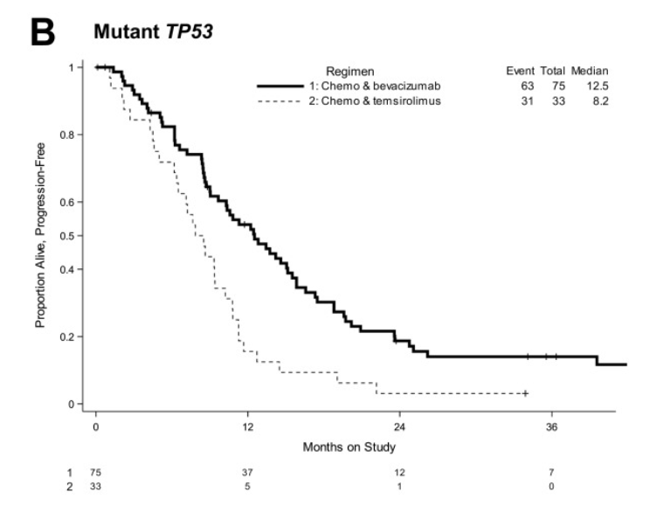
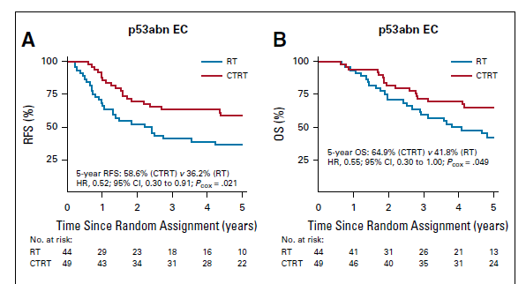
Copy Number High
“serous-like”
73% of copy number high in TGCA are serous
Poor prognosis
PORTEC-3 p53 mutated tumors, benefit with chemotherapy
GOG86P benefit to addition of bevacizumab in p53 mutated tumors
May also benefit from lenvatinib and pembrolizumab
Leslie et al. Gyn Onc 2021

Slide 12
Copy Number Low or No Specific Molecular Profile
40-50% of tumors
Intermediate risk
Hormone receptors
Substantial LVSI
CTNNB1
26% NSMP
No L1CAM, substantial LVSI, HIR patients
Distant recurrence CTNNB1 expression -- 2.96 (1.2-7.1)
L1CAM IHC
https://aacrjournals.org/clincancerres/article/22/16/4215/14937/Improved-Risk-Assessment-by-Integrating-Molecular
Notes:
For NSMP patient HR DSS 7.8 (2.6-21.1) *Note, small numbers 19 versus 209

Slide 13
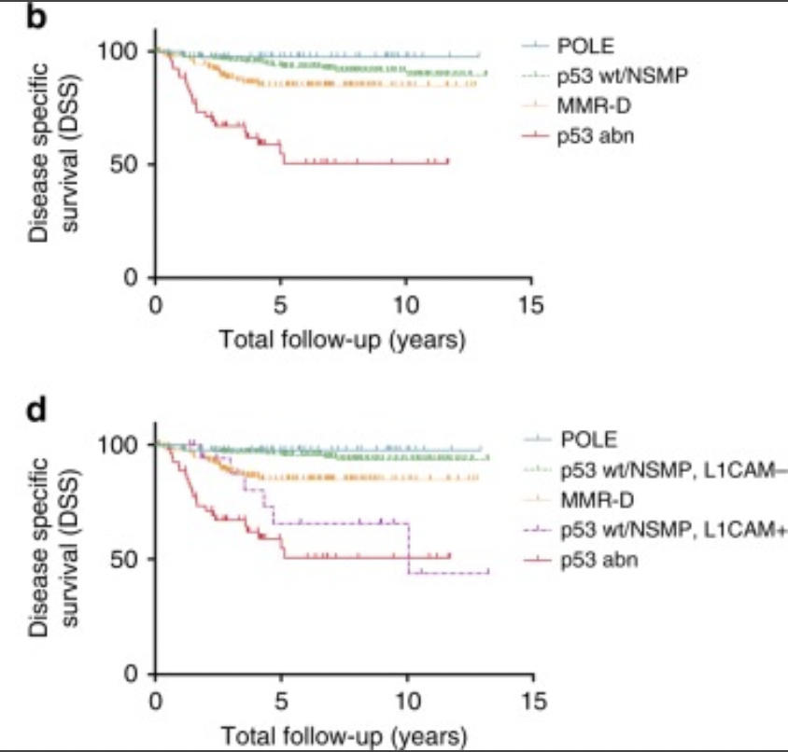
L1CAM
Highly correlated with abnormal p53 (3-10% NSMP, 40-80% of copy number high)
For NSMP patients, HR DSS 7.8 (2.6-21.1)
Br J Cancer. 2018 Aug 14; 119(4): 480–486.
Published online 2018 Jul 27. doi: 10.1038/s41416-018-0187-6,
https://aacrjournals.org/clincancerres/article/22/16/4215/14937/Improved-Risk-Assessment-by-Integrating-Molecular

Slide 14
Endometrial Cancer Staging and Molecular Classification

Slide 15
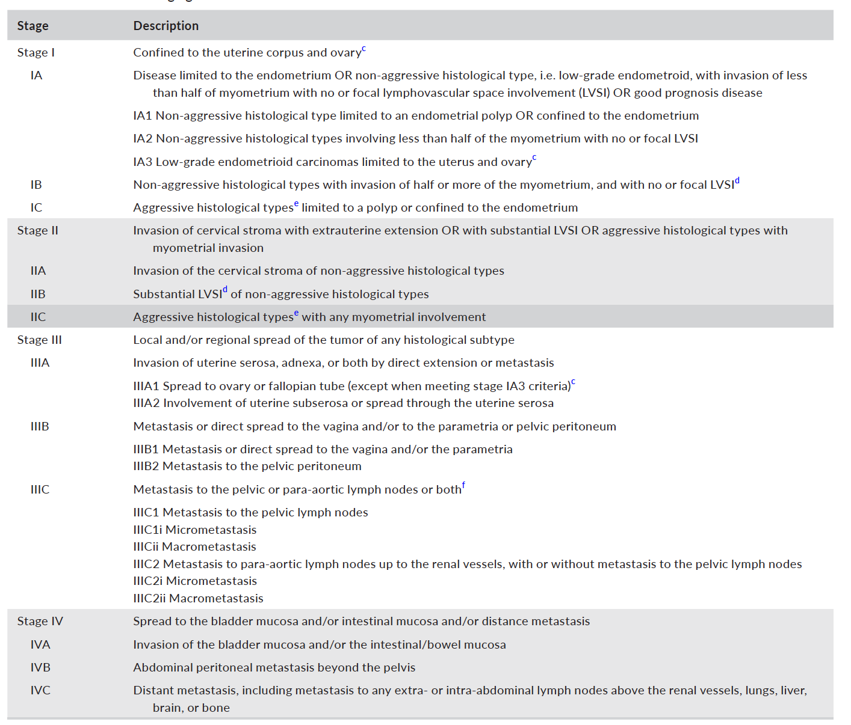
New Staging Incorporates Molecular Factors
Notes:
backbone

Slide 16
Stage I Disease
Non-aggressive Histologic Types
Grade 1 and 2 Endometrioid
Aggressive Histologic Types
Grade 3 cancers including all serous, clear
cell, mucinous, undifferentiated, carcinosarcoma
Notes:
IA3: <50% invasion, no extensive LVSI, no other mets, unilateral ovary with no capsule rupture.
NO LVSI IN STAGE I
No high risk histology with any invasion.

Slide 17
Stage II Disease

Slide 18
Stage III Disease
Notes:
Macromets >2mm
Micromets 0.2 – 2mm
ITCs <200 cells – do not upstage
Pelvic peritoneum: anterior superior iliac spines

Slide 19
Stage IV Disease

Slide 20
Molecular Classification Notation for All Endometrial Cancers
ALWAYS ADD:
m_{polemut}
m_{NSMP}
m_{mmrd}
m_{p53abn}
Molecular classification will become part of stage for all patients.
Notes:
Encourage addn of this always

Slide 21
Stage is Changed based on Molecular Classification Alone
Only relevant for Stage I/II (for III/IV, just note molecular class)
POLEmut: if confined to uterus/cervix, always IAm_{polemut}
p53abn: if any invasion and confined to uterus/cervix, always IICm_{p53abn}
Notes:
? Should we be doing POLE testing with more regularity.

Slide 22
Clinical Trials Using Molecular Classification

Slide 23
PORTEC 4a Classification
https://www.sciencedirect.com/science/article/pii/S0090825818310849#f0005

Slide 24
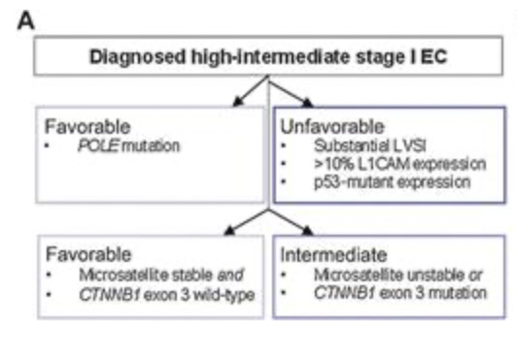
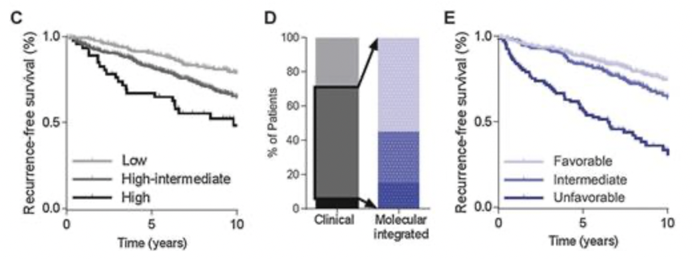
PORTEC 4a Classification Prognosis
https://aacrjournals.org/clincancerres/article/22/16/4215/14937/Improved-Risk-Assessment-by-Integrating-Molecular

Slide 25
Portec 4a Treatment Stratification

Slide 26
Notes:
https://www.researchgate.net/figure/The-planned-treatment-arms-for-the-TransPORTEC-RAINBO-program-of-clinical-trials-DDR_fig1_353910699

Slide 27
Thank you!

